Slide 1
DotAsia Annual General Meeting
2015.03.01 | APRICOT | Fukuoka, Japan

Slide 2
DotAsia AGM Agenda
Welcome Remarks
DotAsia Operations in 2014
Community Works Highlight 2014
.Asia Registry Technical Updates
Financials (Fiscal Year 2013-2014)
Strategic & Operation Plans 2015
Member Resolutions (Ratification of Board Elections)
Open Discussion
Joint Dinner with AP*
@18:30: Ozenya-Iori Restaurant
@18:20: Hotel Okura Lobby
Notes:
1. Welcome Remarks ~5 min 15:20
2. DotAsia Operations in 2013 ~10 min 15:30
3. Financials (Fiscal Year 2012-2013) ~15 min 15:45
4. Community Works Highlight 2013 ~20 min 16:05
5. .Asia Registry Technical Updates ~15 min 16:20
6. Strategic & Operation Plans 2014 ~10 min 16:30
7. Ratification of Board Elections ~10 min 16:40
8. Open Discussion & Closing Remarks ~5 min 16:45
Joint Dinner with AP* 1800

Slide 3
DotAsia Operations 2014

Slide 4







1. Income Development
Renewal of Contract with Macau Government.
Revamp of Domains.Asia
into Retail Showcase
site for .Asia
Implementation of New gTLDs
2. Industry Development
Asia Pacific gTLD Registries & Registrars
Internet of Names
Expansion Across Asia
Expansion on Leveraged Funding
3. Community Development

Slide 5




Slide 6

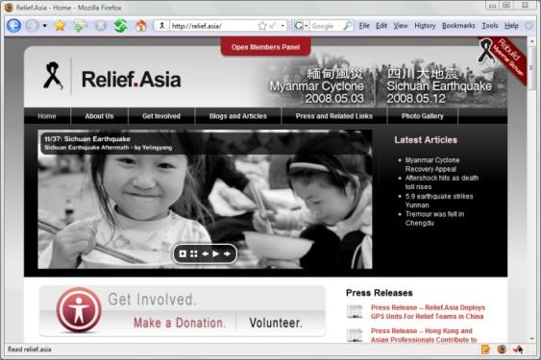
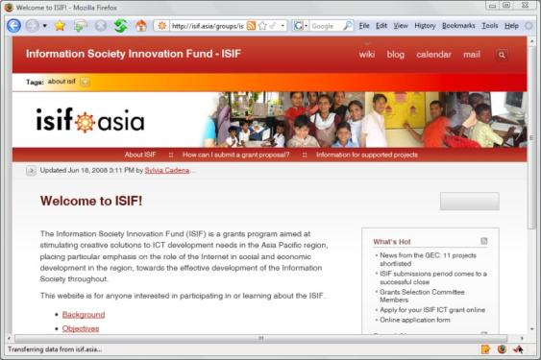
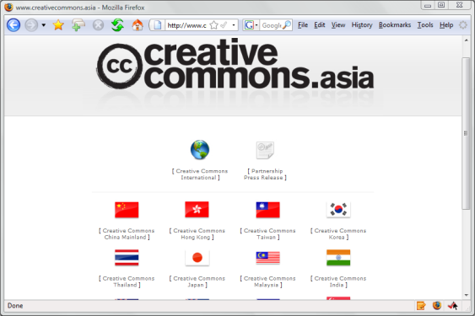
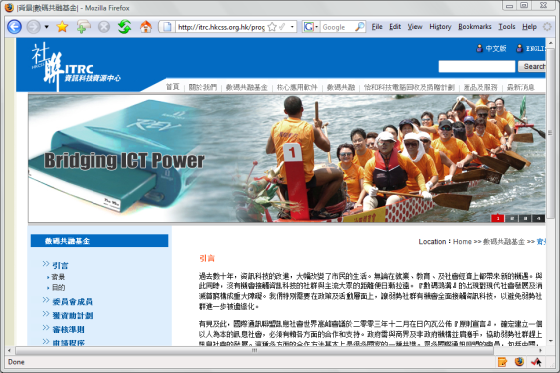

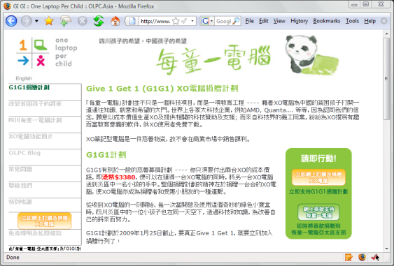

Every .Asia Domain Contributes to Internet Development in Asia

Slide 7
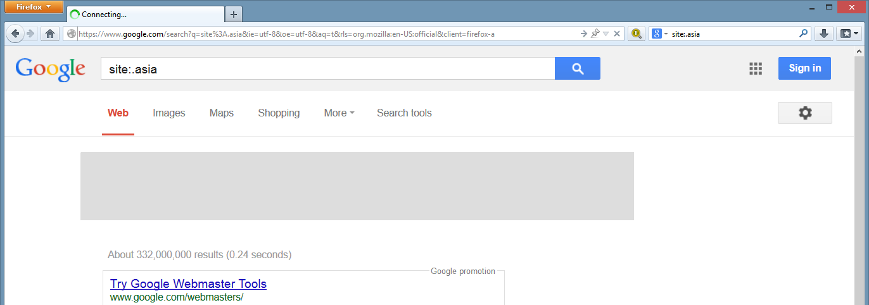

Growing .Asia Presence
2009: 13 Million
2011: 66 Million
2012: 85.8 Million
2013: 140 Million
2014: 332 Million entries indexed at Google
332 Million “.asia” entries indexed at Google

Slide 8
2013
500,000
Domains Under
Management
2014
330,000
2012
Domains Under Management
200,000
Domains Under Management

Slide 9
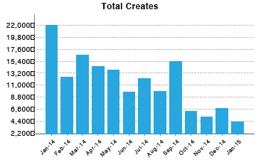
2014 Monthly New Creates
Notes:
2014 Promo Price point $1.50 and $3
2014 Monthly ave new create – 13,257
Highest month – Jan-14 – 21,977
Lowest month – Oct-14 – 5196
Jan 2015 4249
Feb 2015 3482
Declining trend

Slide 10


Slide 11
.inc
.健康
.studio
.quest
.hkt
.asia
.网站
.richardli
.home
.世界
.pccw
.box
.kids
.app
.网店
.nowtv
.新闻
.now
.電訊盈科
.Future

Slide 12

March 2011: Migration from University of Macau
Contract Renewed 2014

Slide 13

Numbers of domains .mo (2014)

Slide 14
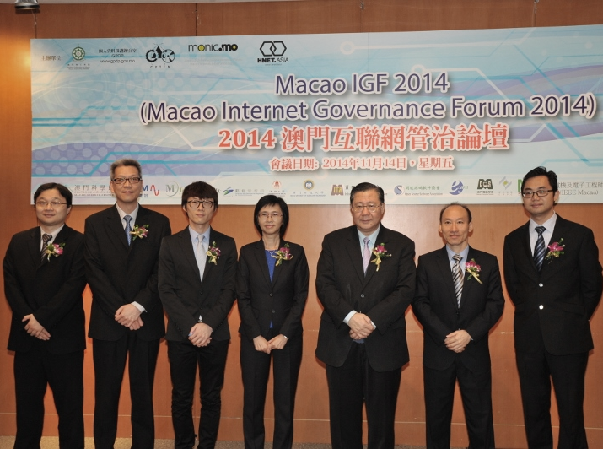
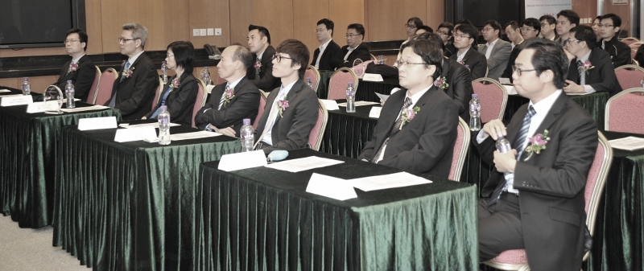
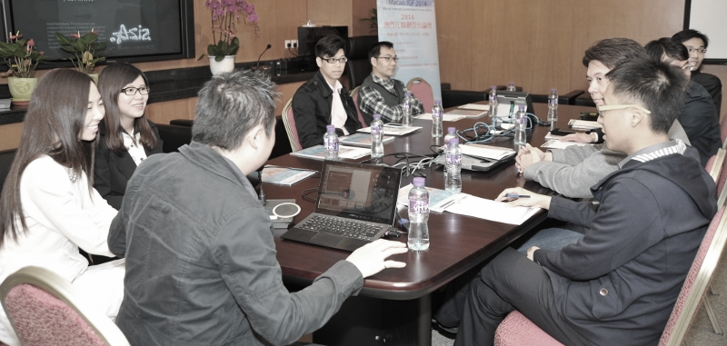

Slide 15




Slide 16
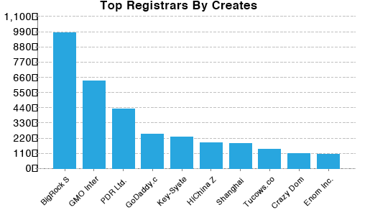
January 2015 Top Registrars by Creates
6 out of top 10 based in Asia
Notes:
2014 Promo Price point $1.50 and $3
2014 Monthly ave new create – 13,257
Highest month – Jan-14 – 21,977
Lowest month – Oct-14 – 5196
Jan 2015 4249
Feb 2015 3482
Declining trend

Slide 17
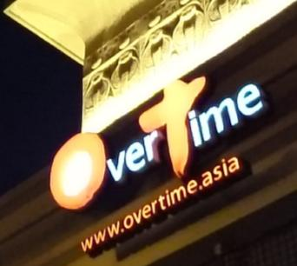
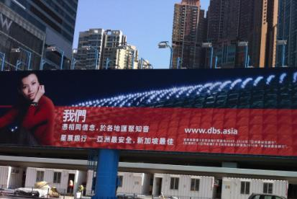



Top 10 of 12 .Asia from Asia Pacific
(by New Creates in 2013-2014)

Slide 18
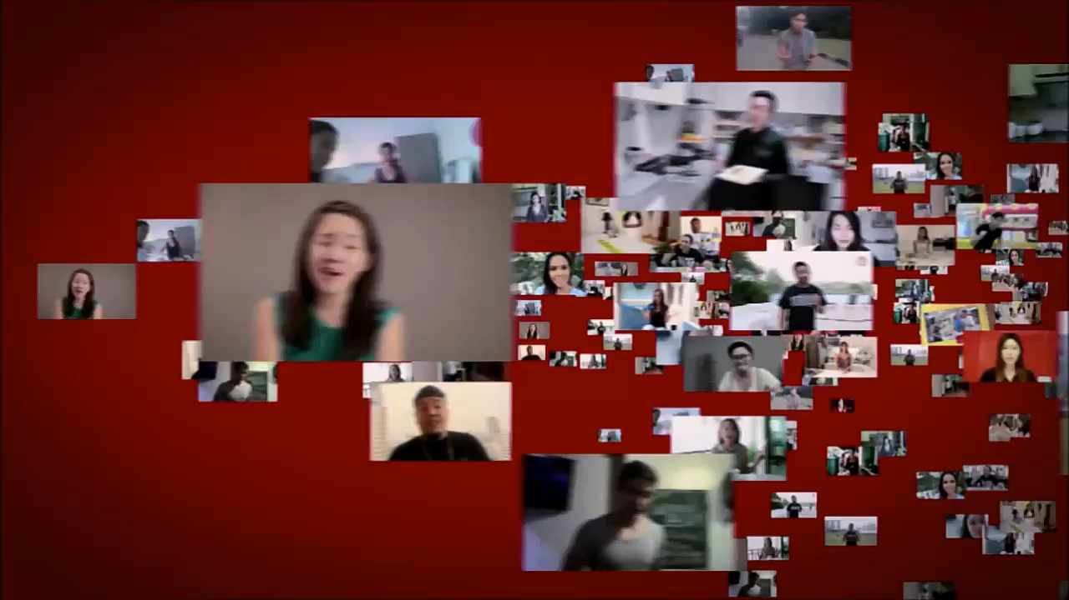

Slide 19
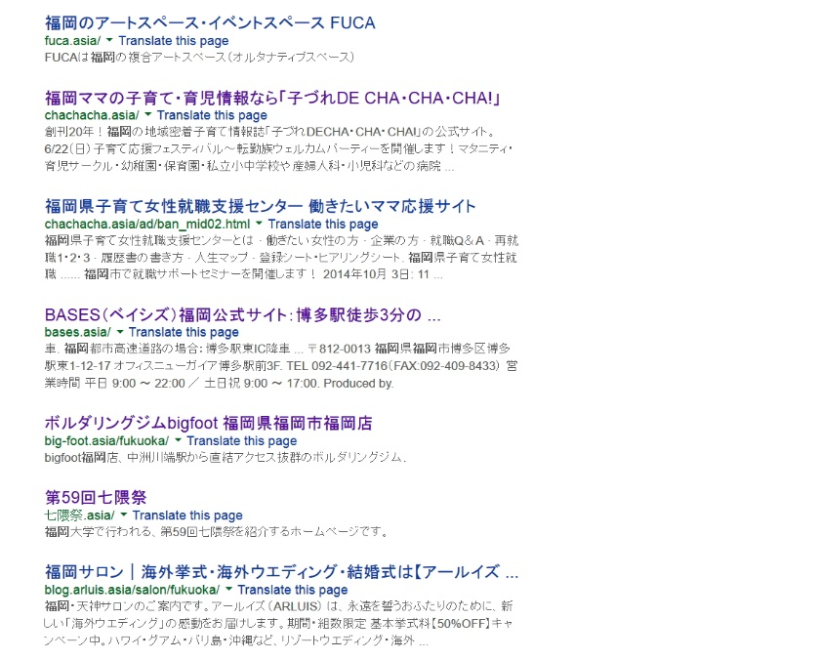
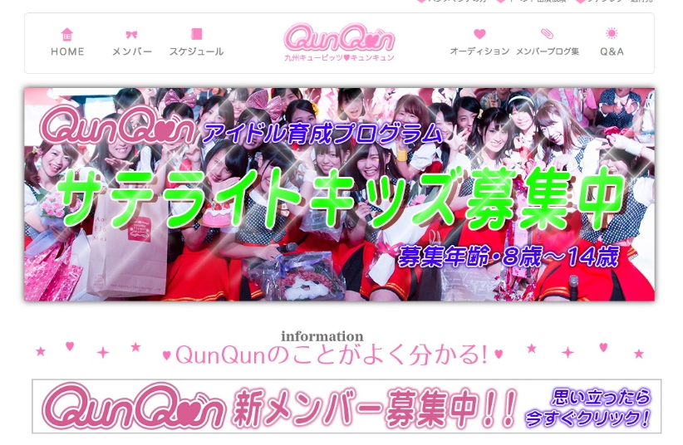

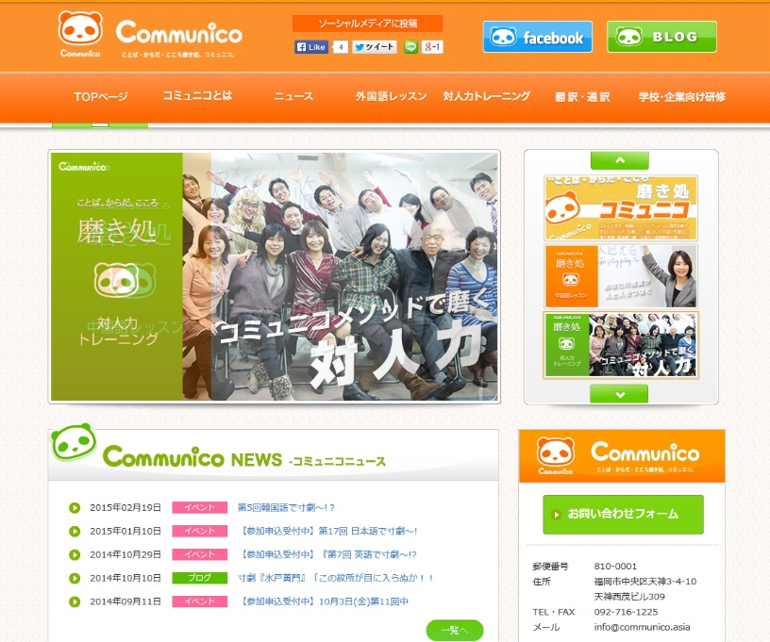
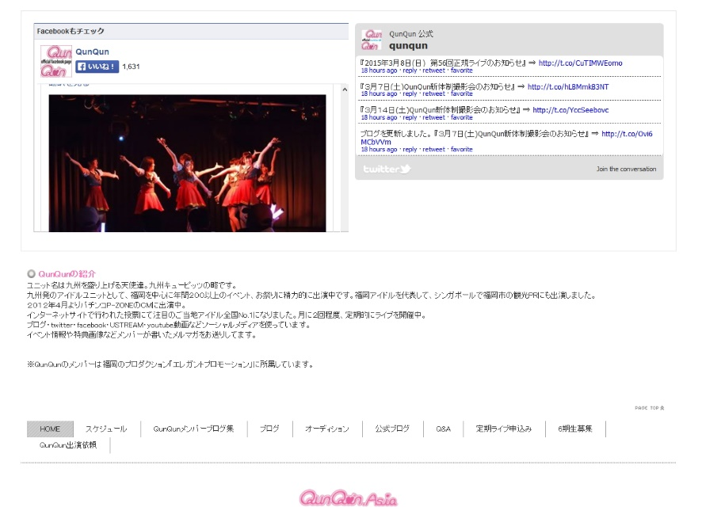
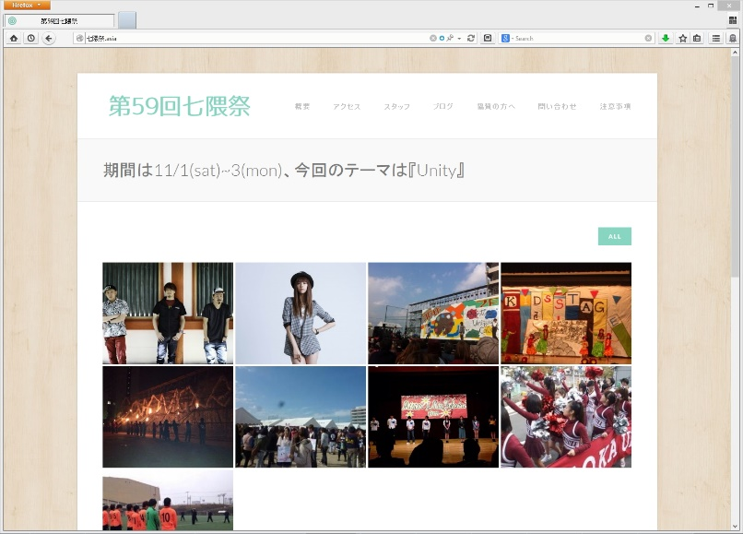
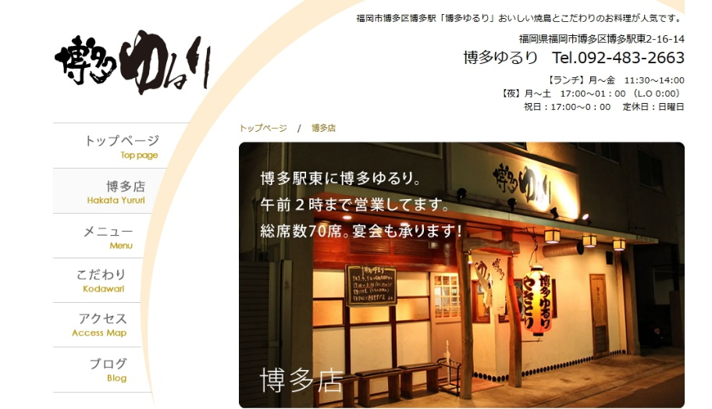
http://七隈祭.asia

Slide 20

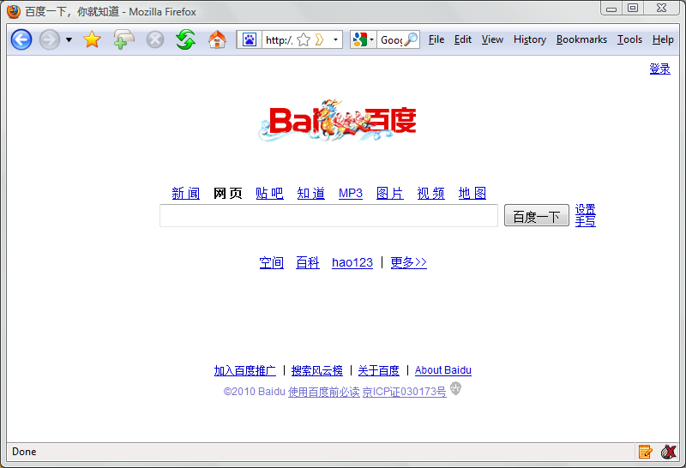
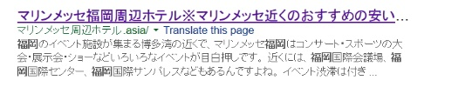
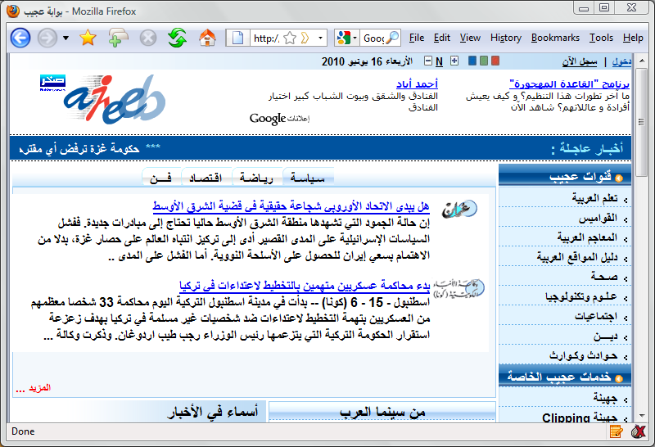

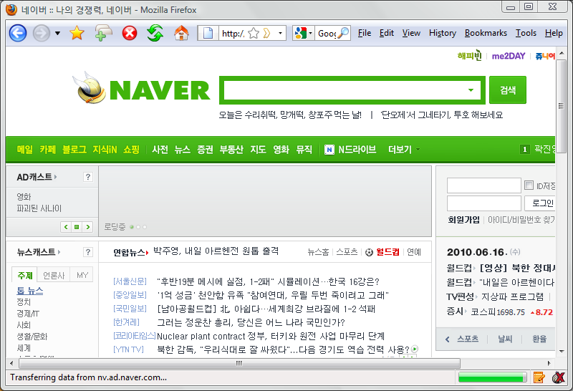
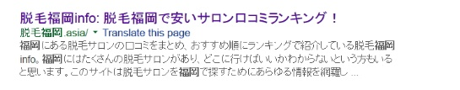
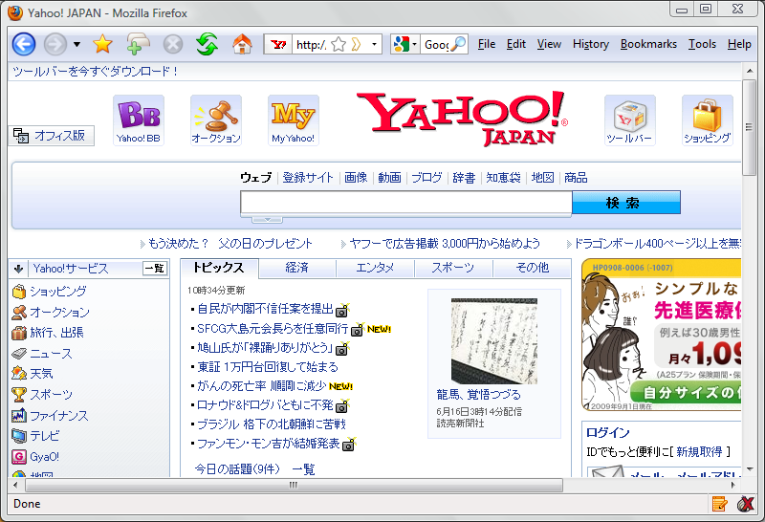
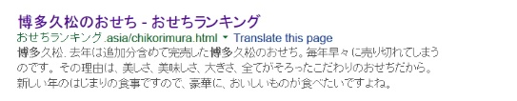

Users Search in Their Native Language

Slide 21
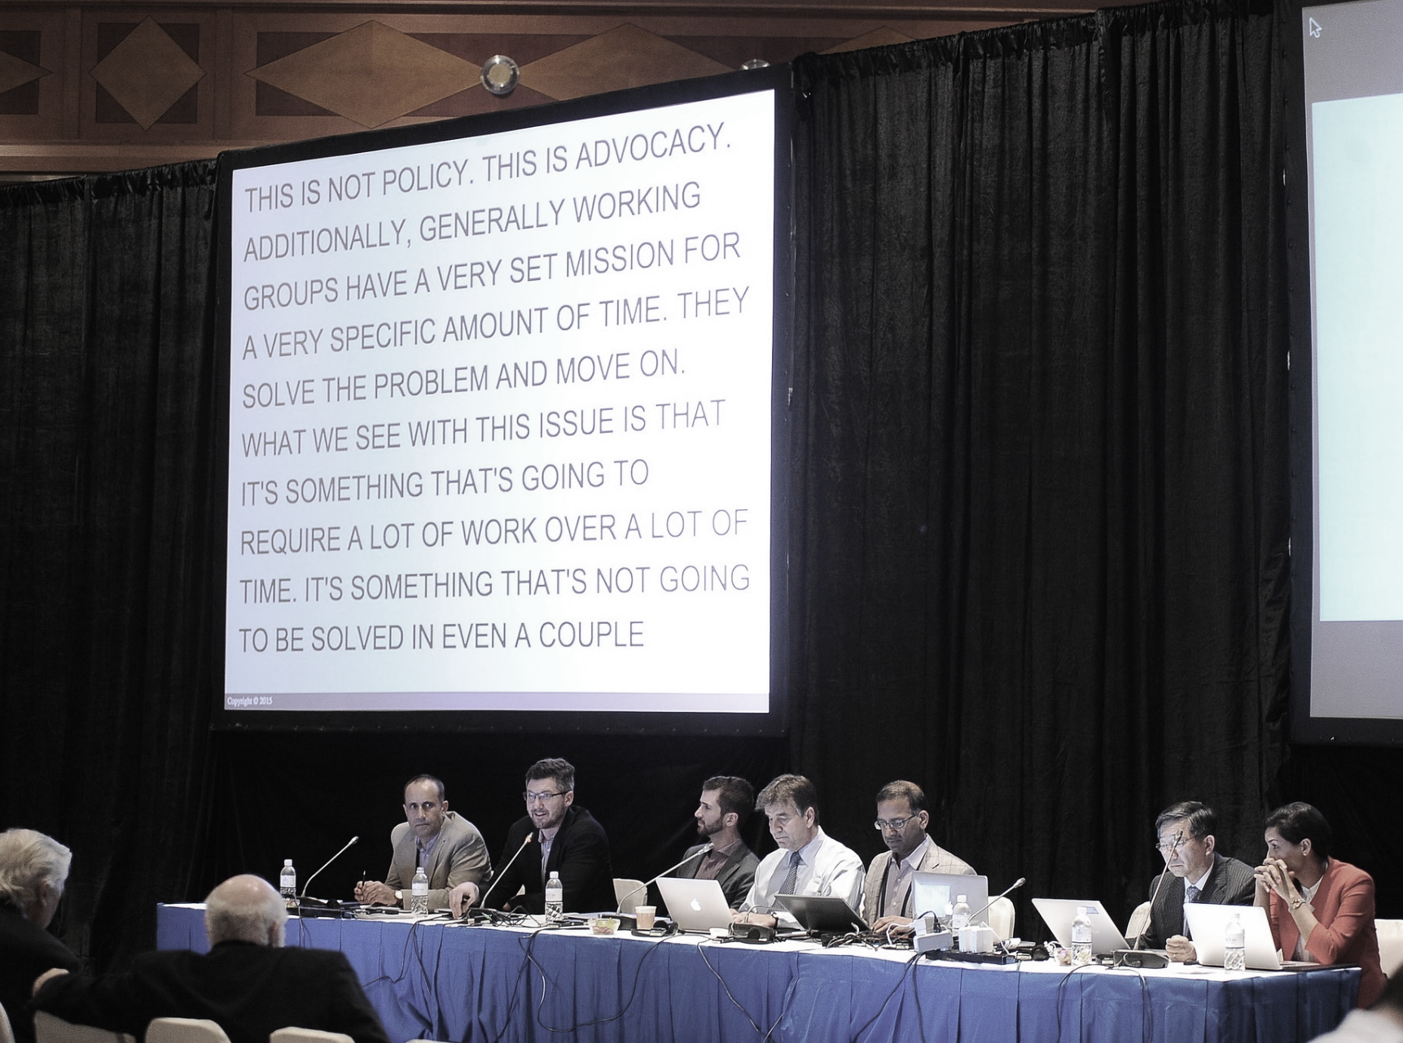
Universal Acceptance Steering Group
(UASG) @ICANN
https://mm.icann.org/mailman/listinfo/ua-discuss

Slide 22
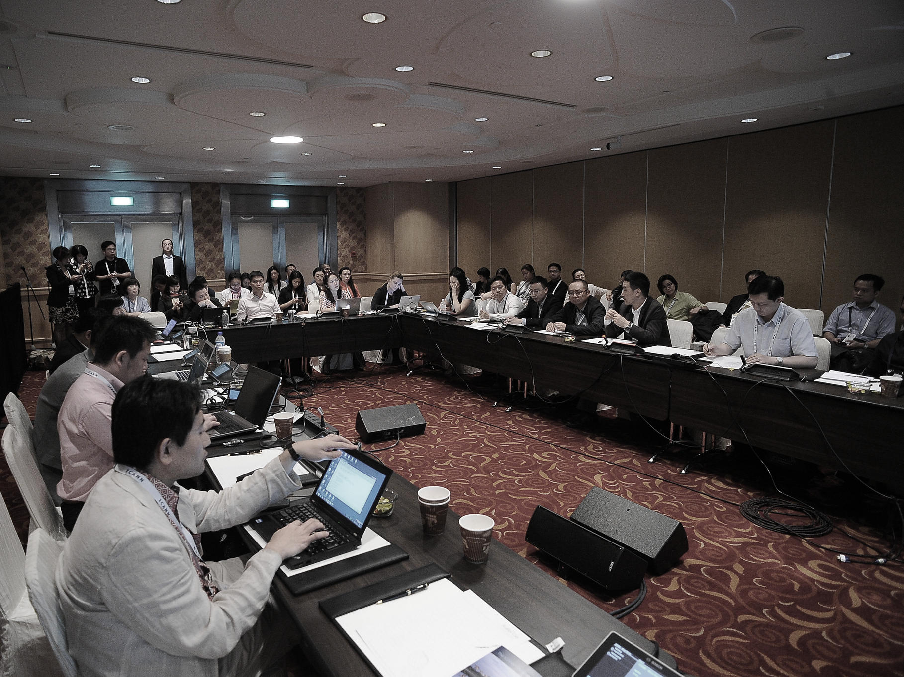
APAC Space @ICANN
  Mar 2013: First Informal Gathering
  Feb 2014: APAC Space on ICANN Schedule

Slide 23

gTLD Strategy Congress @ INTA

Slide 24

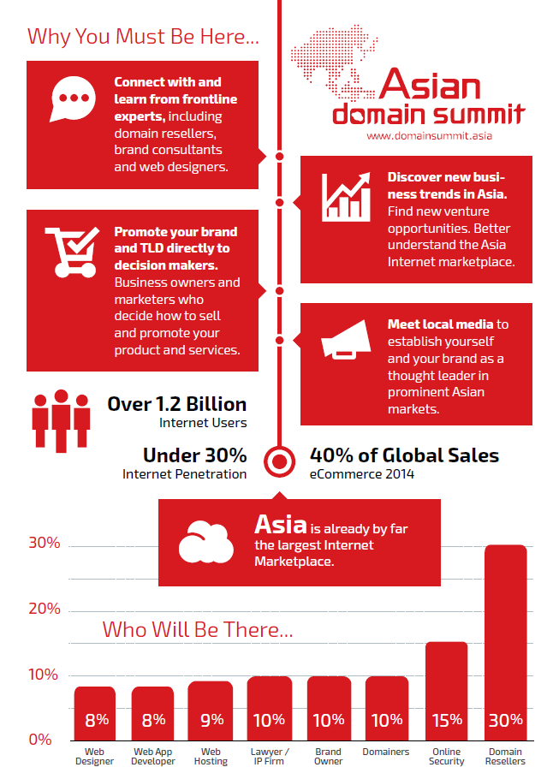

Slide 25



IoNMag.asia
Notes:
Starting our own media portal - domain industry publication
IoNMag.asia - put together by a collaboration of DNS companies, led by DotAsia and in partnership with industry journalist Kieren McCarthy.
IoN - short for Internet of Names - the first magazine that specifically caters to the domain industry, and will be distributed with every ICANN event bag, to attendees during the triannual ICANN meetings.

Slide 26

Internet of Things
tv.john.asia
fridge.john.asia
sink.john.asia
oven.john.asia
Internet of Names

Slide 28
NetMission.Asia

Slide 29
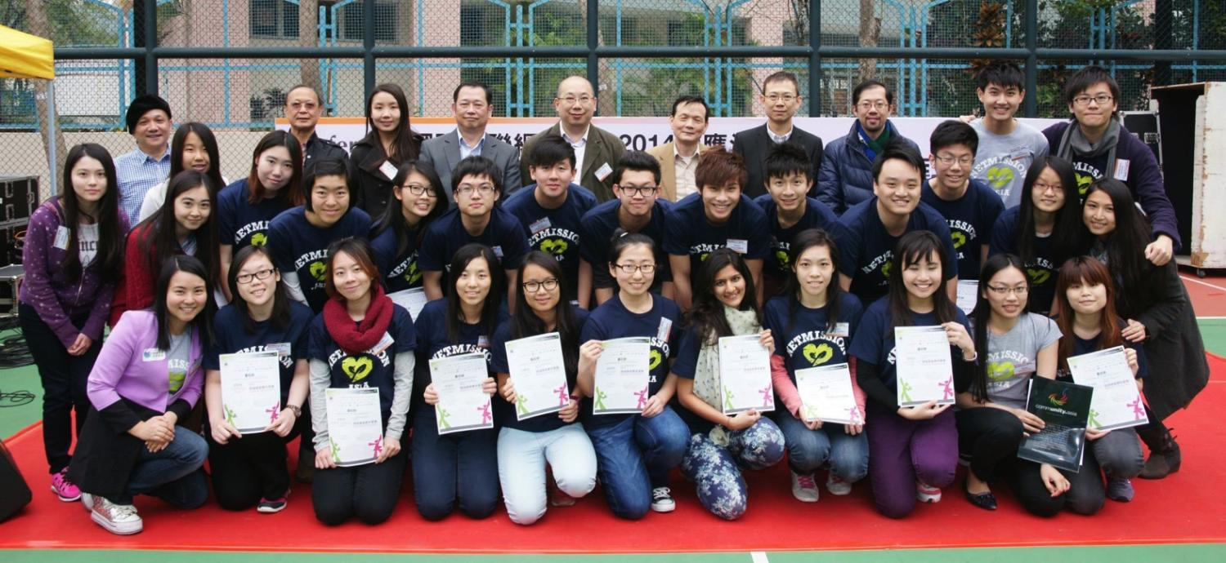
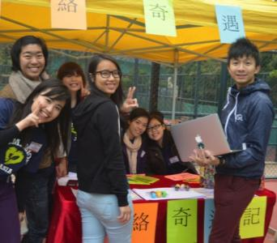
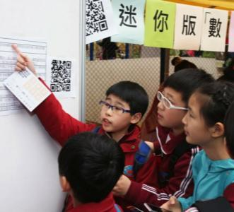
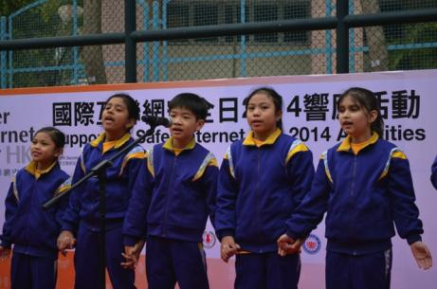
NetMission 4.0
Notes:
20 students from different Universities
Different Major
Hong Kong + Mainland China
Mili from India
The Saint from Burma

Slide 30
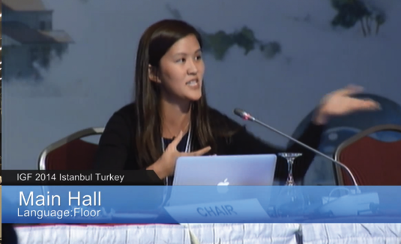

Alumnus: Bianca Caroline Ho (NMA1.0)
Elected as a member of the Multi-Stakeholders Advisory Group (MAG) of UNIGF 2015
Notes:
Bring direct Influence in IGF:
Youth Voice
DotAsia Impact
e.g. Potential Exploration : Youth IGF in Brazil

Slide 31
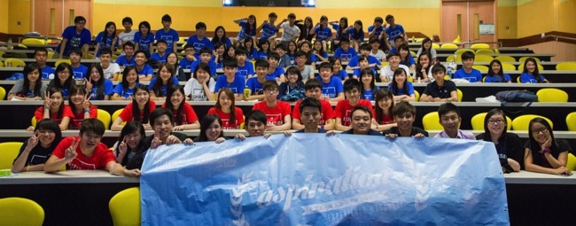
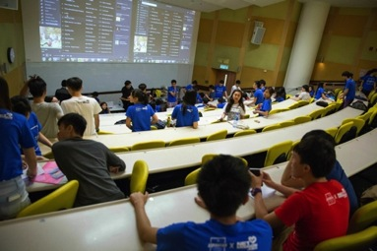
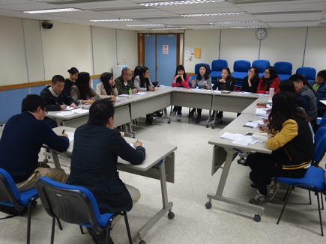
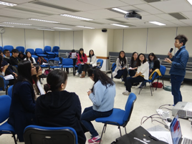
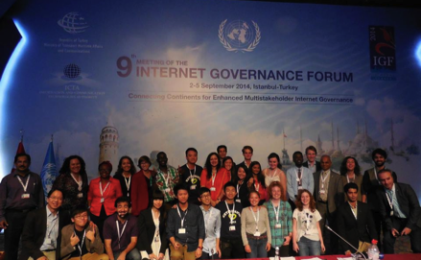
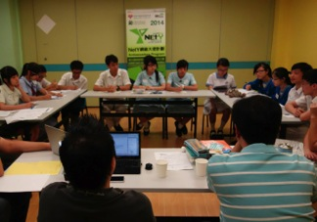
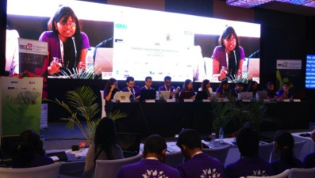
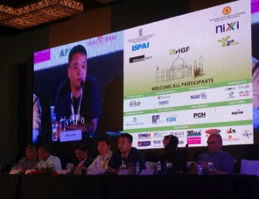
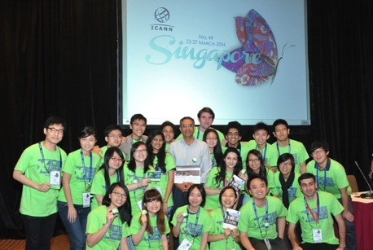
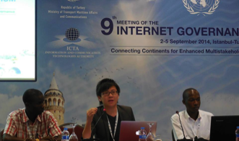
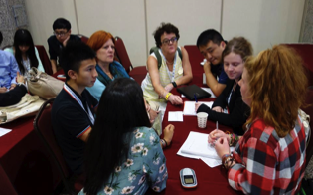

HIGHLIGHTS
Notes:
Fulfil DotAsia's Mission of contribute to the development of Internet in Asia Region...
Support youth participation in IG, prepare youth to bring positive influence to the Internet
Brand image (DotAsia support sustainable development of Internet by getting Youth prepare for the future)
Influence in IG Policy Discussion (local, regional, global[even in UN])

Slide 32
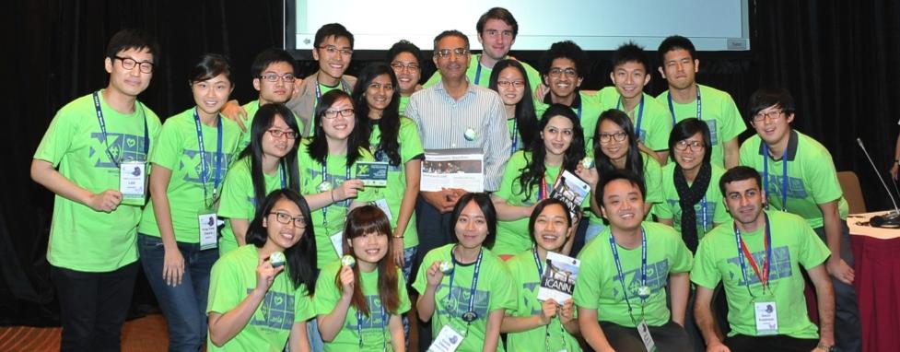


NextGen@ICANN
X
→

Slide 33
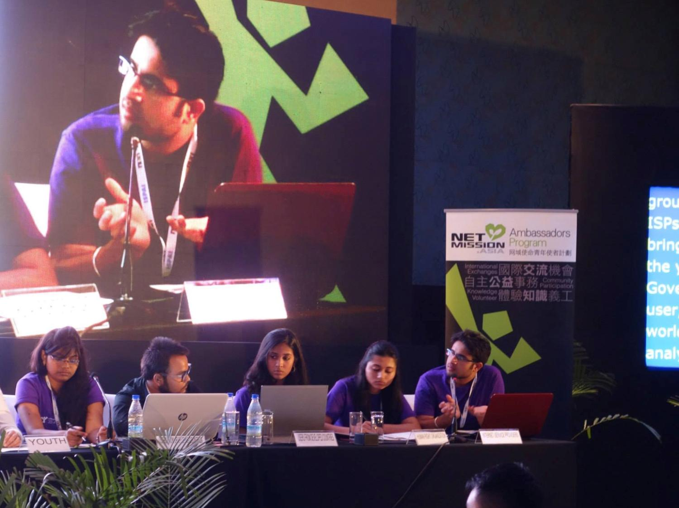
YIGF.Asia
Youth IGF Camp
Delhi, India
3-6 Aug 2014

Slide 34
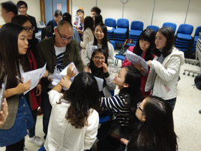
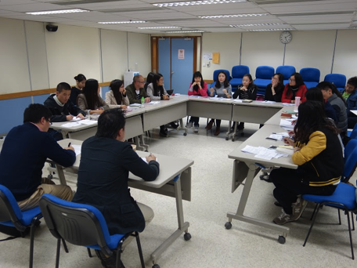
University Students
HK-GZ IG Workshop
Hong Kong
18 Jan 2015
PreUni Workshop
Hong Kong
14, 15 & 21 Jun 2014
Notes:
HK-GZ IG Workshop
*Expansion of project beyond Hong Kong
Cooperate with Sun Yat-sen University
=> Bring influence to Mainland young academic
PreUni
* Potential population of NetMission Ambassador

Slide 35



NetY.Asia

Slide 36



yIGF@IGF2015 Brazil
NetMission @ Paraguay
Children and Youth Conference
@ World Internet Conference
Notes:
NetMission @ Paraguay
Establishment of sister organization

Slide 37
Go.Asia

Slide 38









4,500,000
Page Views per Month
18x in 30mths

Slide 39





Slide 40

SciChef.Asia

Slide 41



Slide 42


FoodRevolutionDay.Asia

Slide 43


Slide 44




MandelaDay.Asia

Slide 45




www.give.asia

Slide 46



Asian NGO Platform & Summit

Slide 47


Supporting Elephant Parade & Free the Children

Slide 48
Love.from.Asia

Slide 49

AsianFilmAwards.Asia
The Asian Oscars

Slide 50





Slide 51




AFA Academy
From a few select jury
To hundreds of past winners and nominees
Voting Jury for the AFA
Online Screening & Voting System

Slide 52
9th Asian Film Awards Presentation Ceremony
25 March 2015 (Wednesday)
The Venetian Theatre, Macau

Slide 53


Masterclasses, Study Tours & Exchange

Slide 54
Dot.Asia

Slide 55

www.olpc.asia

Slide 56

www.MaD.asia

Slide 57



Slide 58

Asia Pacific Regional Internet Governance Forum (APrIGF)
2010: Hong Kong
2011: Singapore
2012: Tokyo
2013: Seoul
2014: Delhi
2015: Macau – June 30 – July 3

Slide 59


Slide 60
.Asia Registry Technical Updates
Afilias
Notes:
1. Welcome Remarks ~5 min 15:20
2. DotAsia Operations in 2013 ~10 min 15:30
3. Financials (Fiscal Year 2012-2013) ~15 min 15:45
4. Community Works Highlight 2013 ~20 min 16:05
5. .Asia Registry Technical Updates ~15 min 16:20
6. Strategic & Operation Plans 2014 ~10 min 16:30
7. Ratification of Board Elections ~10 min 16:40
8. Open Discussion & Closing Remarks ~5 min 16:45
Joint Dinner with AP* 1800

Slide 61
Financial Report 2014
Fiscal Year Ending September 30, 2014
October 2013 – September 2014
Notes:
1. Welcome Remarks ~5 min 15:20
2. DotAsia Operations in 2013 ~10 min 15:30
3. Financials (Fiscal Year 2012-2013) ~15 min 15:45
4. Community Works Highlight 2013 ~20 min 16:05
5. .Asia Registry Technical Updates ~15 min 16:20
6. Strategic & Operation Plans 2014 ~10 min 16:30
7. Ratification of Board Elections ~10 min 16:40
8. Open Discussion & Closing Remarks ~5 min 16:45
Joint Dinner with AP* 1800

Slide 62
Strategic Plan 2015
Notes:
1. Welcome Remarks ~5 min 15:20
2. DotAsia Operations in 2013 ~10 min 15:30
3. Financials (Fiscal Year 2012-2013) ~15 min 15:45
4. Community Works Highlight 2013 ~20 min 16:05
5. .Asia Registry Technical Updates ~15 min 16:20
6. Strategic & Operation Plans 2014 ~10 min 16:30
7. Ratification of Board Elections ~10 min 16:40
8. Open Discussion & Closing Remarks ~5 min 16:45
Joint Dinner with AP* 1800

Slide 63
2007-2010: .Asia Launch
Sunrise, Landrush, Auctions
Pioneer Domains
2010: Community Contributions
2011: Year of Exploration
2012: Year of Investments
2013: Year of Consolidation
2014: Year of Development

Slide 64
2015: Rebalancing

Slide 65

Recalibrating & Responding

Slide 66
Total Comprehensive
Loss for Financial Year
2014
-$240,000
2013
-$400,000
2011/2012
-$640,000

Slide 67

Cost Containment
Income Growth
Balancing Budget
Keeping up market development
Personnel Adjustments
Community Contribution Adjustments
Cost Allocation Adjustments
.Asia Market Development
Domains.Asia
Grants, Sponsorships and NGO Funding Opportunities
Beyond .Asia: .MO / new gTLDs / others.

Slide 68

Data Driven Development
Market Relevance
Supporting Registrars
Macro Socio-
Economic Trends
Identifying New
Opportunities

Slide 69

ASEAN – the new engine
of growth for Asia
and the World
-- Philip Kotler
www.mheducation.asia

Slide 70









2015 ASEAN Economic Community (AEC)
No.7
No.6:
Population:
600+
No.8:
Largest Economy by GDP
No.9:
Million
US$2.4 Trillion
Annual trade exceeding US$1.4 trillion
96%
+1
of enterprises are SMEs
Notes:
Asia will be more connected than ever

Slide 71

DotAsia as a not-for-profit organisation with a mandate to promote Internet development and adoption in Asia.

Slide 72
Board Elections 2015
Notes:
1. Welcome Remarks ~5 min 15:20
2. DotAsia Operations in 2013 ~10 min 15:30
3. Financials (Fiscal Year 2012-2013) ~15 min 15:45
4. Community Works Highlight 2013 ~20 min 16:05
5. .Asia Registry Technical Updates ~15 min 16:20
6. Strategic & Operation Plans 2014 ~10 min 16:30
7. Ratification of Board Elections ~10 min 16:40
8. Open Discussion & Closing Remarks ~5 min 16:45
Joint Dinner with AP* 1800

Slide 73
Board Elections 2014
Seats up for election
  4 seats from Sponsor Member Category
  1 seat from Co-Sponsor Member Category
Development of Election Procedures
  Draft Circulated to Board: Oct 29, 2014
  First Draft Posted: Nov 19, 2014
  Final Procedures Posted: Dec 8, 2014
Nominations Process (5 weeks)
  December 10, 2013 (Wed) – Nomination Period Begins
  January 14, 2014 (Wed) – Nomination Period Ends

Slide 74
Highlights of Procedures
Nominations & Voting Process (via email)
Sub-Regions (Sponsor Category):
  At least 1 member from each of the 4 Sub-Regions
    North and Northeast Asia
    South and Southeast Asia
    Middle East, Asia Minor and Eurasia
    Australia and Pacific Asia
Geographic diversity requirements already met by remaining Board Members
Vacant Seats for Co-Sponsor Category
  1 seat vacant

Slide 75
Elections / Membership Voting Procedures
Considerations Raised:
  Process for changes in Contact Person for Member
  Non Responsive Member Contacts
  Trust Anchors / Due Diligence Processes
Proposed Approach / Refinement:
  Identification of 3 Valid Contact Persons from Member (Primary / Secondary / Tertiary)
  In case of conflicts between votes/nominations received, priority considered in order ( Pri. > Sec. > Ter. )
  Changes to Contact Persons to be initiated by any Member Contact and affirmed to by at least one other Member Contact OR unobjected to by both other Member Contacts (5 days)
  Changes to Member Contacts accepted within nomination/voting periods

Slide 76
Board Elections 2015
Nominations Received:
Sponsor Member Category
Co-Sponsor Member Category
Candidate | Nominated By | Seconded By
Dr. THAM Yiu Kwok | DotPH (.PH) | SGNIC (.SG)
Choon Sai LIM | JPRS (.JP) | IUSN Foundation (.NU)
Atsushi ENDO | SGNIC (.SG) | CNNIC (.CN)
Dr. Xiaodong LEE | CNNIC (.CN) | JPRS (.JP)
Candidate | Nominated By | Seconded By
Tommy MATSUMOTO | APNG | APNIC

Slide 77
Voting Process
Sponsor Members
  Number of candidates (4) standing for election in the Sponsor Member category is equal to the number of vacancies in the category (4)
  No voting required
Co-Sponsor Members
  Number of candidates (1) standing for election in the Sponsor Member category is equal to the number of vacancies in the category (1)
  No voting required

Slide 78
Proposed Member Resolution
AGM2015 Resolution
  To accept the Board Elections 2015 results in the election of the following duly nominated candidates:
  Sponsor Member Category:
    Atsushi ENDO (re-elected)
    Choon Sai LIM (re-elected)
    Dr. Xiaodong LEE (re-elected)
    Dr. THAM Yiu Kwok (re-elected)
  Co-Sponsor Member Category
    Tommy MATSUMOTO (re-elected)

Slide 79
Complete Board Elections 2015 Results
Elected Board Members: (serving until AGM 2017)
  Atsushi ENDO – North & North East Asia
  LIM Choon Sai – South & South East Asia
  Dr. THAM Yiu Kwok – North & North East Asia
  Xiaodong LEE – North & North East Asia
  Tommy MATSUMOTO
Other Elected Board Members: (serving until AGM 2016)
  Alireza SALEH – Middle East, Asia Minor, Eurasia
  Stafford GUEST – Australia and Pacific Asia
  Dr. SIR Jae-Chul – North & North East Asia
  Joel DISINI – South & South East Asia
  Ching CHIAO

Slide 80



Slide 81
Sponsor Community Project (SCP) Funds
Total Allocated Funds to Date: US$921,811
Total Utilized Funds to Date: US$106,780

Slide 82
SCP Funds Expiration Scheme
Only bring forward accrued and unused portion for the last 4 years
For first year of implementation any amounts accrued for more than 4 years will also be expired
Notifications via email to each member (around mid-March):
  accrued amount as of to date
  withdrawn amount as of to date
  amount to be expired on Sep 30, 2015
Email reminders will be sent around end of Oct (1 month after Fiscal Year End)

Slide 83
Illustration of SCP Funds Expiration as Proposed (using data as of Sep 2014)
Year As Of | Accrual | Withdrawal | Net Accrual
2008-09 | 214,013 | - | 214,013
2009-09 | 64,805 | - 4,700 | 60,105
2010-09 | 117,939 | - 3,000 | 114,939
2011-09 | 133,706 | - 22,120 | 111,586
2012-09 | 141,821 | - 14,960 | 126,861
2013-09 | 102,102 | - 50,000 | 52,102
2014-09 | 125,704 | - 12,000 | 113,704
Total | 900,090 | - 106,780 | 793,310
Expired as of Sep 30, 2015 | 530,463 | - 106,780 | 423,683
 |  | Accrual Brought Forward: | 369,627

Slide 84
Thank you Everyone for your Continued Support
Joint Dinner with AP*
@18:30: Ozenya-Iori Restaurant
@18:20: Hotel Okura Lobby

Slide 85







Every .Asia Domain
Contributes to Internet Development in Asia
Edmon Chung <edmon@registry.asia>

