Slide 1
DotAsia AGM 2012
Feb 26, 2012
APRICOT, New Delhi

Slide 2
Overview
15:30 Welcome Remarks
15:40 DotAsia Operations in 2011
16:15 Special Projects: (.MO, New TLDs, etc)
16:25 Audited Financials
(Fiscal Year 2010-2011)
16:35 Member Resolution
(Ratification of Board Elections results)
16:45 Strategic & Operational Plans 2012
16:50 Open Discussion & Closing Remarks
18:00 Joint Dinner with AP*

Slide 3
Exciting .Asia Adoption

Slide 4
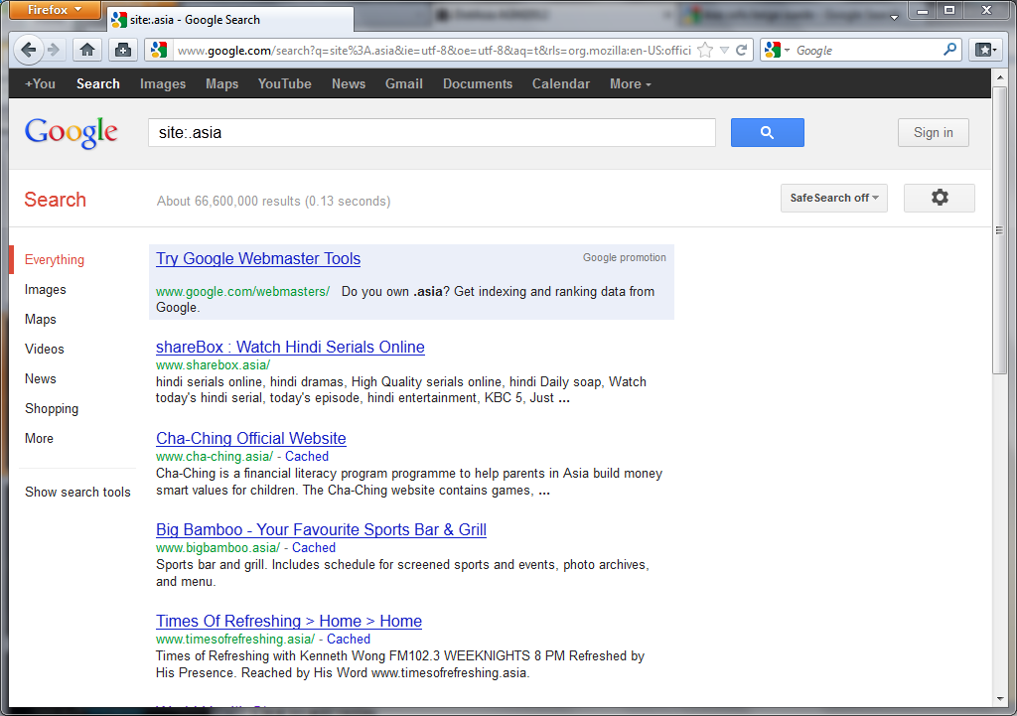
Growing .Asia Footprint
From 13 Million entries to 66 Million Entries

Slide 5
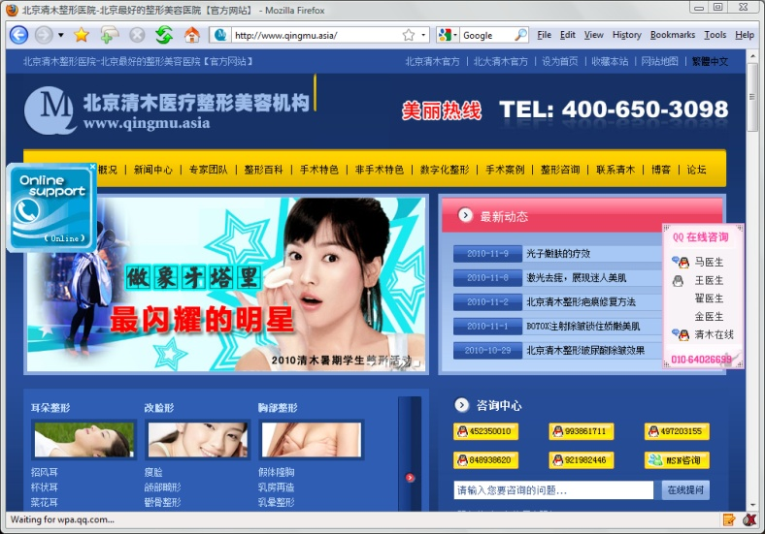
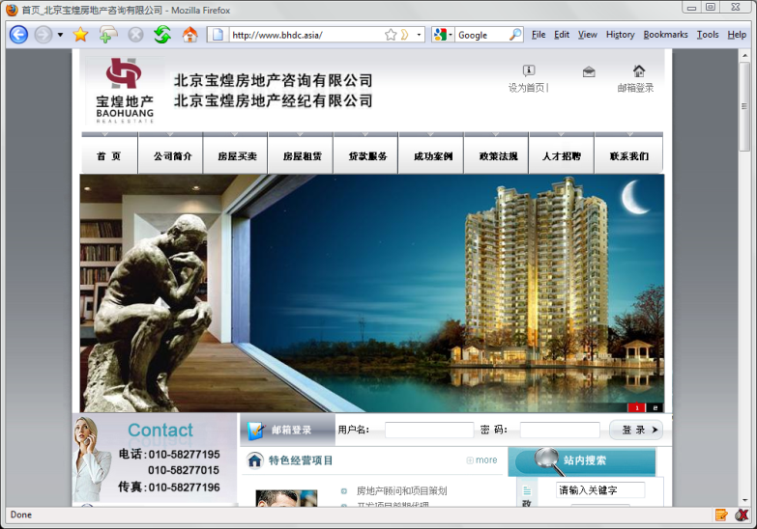
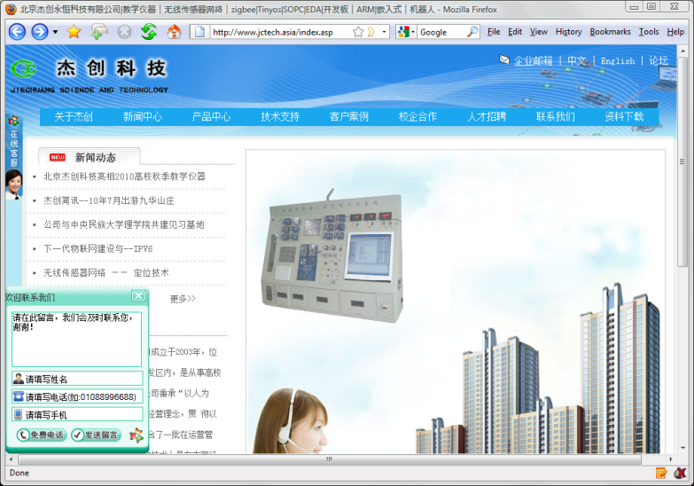
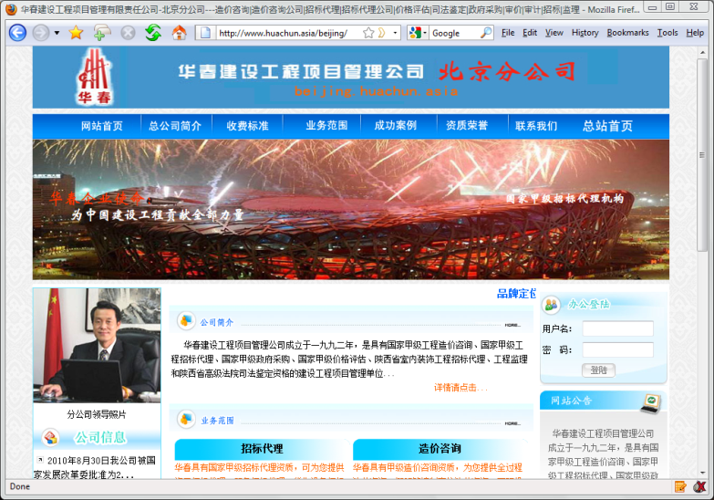
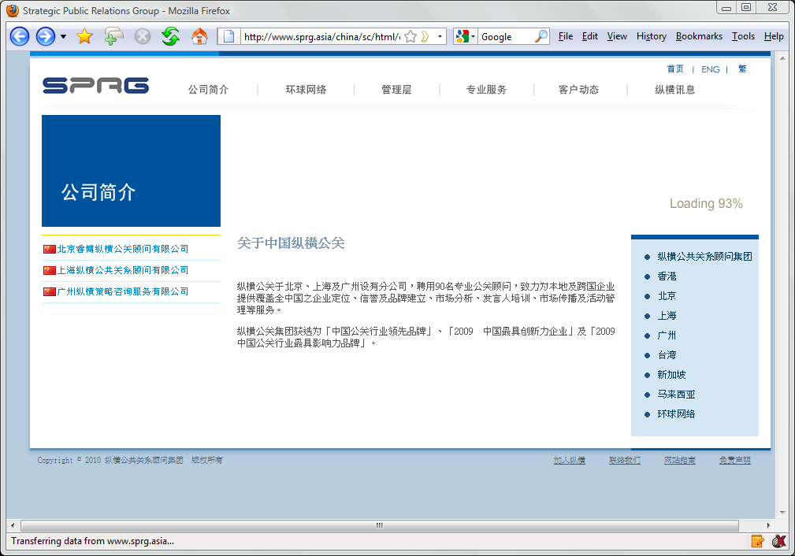
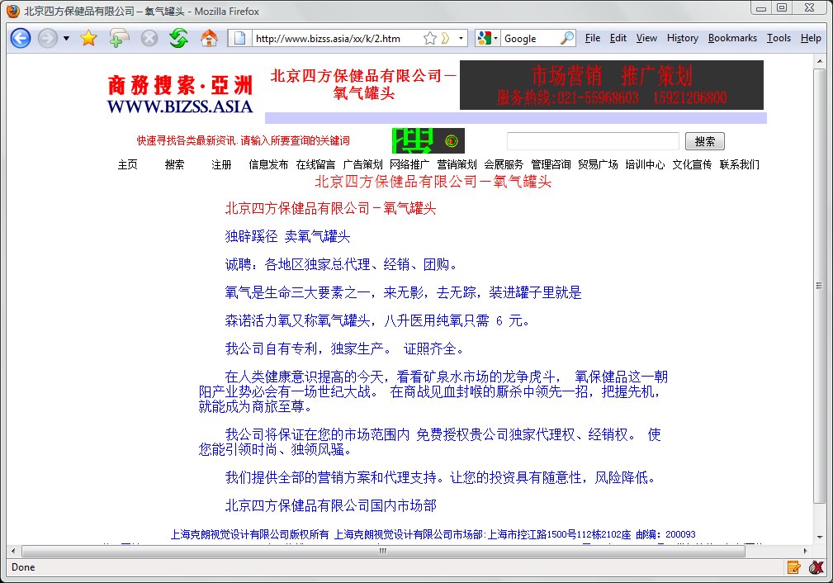
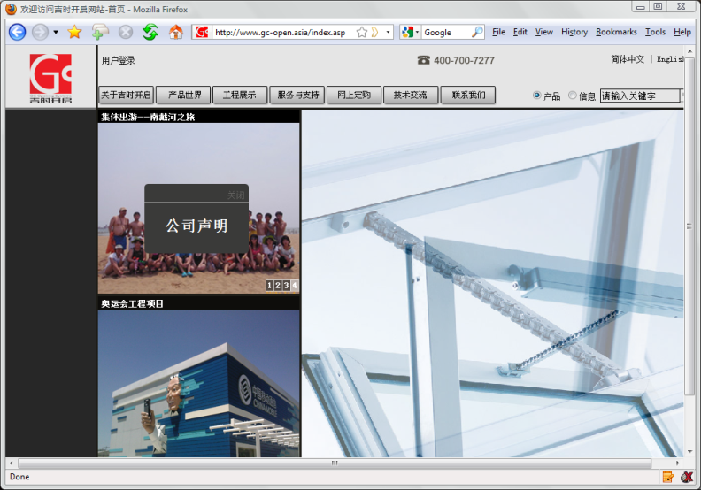
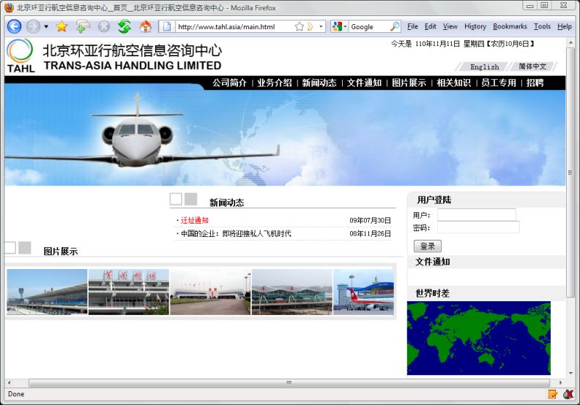
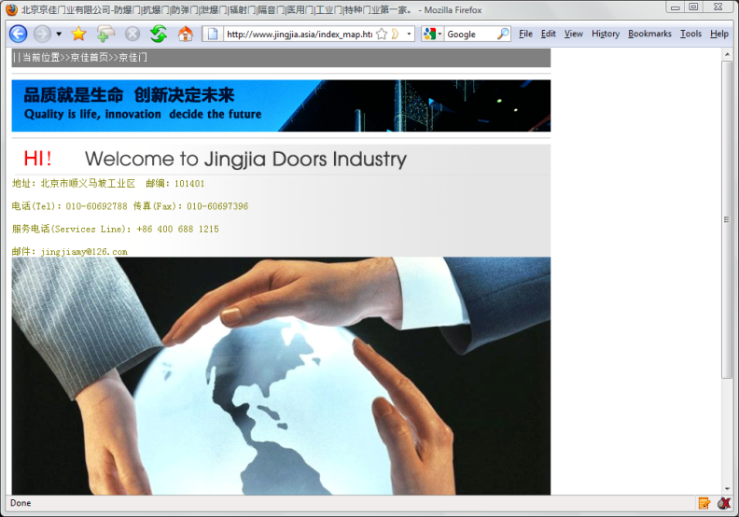
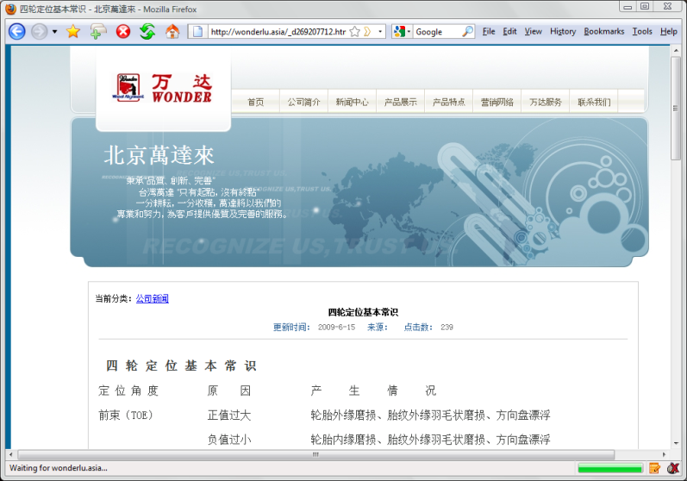
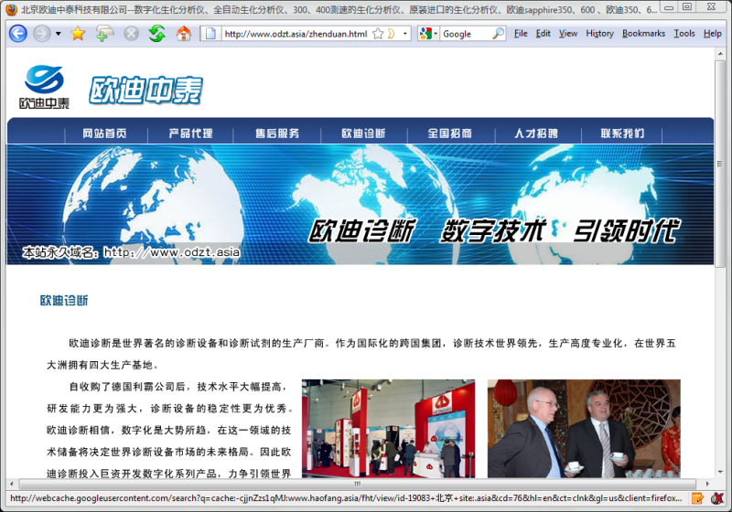
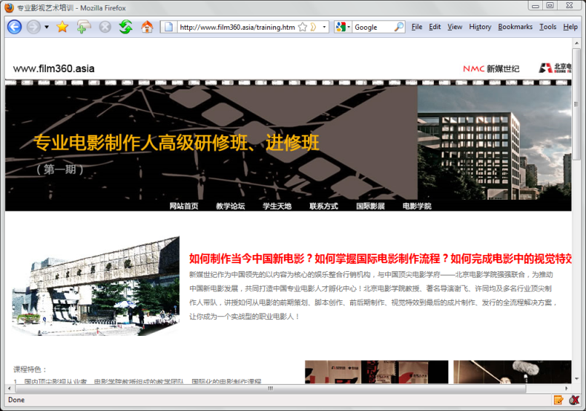
.Asia in Beijing
bhdc.asia
huachun.asia
qingmu.asia
jctech.asia
bizss.asia
tahl.asia
sprg.asia
gc-open.asia
jingjia.asia
wonderlu.asia
film360.asia
odzt.asia

Slide 6
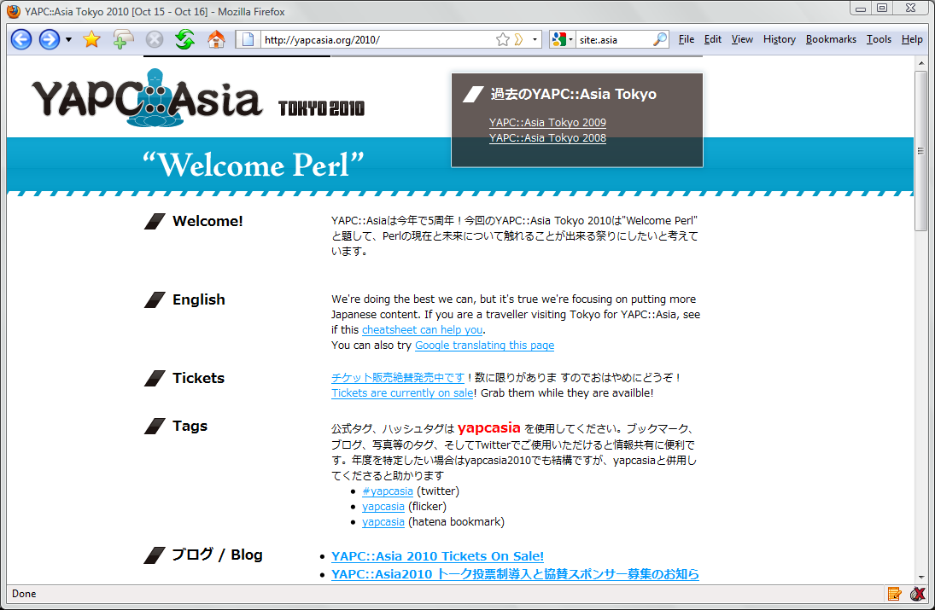
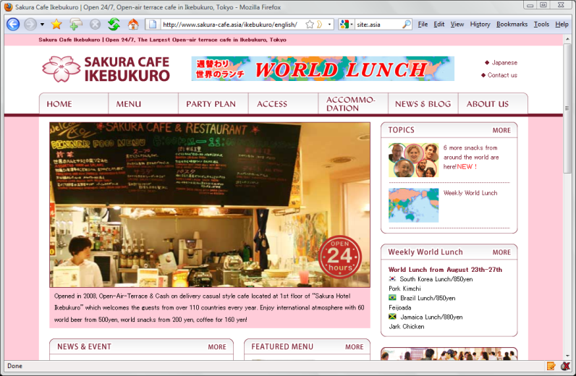
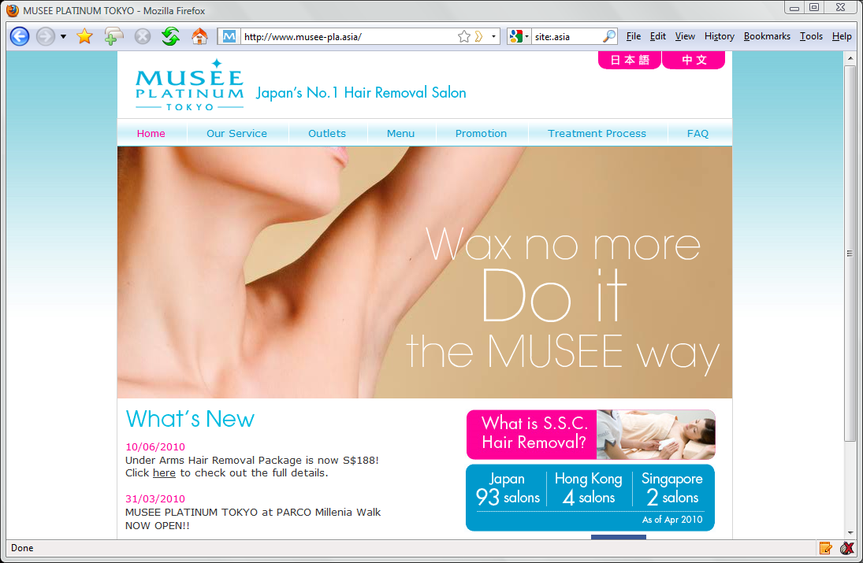
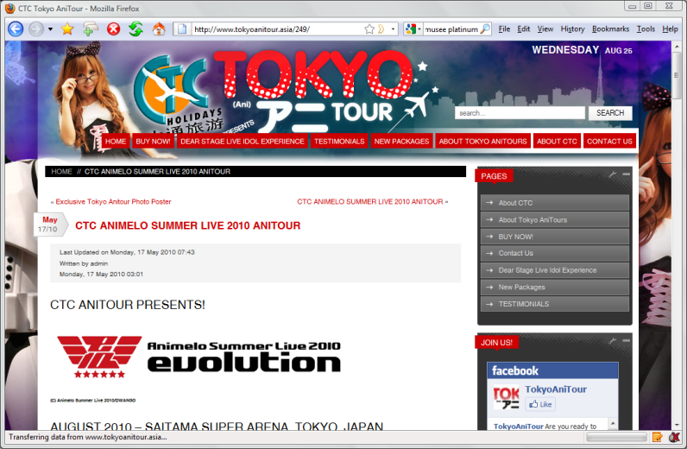

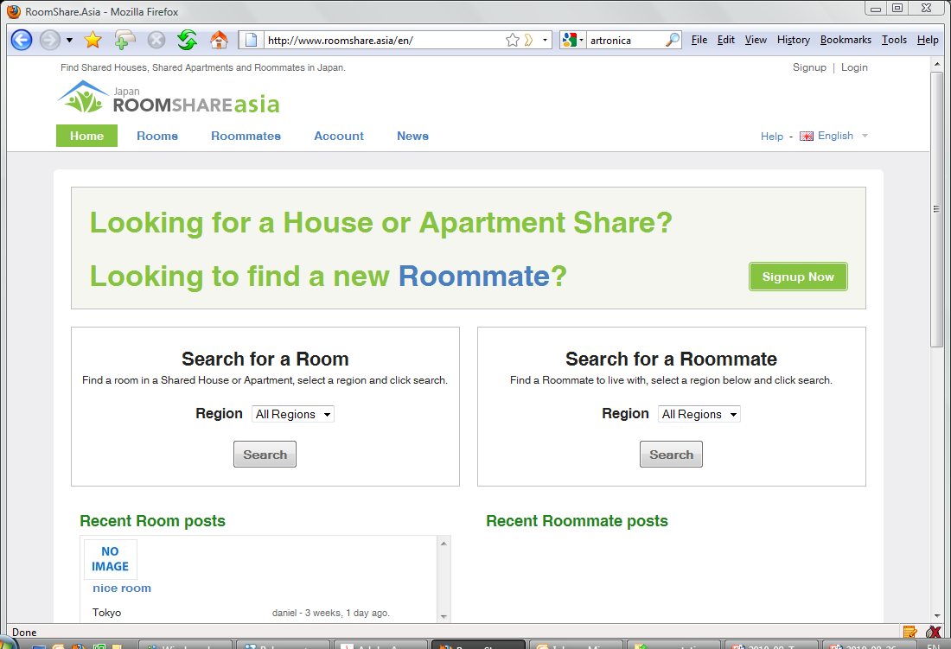
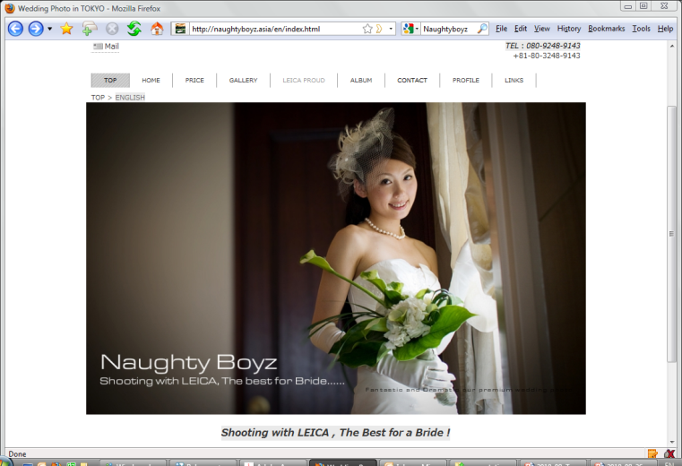
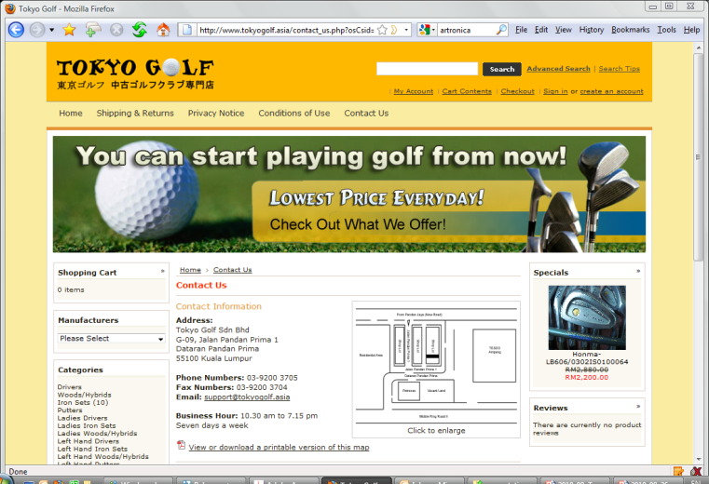
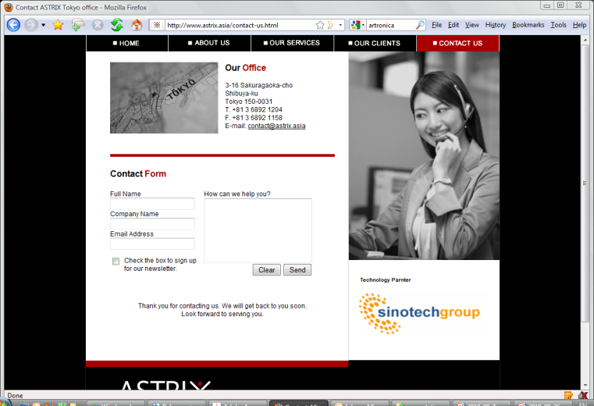
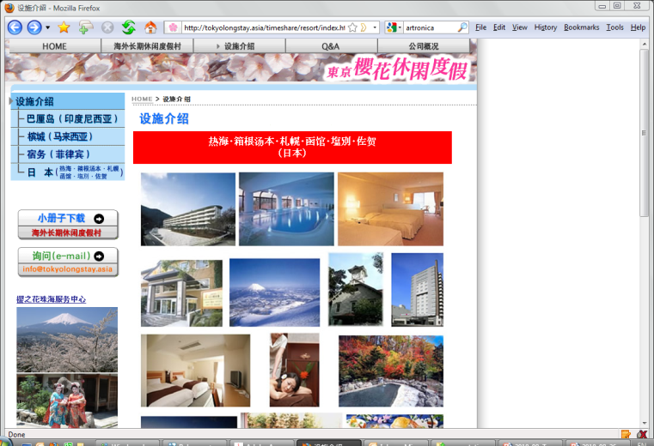
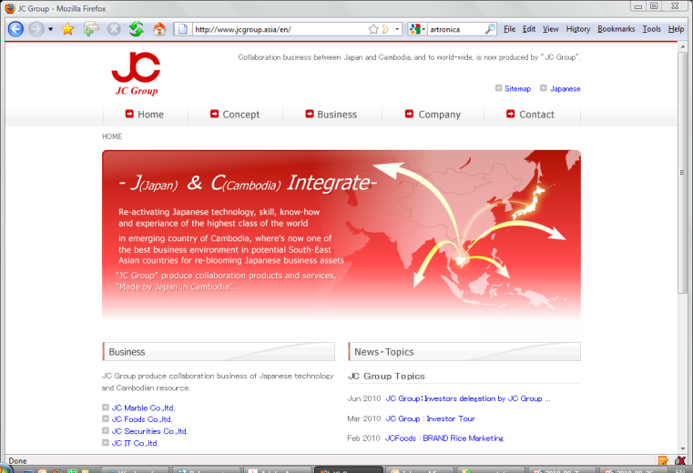
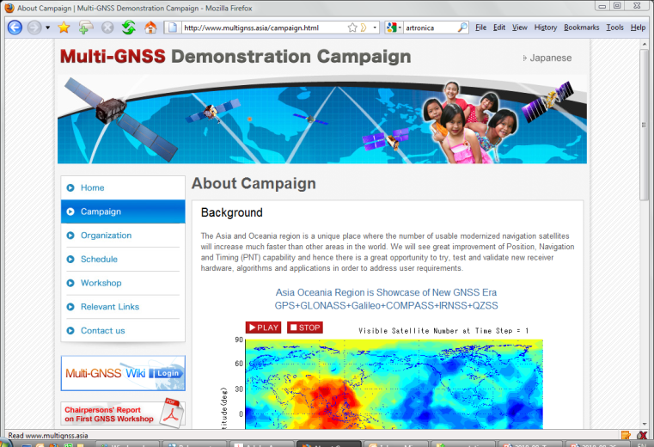
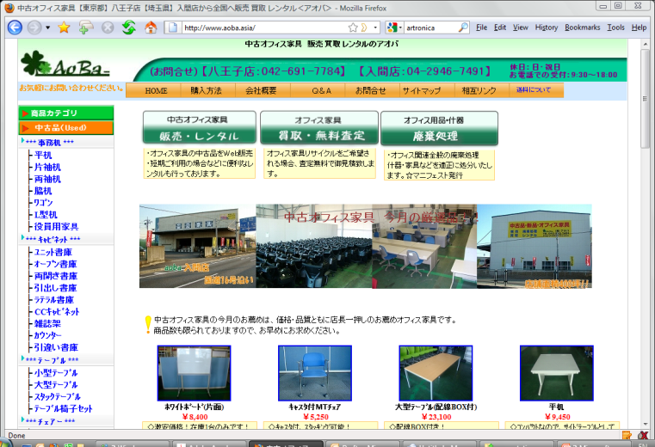
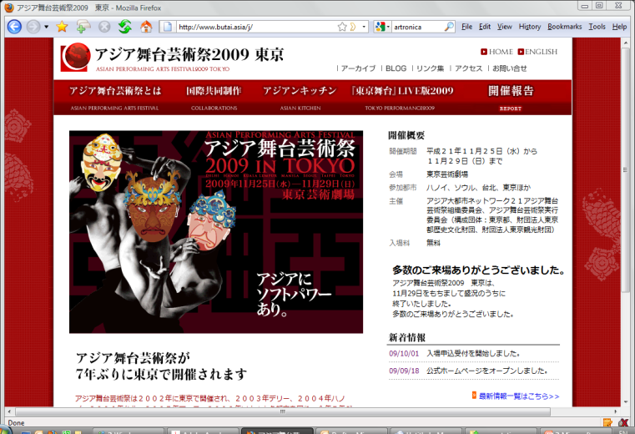
.Asia in Tokyo
yapc.asia
musee-pla.asia
gbes.asia
sakura-cafe.asia
tokyoanitour.asia
roomshare.asia
tokyogolf.asia
naughtyboyz.asia
astrix.asia
tokyolongstay.asia
aobo.asia
multignss.asia
butai.asia
jcgroup.asia

Slide 7
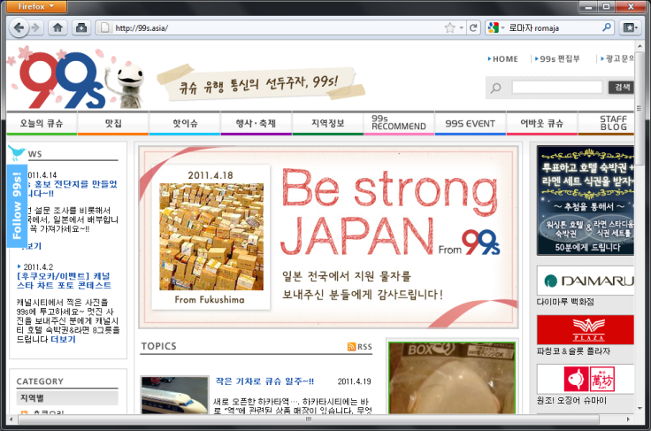

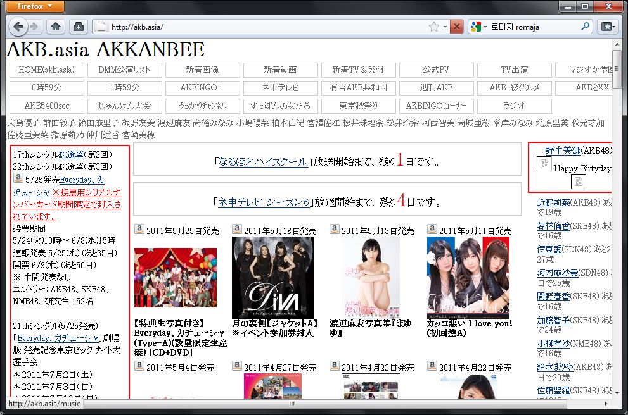
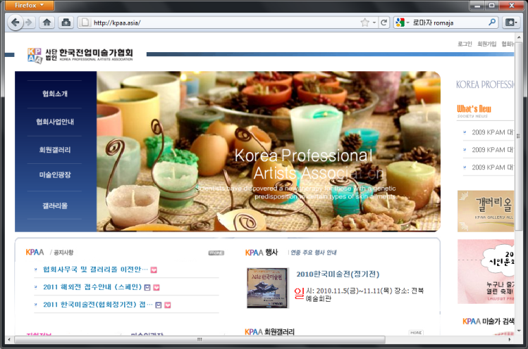
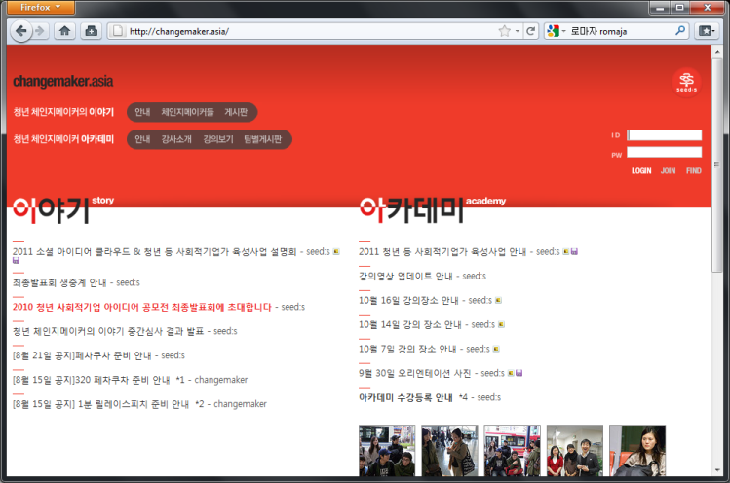
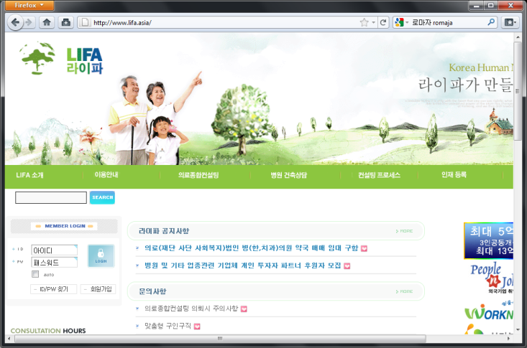
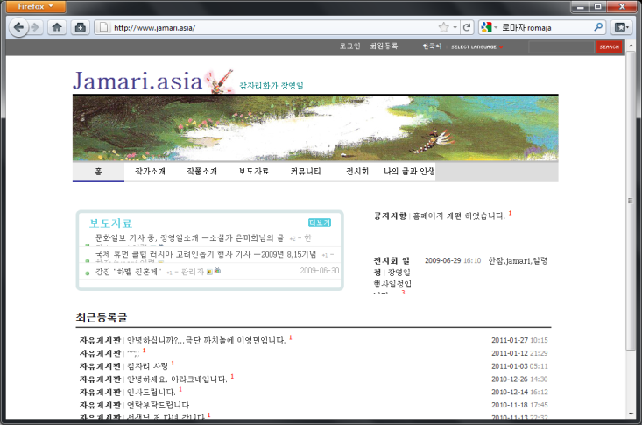
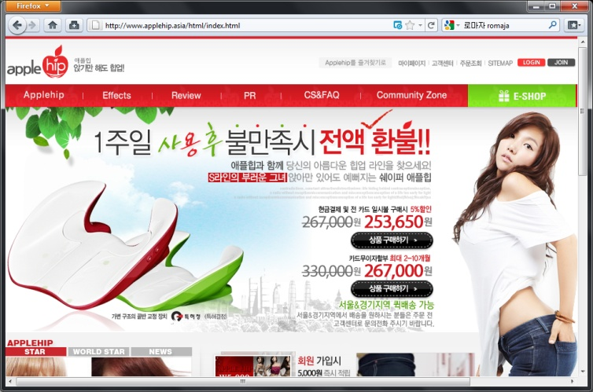
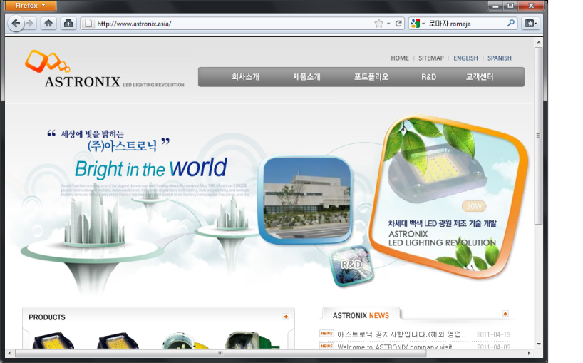
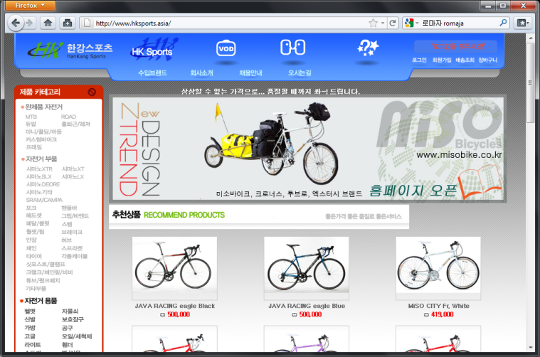
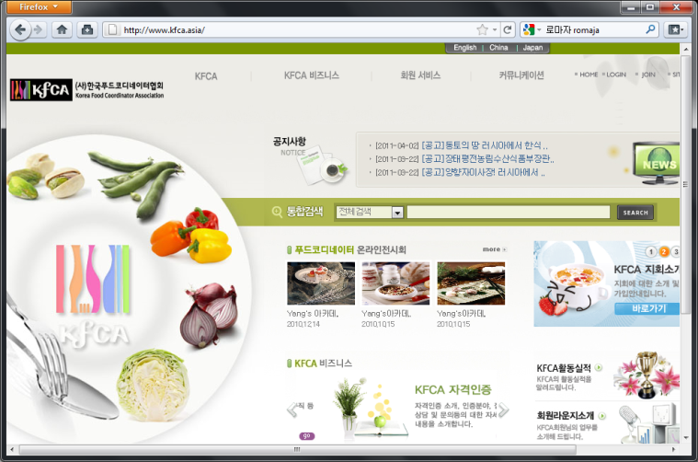
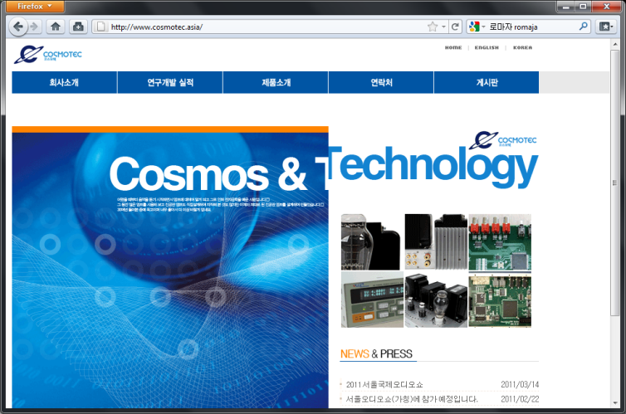
.Asia in Seoul
99s.asia
akb.asia
rodem.asia
kpaa.asia
lifa.asia
jamari.asia
changemaker.asia
applehip.asia
astronix.asia
welife.asia
cosmotec.asia
hksports.asia

Slide 8

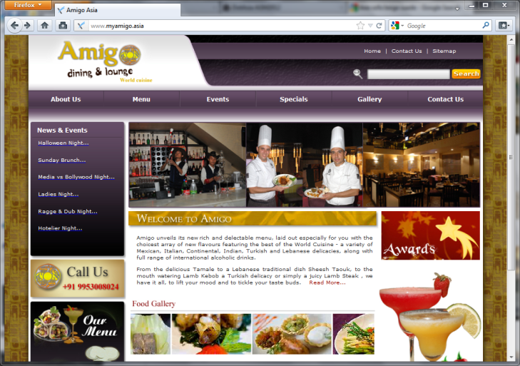
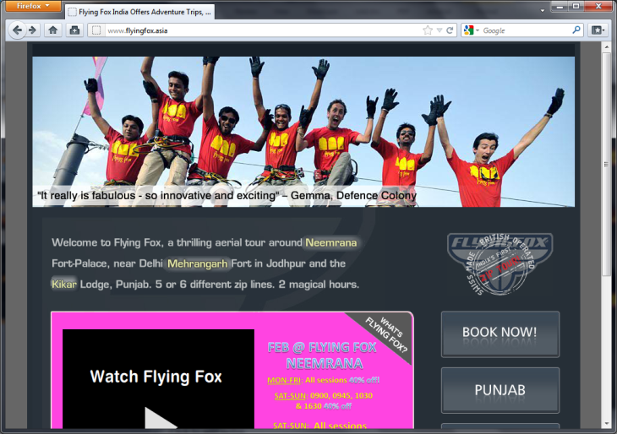
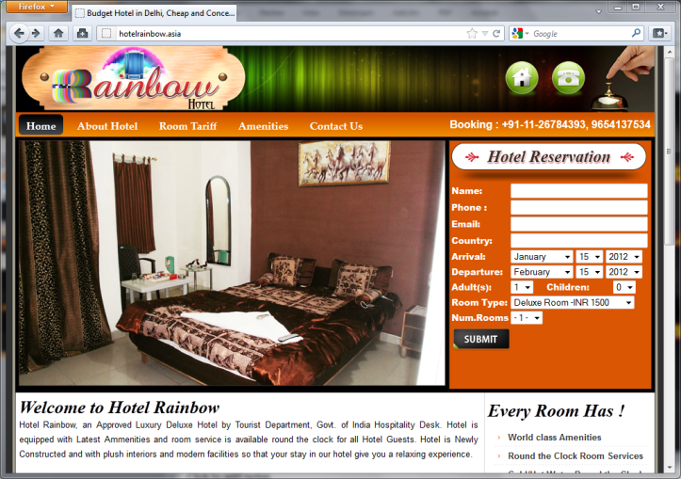
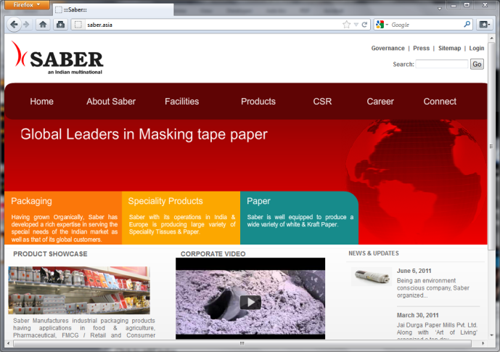
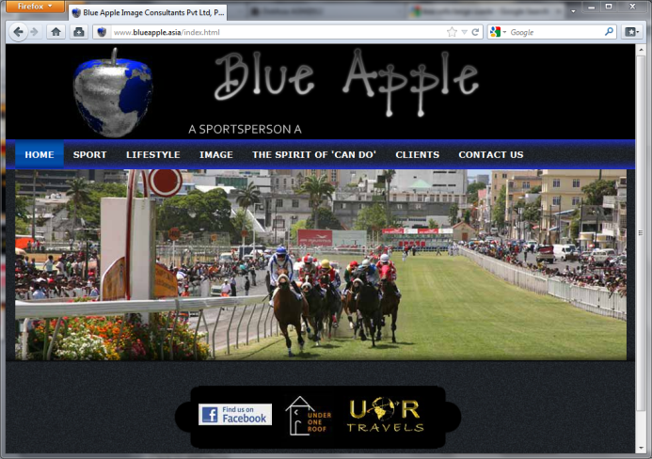
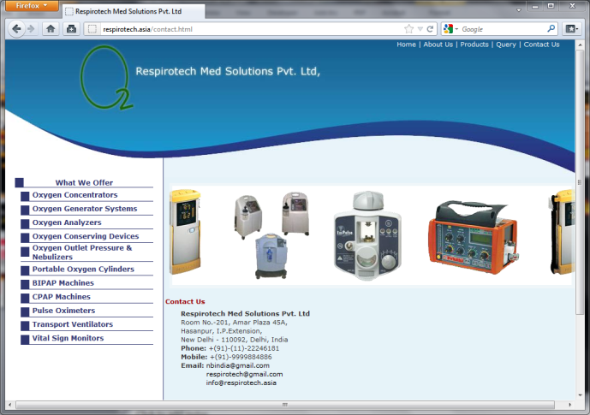

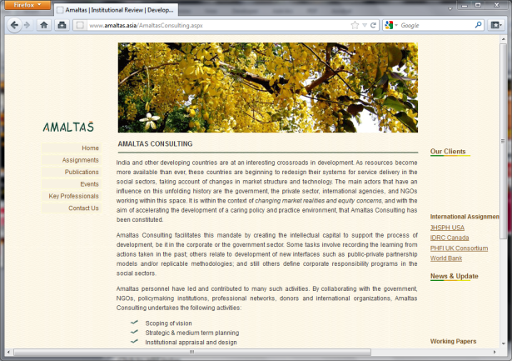
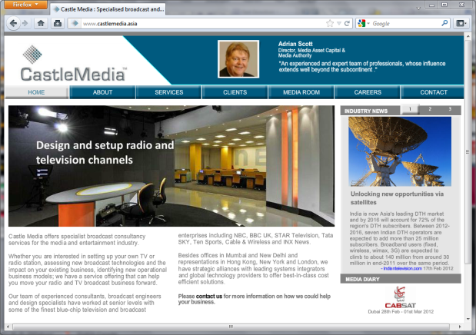

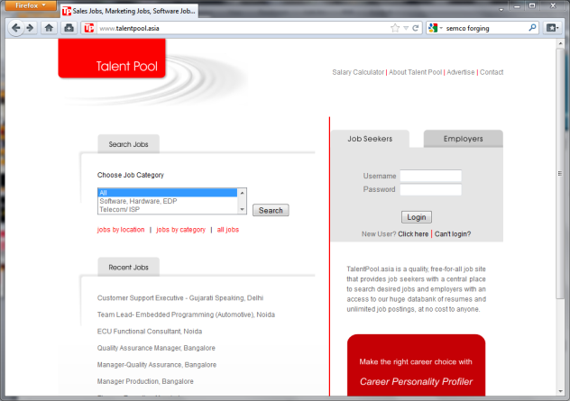
.Asia in New Delhi
festivaloflife.asia
flyingfox.asia
myamigo.asia
hotelrainbow.asia
blueapple.asia
delhi99.asia
saber.asia
respirotech.asia
amaltas.asia
talentpool.asia
castlemedia.asia
studioone.asia

Slide 9


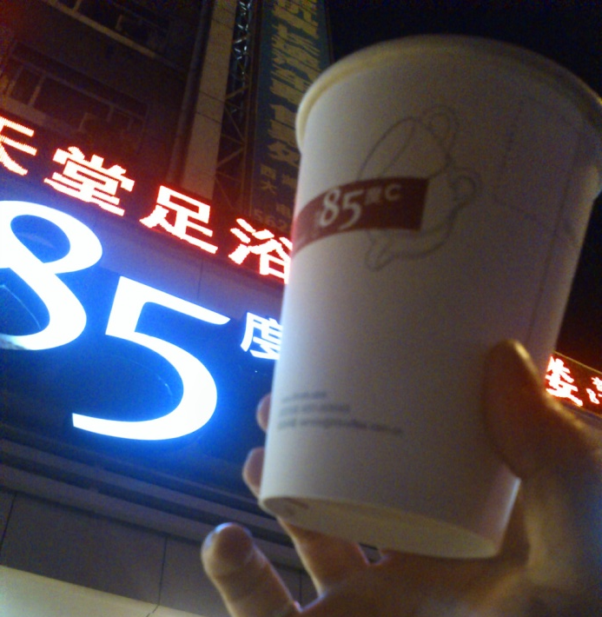
.Asia on Products
slimmm.asia
bamboa.asia
85cafe.asia

Slide 10


Magazines Launching with .Asia Domain

Slide 11
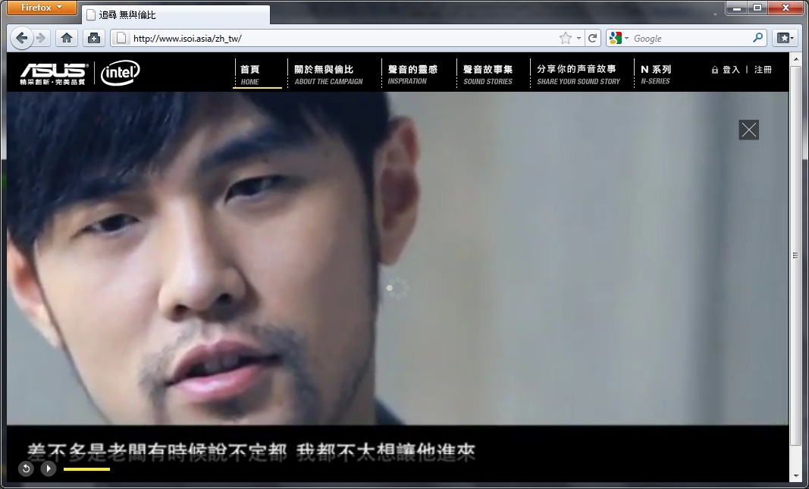
www.isoi.asia

Slide 12
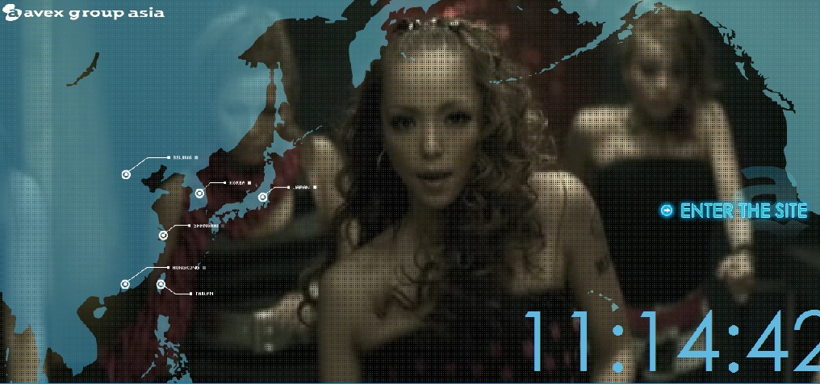
www.avex.asia

Slide 13

www.KMTV.asia

Slide 14
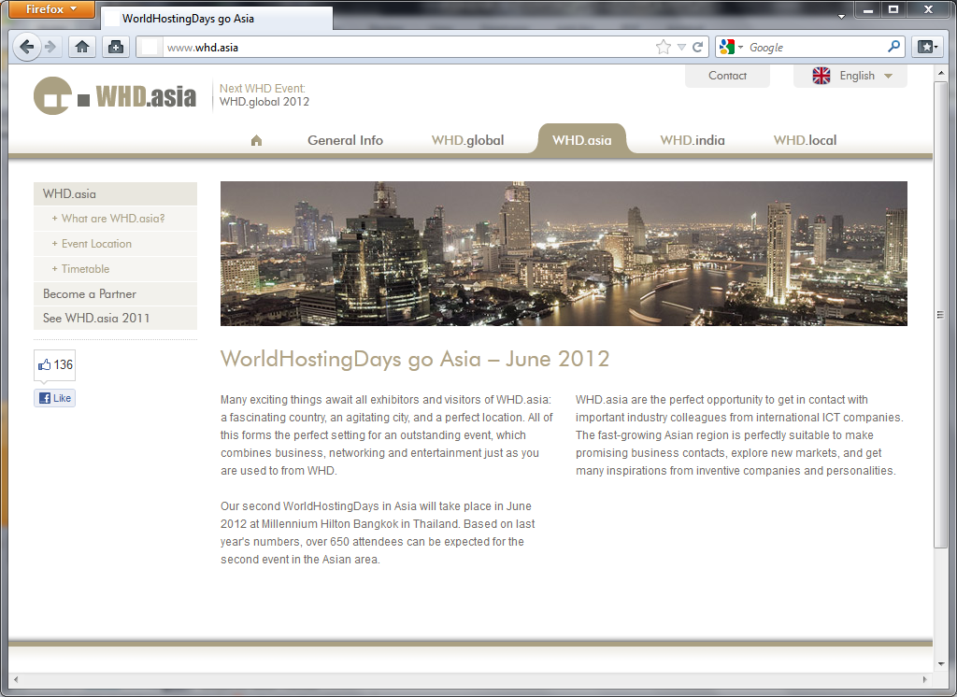
World Hosting Day selects WHD.Asia

Slide 15

Asian Marketing Effectiveness Festival selects AME.asia domain

Slide 16



Asian Banks Trust .Asia

Slide 17

www.FutureGov.asia

Slide 18

www.CDIA.asia

Slide 19

www.development.asia

Slide 20
DotAsia in 2012

Slide 21
DotAsia Strategic Directives 2010

Slide 22
Strategic Community Contributions
Moderation on Sponsorships
Explore sustainable support
  Preference on self-sustainable projects
  Provide support in cash flow
  Aim for cost-recovery on supported projects
  Utilize loan or investment structure
Efforts & Expertise based Contributions
.Asia domain names
Website development and maintenance
Leveraging network

Slide 23
Channel Development
Reducing Street Price for .Asia registrations
Expanding Channel
Updated Charter Eligibility Requirements
Worked more closely with registrars to customize promotion efforts

Slide 24








Notes:
Aust domains – crazy domains
Key System retail
NSI

Slide 25
DotAsia Strategic Directives 2011

Slide 26
Multi-Dimensional Growth
Expansion
  Continue to develop channel
  Launching of IDN.Asia
Horizontal Development
  Support other TLDs
  Explore New gTLD Opportunities
Vertical Development
  Vertical Integration Deregulation
  Secondary Market
Diversification
  .Asia Domains & Other Investments
  Leveraging Funding Sources

Slide 27

Your Customers are Searching for Your Brand in their Native Languages in Asia .
Do you have a Domain that matches what they are looking for?
Brand Protection Value
Domain Investment Value
Search Engine Optimization (SEO) Value
Market Perception Value

Slide 28
CJK IDN GoLive: June 21, 2012
Indic, Thai and other Languages to Follow

Slide 29
New Domain Registrations Growth

Slide 30
Growth: Actual vs. Projections

Slide 31
Growth Stimulation Programs
Base Price Promo
(BPP)
Asia Super Achiever Promo
(ASAP)
ASAP+
ASAP++
ASAP
ASAP

Slide 32



Slide 33

Top New Creates by Country (2011)
7 of Top 10 in Asia Pacific

Slide 34

Steady Growth in
Domain Registration
Domains Under Management Reassumed Net Total Growth from ~210K
Month-by-Month Growth: 3%
Month-to-Month (by year) Growth: 28%
Year-to-Year Growth: 22%

Slide 35
Horizontal Development

Slide 36





Slide 37

Leveraging DotAsia’s New gTLD Knowledge & Experience
Application Support through the Phases
  Preparation / Application / Evaluation / Implementation
Policy & Community Development
Expert IDN Knowledge
Domain Industry
Understanding

Slide 38
Namesphere名天科建
DotAsia Seeding and Raising Fund to Invest into New TLDs
Balanced Portfolio Approach
Prioritized for Asian & Community Based Initiatives

Slide 39
.inc
.台北
.music
.africa
.art
.asia
.hainan
.音樂
.film
.广州
.seoul
.movie
.kids
.klc
.黑龙江
.microblog
.新闻
.taipei
.서울
.Future

Slide 40
Vertical Development

Slide 41


Slide 42

Asia Pacific Domain Exchange
Registry-Registrar Exchange

Slide 43
Why APTLD + DotAsia
APTLD
  Leverage relationships with member ccTLDs
  Trusted industry / trade association
  Neutral organization with shared governance oversight
DotAsia
  Leverage relationships with gTLD registrars
  Experience and expertise with registry technology
  Understanding of registry-registrar relationships and operations
Shared membership base and aligned interest

Slide 44
Diversification

Slide 45
OKO.Asia
Tool that analyses
  what you write
  as you write it
  to provide you with the most relevant materials
  related to what you are writing
  in real time
Chain-of-thoughts engine
  Density: concentration of elements within vicinity
  Momentum: recentness and rate of change on subject
  Relativity: relevance with other parts of work and prior works of author and peers

Slide 46
Commercialization Value
Applied for provisional patents
  March 2012 to complete full filing
Areas of interest
  Blogging / micro-blogging platforms
  Word processing interfaces (like spell check)
  Corporate / Large scale knowledge bases (CRM / tech support / legal / academic papers / etc.)
Conceptual approach
  Incubate and develop technology to alpha state
  Raise venture capital to operate as separate entity
  Identify early adopter for technology

Slide 47
Personal Cloud & Mobile App
Based on .Asia Domain Name
ChannelEgg.Asia

Slide 48
Multi-Dimensional Growth
Expansion
  IDN Launch Continuing
  Continued Growth in .Asia registrations
Horizontal Development
  .MO successfully migrated
  Namesphere and new gTLD support
Vertical Development
  Joint Registry-Registrar Platform with APTLD
  591.Asia
Diversification
  OKO.Asia

Slide 49
Registrar Promotion

Slide 50
Price Promo Program
ASAP+
  Base volume per registrar
  Growth target %
  Further accumulated credit program for renewal
Asia100
  Minimum 100 new create per month for eligible registrars
  Further discount if reaching higher target

Slide 51
Promo outlet
Online / Email blast
Industry tradeshow
Direct marketing

Slide 52
Notes:
Aust domains – crazy domains
Key System retail
NSI

Slide 53


WHD.asia / Internetshow / CMMA …

Slide 54

591.Asia
“.Asia” brand promotion
Chinese market as a pilot
Integrated approach
Notes:
Over 10000 hits over
convertion rate (queries vs. registered around 5%)
Other TLD checked

Slide 55

591.Asia for 2012

Slide 56

IDN.asia

Slide 57

Domains.asia

Slide 58
Membership,
Community & Projects

Slide 59
Membership
Sponsor Member: 22
  .AF, .BT, .CN, .HK, .ID, .IN, .IR, .JP, .KH, .KR, .KZ, .MN, .MO, .NU, .NZ, .PH, .SG, .TJ, .TH, .TW, .UZ, .VN
Co-Sponsor Member: 8
  APNIC, APNG, APCERT, APTLD, APRALO, & PAN, APIA, SANOG
Membership Briefing & Application is available on http://www.registry.asia/about/members.html

Slide 60
Advisory Council
- Policy consultation
- Governance on SCP fund and projects
Maria NG Lee Hoon (PAN)
Paul Wilson (APNIC)
Xue Hong (APRALO)
Roy Ko (APCERT)
Jian Zhang (APTLD)
Izumi Aizu
Kilnam Chon
Khaled Fattal
Kenny Huang
Hiro Hotta

Slide 61

Participation
ICANN
  GNSO / RySG / ALAC / ccNSO
APRICOT / APNIC / APTLD
AP* / APNG / APTLD
IGF / rIGF

Slide 62
New gTLD -- Geographic names
IDN version of “Asia” – 亚洲，アジア，아시아
60% support from government required for continental name -- Module 2, Section 2.2.1.4.2 of DAG
A numeric “cut-off” percentile is not an appropriate approach – for only 5 macro region
“Early warning” mechanism and continued collaboration / communication with GAC members are practical
DotAsia submitted formal statement on May 2011 and received strong community support
Awareness has been raised among ICANN Board and Staff

Slide 63


rIGF.asia (APrIGF)
APrIGF 2012
Week of July 16
Tokyo, Japan
Notes:
New date / place

Slide 64

Community.asia

Slide 65




Community Initiatives
Notes:
uGames.asia

Slide 66


Other community projects
CIRC.asia
2008 – HKU
2009 – U. of Penn
2010 – PKU
2011 – Georgetown U
May, 2012 -- USC
Notes:
Internethistory.asia

Slide 67


14th APNG Camp in Seoul, Korea
15~19 Aug, 2012
Ewha Womans University
Camp Committee: Chaired by Matthew Hui (HK) with members from 10 different countries
Expected to have 20~30 overseas fellows and 50~60 local students

Slide 68

DotAsia as a not-for-profit organisation with a mandate to promote Internet development and adoption in Asia.

Slide 69
Community Contributions
Secretariat / Webmaster / Administrative Supportive
  APNG
  APRICOT-APAN 2011
  APrIGF
  Paragon 100
  OSS.Asia
  OLPC Asia Pacific
  GNOME Asia
  …

Slide 70
Update from Registry Technology provider: Afilias

Slide 71
Overview
15:30 Welcome Remarks
15:40 DotAsia Operations in 2011
16:15 Special Projects: (.MO, New TLDs, etc)
16:25 Audited Financials
(Fiscal Year 2010-2011)
16:35 Member Resolution
(Ratification of Board Elections results)
16:45 Strategic & Operational Plans 2012
16:50 Open Discussion & Closing Remarks
Joint Dinner with AP*

Slide 72
.Asia Financial Report
Fiscal Year Ending September 30, 2011

Slide 73
Financial Report
Fiscal Period
  Oct 1, 2010 – Sep 30, 2011
  Fifth Fiscal Year
Auditor
  RSM Nelson Wheeler
  One of the top firms in Hong Kong
  Member of RSM International, sixth largest in the world
  Changed from BDO
Currency
  Expressed in USD

Slide 74
Financial Report
Financial Statements
Operating Expenses
Investment Portfolio

Slide 75
Financial Statements

Slide 76
Income Statement (Oct 1, 10 to Sep 30, 11)
Income (Recognized) | $2,035,531
Cost of Sales (Recognized) | -$1,019,318
Gross Profit | $1,016,213
Other Income (Interest & Misc) | $193,420
Operating Expenses | -$1,802,137
Gain/Loss from Operations | -$592,504

Slide 77
Income Statement (Cont'd)
Other Costs | -$5,641
Share on Profits of Associate | $26,522
Taxation Provision Reversal | $200,637
Gain/Loss for the Year | -$370,986
Change in Unrealized G/L on Investment | -$194,503
Total Comprehensive G/L for the Year | -$565,489

Slide 78
Balance Sheet (as at Sep 30, 11)
Non-Current Assets
Fixed Assets | $51,360
Equity in an Associate (HNet Asia) | $77,607
Total Non-Current Assets | $128,967

Slide 79
Balance Sheet (as at Sep 30, 11)
Current Assets
Cash & Bank Deposits | $1,100,566
Available-for-sale Investments | $3,256,525
Receivables, Deposits & Prepayments | $319,773
Deferred Expenses | $706,264
Total Current Assets | $5,383,127

Slide 80
Balance Sheet (Cont'd)
Current Liabilities
Accounts Payable | $189,176
Accruals & Other Payables | $902,205
Deposits Received | $1,493,457
Deferred Revenue | $1,813,379
Promissory Note Payable | $474,565
Total Current Liabilities | $4,872,782

Slide 81
Equity
Retained Earnings | $1,053,778
Current Earnings | -$370,986
Unrealized G/L on Investments | -$43,480
Total Equity | $639,312

Slide 82
Summary
Total Assets | $5,512,095
Total Liabilities | -$4,872,783
Total Equity | $639,312

Slide 83
Operating Expenses
Salaries & Professional Fees | $775,546 | 43%
Marketing & Promotion | $460,682 | 26%
Travel & Outreach | $193,921 | 11%
Community Contributions | $148,408 | 8%
Other Expenses | $223,578 | 12%
Total Operating Expenses | $1,802,136 | 100%

Slide 84
Contributions to Community
8% expenses are direct contribution to community projects
Need to better reflect expenses to account for community contributions beyond funds
Account for Salaries and overhead spent on community projects, such as NetMission, Go.Asia, APRICOT, rIGF and other initiatives
Staff survey as mechanism to account for the expenses

Slide 85
Accounting for Contributions
Expenses Directly Attributable to
Community Work:
Salaries & Professional Fees | $255,278 | 33%
Overhead Expenses | $21,617 | 10%
Community Contributions | $148,408 | 100%
Total Expenses for Community Work: | $425,303 | 24% (of ~$1.8M Operating Expenses)

Slide 86
Expenses (Breakdown)
After Accounting for Costs Directly Attributable to Community Work
Original Breakdown

Slide 87
Investment Portfolio (Current)
Investment Portfolio at JP Morgan
Current Market Value: $3,803,426
Conservative portfolio aiming at long-term investment
Mainly investing in bonds which generate steady income from coupon interests issued regularly

Slide 88
Investment Portfolio (Breakdown)
 | Value | % | Annualized Yield
Cash & Cash Equiv. | $453,716 | 12% | 0 - 0.2%
Fixed Income | $3,349,710 | 88% | 4.73%
Total | $3,803,426 | 100% | 4.18%

Slide 89


Investment Portfolio (Performance)

Slide 90
Thank You!

Slide 91
Overview
15:30 Welcome Remarks
15:40 DotAsia Operations in 2011
16:15 Special Projects: (.MO, New TLDs, etc)
16:25 Audited Financials
(Fiscal Year 2010-2011)
16:35 Member Resolution
(Ratification of Board Elections results)
16:45 Strategic & Operational Plans 2012
16:50 Open Discussion & Closing Remarks
Joint Dinner with AP*

Slide 92
Ratification of Board Elections
2011 Results

Slide 93
Board Elections 2010
Seats up for election
  4 seats from Sponsor Member Category
  1 seat from Co-Sponsor Member Category
Development of Election Procedures
  First Draft Posted: Nov 10, 2010
  Final Procedures Posted: Nov 29, 2010
Nominations Process
  Nov 30, 2011 (Wed) – Nomination Period Begins
  January 4, 2012 (Wed) – Nomination Period Ends

Slide 94
Highlights of Procedures
Nominations & Voting Process (via email)
  Number of Eligible Members: 30
  Eligible No. of Nominations & Seconds: No. of Vacancy in Category
  Eligible No. of Votes: No. of Vacancy in Category
Sub-Regions (Sponsor Category):
  At least 1 member from each of the 4 Sub-Regions
    North and Northeast Asia
    South and Southeast Asia
    Middle East, Asia Minor and Eurasia
    Australia and Pacific Asia

Slide 95
Nominations Recieved
Candidates Nominated: 5
  Sponsor Category: 4
  Co-Sponsor Category: 1
Candidate | Nominated by: | Seconded by:
Stafford GUEST IUSN | Foundation (.NU) | InternetNZ (.NZ)
Alireza SALEH | JPRS (.JP) | KISA (.KR)
Dr. SIR Jae-Chul | JPRS (.JP) | IRNIC (.IR)
Joel DISINI | DotPH (.PH) | JPRS (.JP)
Candidate | Nominated by: | Seconded by:
Che-Hoo CHENG | APNG | IDRC/PAN

Slide 96
Voting Process
Sponsor Members
  Number of candidates (4) standing for election in the Sponsor Member category is equal to the number of vacancies in the category (4)
  No voting required

Slide 97
Board Elections 2012 Results
Elected Board Members (serving until AGM 2014):
  Stafford GUEST (re-elected) – Australia and Pacific Asia
  Alireza SALEH (re-elected) – Middle East, Asia Minor and Eurasia
  Dr. SIR Jae-Chul(re-elected) – North & North East Asia
  Joel DISINI (re-elected) – South & South East Asia
Other Elected Board Members
(serving until AGM 2013):
  Atsushi ENDO – North & North East Asia
  LIM Choon Sai – South & South East Asia
  Tommy MATSUMOTO – North & North East Asia
  Dr. THAM Yiu Kwok – North & North East Asia
  Xiaodong LEE – North & North East Asia

Slide 98
Member Resolution:
Ratification of the Board Election 2011 Results. Congratulate all Elected Candidates
  Stafford GUEST (re-elected)
  Alireza SALEH (re-elected)
  Dr. SIR Jae-Chul (re-elected)
  Joel DISINI (re-elected)

Slide 99

The MVP of the .Asia Bidding Team,
The Guiding Light and the Father of DotAsia:
Thank You! Che-Hoo Cheng

Slide 100
By Elections Process

Slide 101
By Elections Schedule:
Day 0 = Feb 27 (Mon)
  Identification of vacancy by Board
Day 1 = Feb 28 (Tue)
  Call Extraordinary General Meeting
Day 3 = Mar 2 (Fri)
  Nomination Period Begins (5 days)
Day 8 = Mar 7 (Wed)
  Nomination Period Ends
Day 22 = Mar 21 (Wed)
  Voting Period Begins (if necessary)
Day 27 = Mar 26 (Mon)
  Voting Period Ends
Day 30 = Mar 29 (Thu)
  Extraordinary General Meeting

Slide 102
Strategic Directives for 2012

Slide 103
2011: A Year of Exploration

Slide 104
2012: A Year of Investment
Continued Investments into Expansion
Investments into New gTLDs
Investment into New Office Space

Slide 105
1 & 2 Character .Asia Domains
Completing ICANN RSEP Process

Slide 106
Startup Phases for 1&2 Char .Asia
Similar to ASCII.Asia and IDN.Asia Startup Phases
  Pioneer Domains Program (RFP)
  Sunrise Process (IPR Priority)
  Landrush (Public Auction)
Governmental Reserved Names
  <ccTLD>.Asia
Special Showcase: Go.Asia
  Online Volunteerism Platform
Government SLD:
go.ci
go.cr
go.id
go.it
go.jp
go.kr
go.pw
go.th
go.tj
go.tz
go.ug

Slide 107
Budget Development

Slide 108
Distribution of Expenses
Human Resources: ~40%
Marketing & Travel: ~20%
Community Contributions: ~30%
Other Admin Expenses: ~10%

Slide 109
Projections & Approaches
New Create Projections
  Baseline / Exponential / Average
Income: Organic/Linear Growth
  Month-to-month growth @4%

Slide 110







Every .Asia Domain Contributes to Internet Development in Asia

Slide 111
Joint AP* DotAsia Dinner
Thai High Restaurant in Mehrauli
18:00 Depart from Ashok Hotel

