Slide 1
DotAsia AGM 2010
Feb 20, 2011
APRICOT-APAN, Hong Kong

Slide 2
Overview
17:00 Welcome Remarks
17:20 DotAsia Operations in 2010
17:50 Audited Financials (Fiscal Year 2009-2010)
18:10 Member Resolution (Ratification of Board Elections)
18:15 Community Development Updates
18:30 Technology Provider Update (Afilias)
18:40 DotAsia Strategic Plans 2011
18:50 Open Discussion
19:00 AP* DotAsia Joint Dinner

Slide 3
DotAsia in 2010

Slide 4
Strategic Directives in 2010 From AGM 2010 in KL:
Channel Development
Strategic Community Contributions

Slide 5
Channel Development
Key Goals:
Encourage more resellers to offer .Asia domains
Bring down street prices
Further develop market awareness
Working more directly with Registrars
Developing Resellers and end customer markets
Explore possibilities for updating Charter Eligibility Requirements for registration of .Asia domains

Slide 6
Strategic Community Contributions
Moderation on Sponsorships
Explore sustainable support
Preference on self-sustainable projects
Provide support in cash flow
Aim for cost-recovery on supported projects
Utilize loan or investment structure
Efforts & Expertise based Contributions
.Asia domain names
Website development and maintenance
Leveraging network

Slide 7
Channel Development
Reducing Street Price for .Asia registrations
Expanding Channel
Updated Charter Eligibility Requirements
Worked more closely with registrars to customize promotion efforts

Slide 8
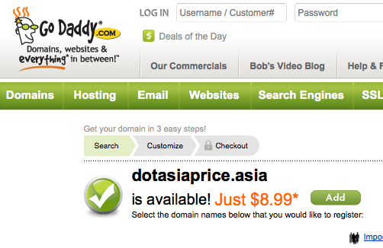

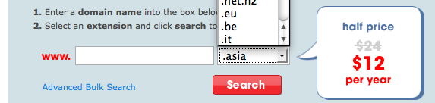

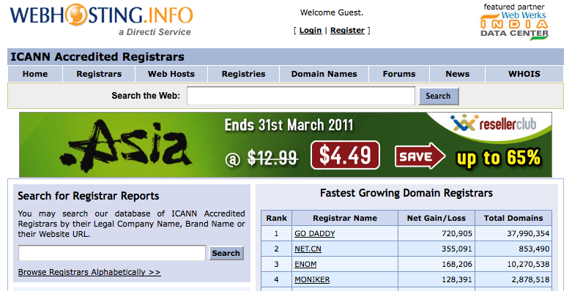



Notes:
Aust domains – crazy domains
Key System retail
NSI

Slide 9

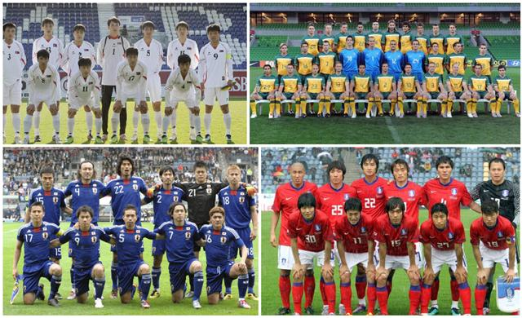
DotAsia Cheering for Asian Teams
.Asia Playtime Promo @ World Cup 2010

Slide 10

.Asia for the Asian Games

Slide 11
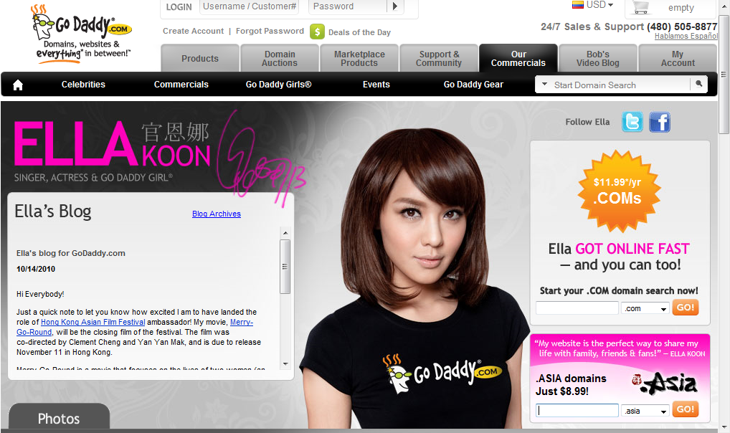
Ella Koon as 1st Asian GoDaddy Girl

Slide 12


Lesley.Asia Video

Slide 13
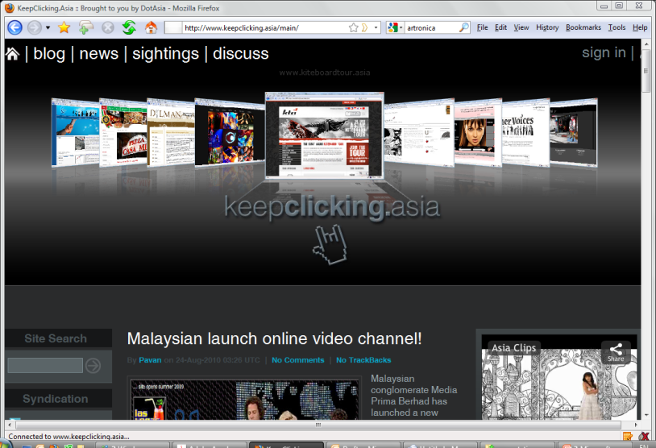
KeepClicking.Asia
Notes:
.Asia News Letter for end users and registrars
13

Slide 14

SunZi.Asia: The Art of War for Domaining

Slide 15

http://Domains.Asia
Notes:
15

Slide 16
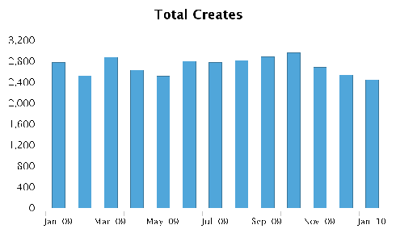
Year 2: 2009 – Development

Slide 17
Year 3: 2010 – Growth

Slide 18
Year-to-year Growth in New Creates

Slide 19
New Creates Growth
Year-to-year 28% growth
Month-to-month 5.5% in 2010
Total Domains: ~200,000
Total Domain Years: ~

Slide 20
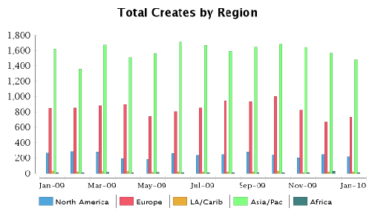
Asia Embracing .Asia Domains
2008
2009

Slide 21
2010 New Creates - Top 12 Economies 7 of Top 10 in Asia
Notes:
NOTE:
Registration from Auz came from mainly – Go Daddy / MIT / Planet Domain
De – Cronon / Key / internetX
CN - Todaynic.com / Go Daddy / Xinnet
US - more of a long tail, most come from GD
IN – Directi and net4
SG – Go Daddy and IPmirror
Virgin islands – Domainer – Registrar: Dynadot

Slide 22
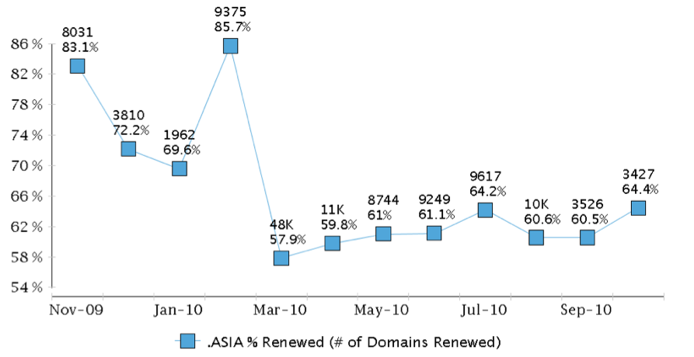
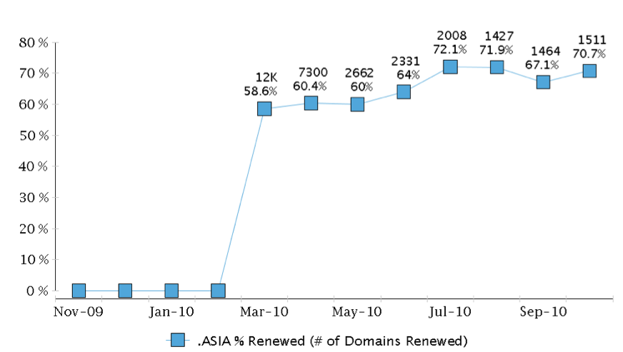
Developing Renewal Rates
1st Year Renewal Rates ~60%
2nd Year Renewal Rates ~70%

Slide 23
Charter Eligibility Requirements
Introduction of CEA Contact
Charter Eligibility Administrative Contact
An Administrative Contact with an Asian Address
Charter Eligibility Declaration Contact
Legal Entity in Asia
Implemented in October 2010

Slide 24
Promoting Mass Market Awareness of .Asia

Slide 25

AsianFilmAwards.Asia
The Asian Oscars

Slide 26
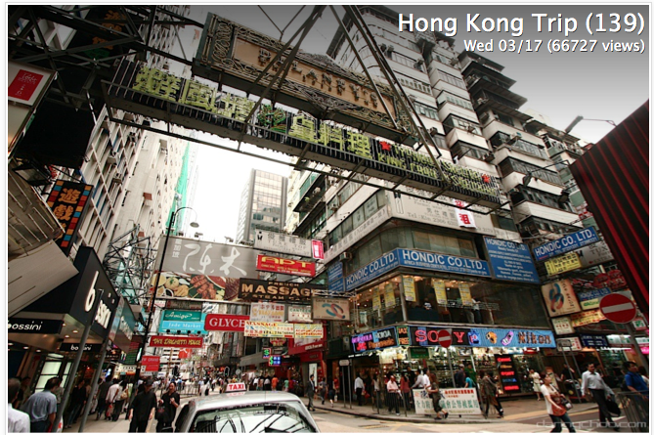
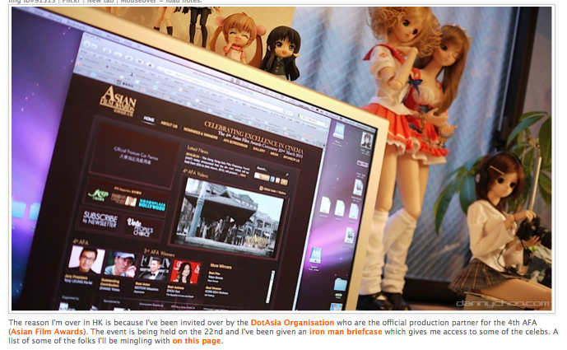
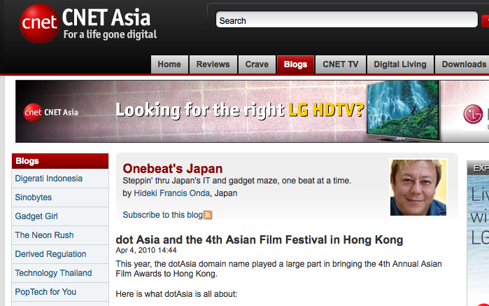
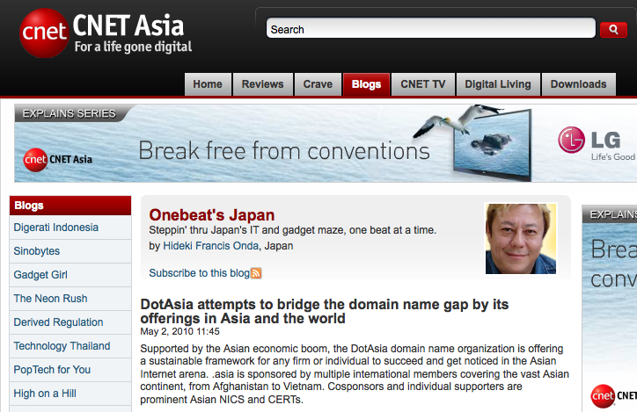

Extensive Social Media Coverage
Notes:
Asian Film Awards and bloggers
26

Slide 27
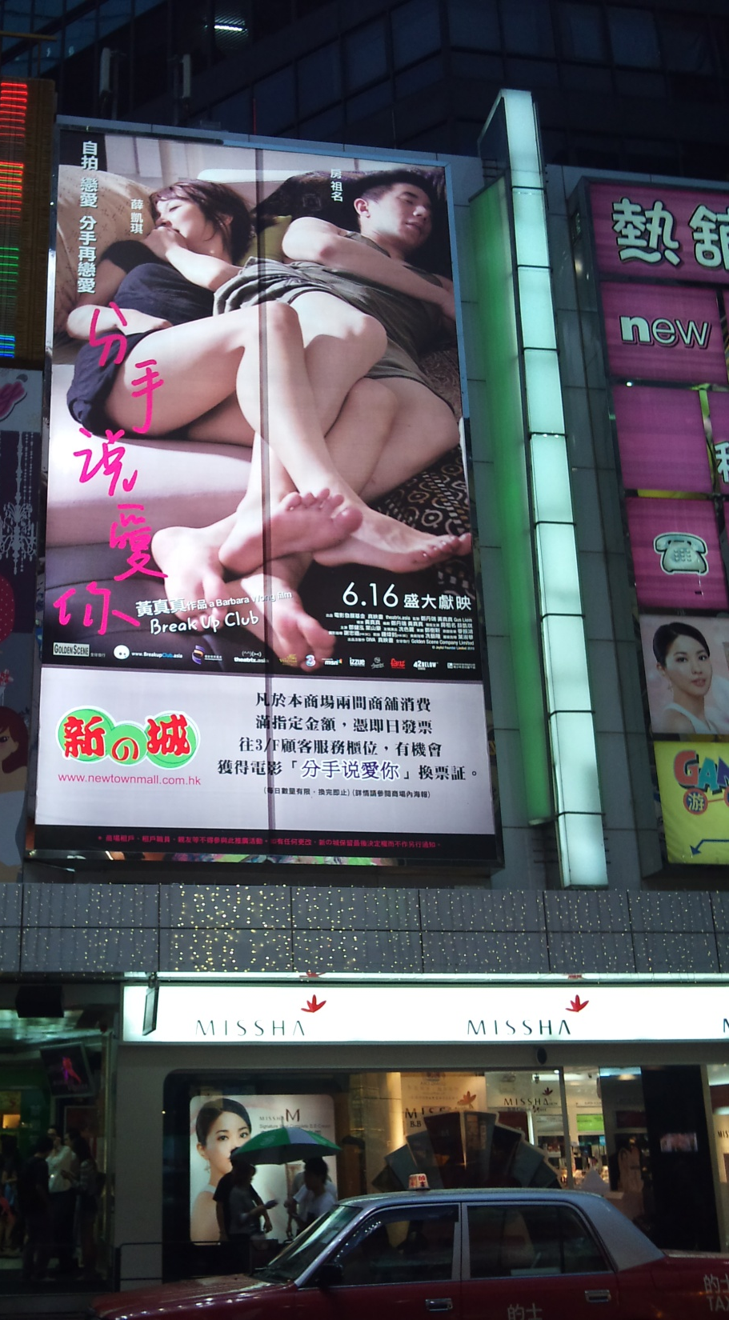


BreakupClub.Asia
Feature film starring Jackie Chan’s son
Social networking site for the heartbroken

Slide 28

DreamHome.asia

Slide 29


Slide 30

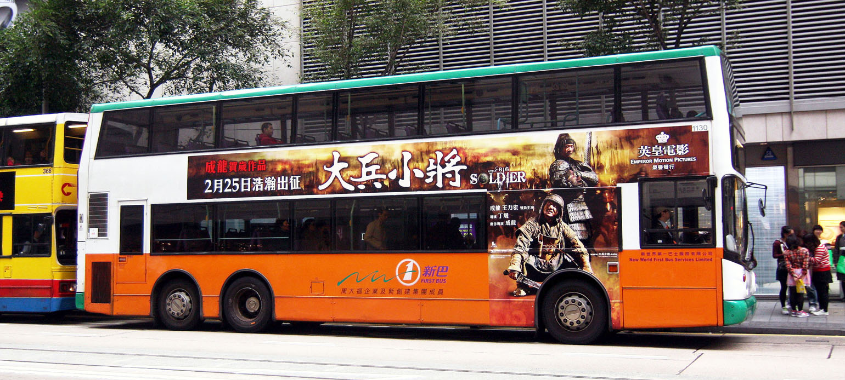

Slide 31
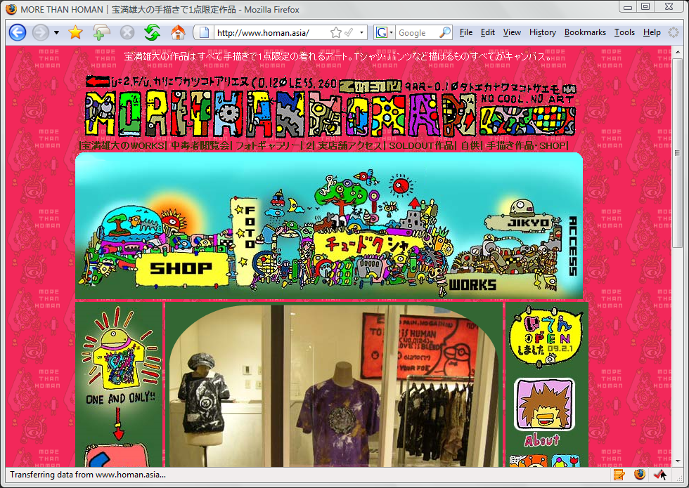
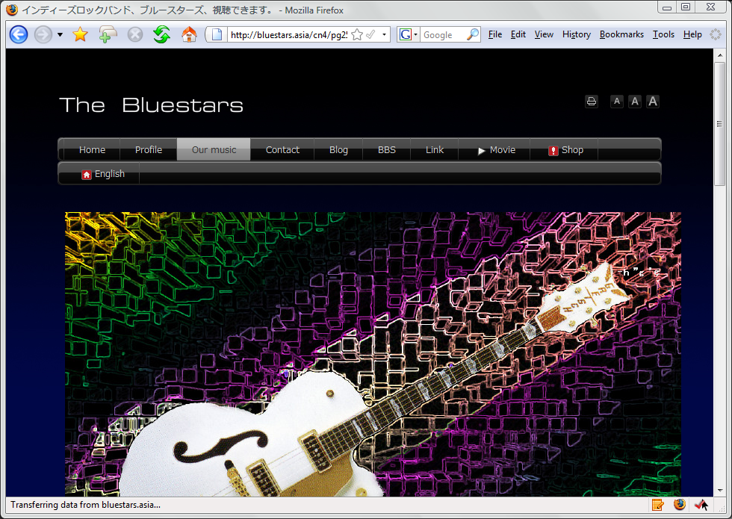



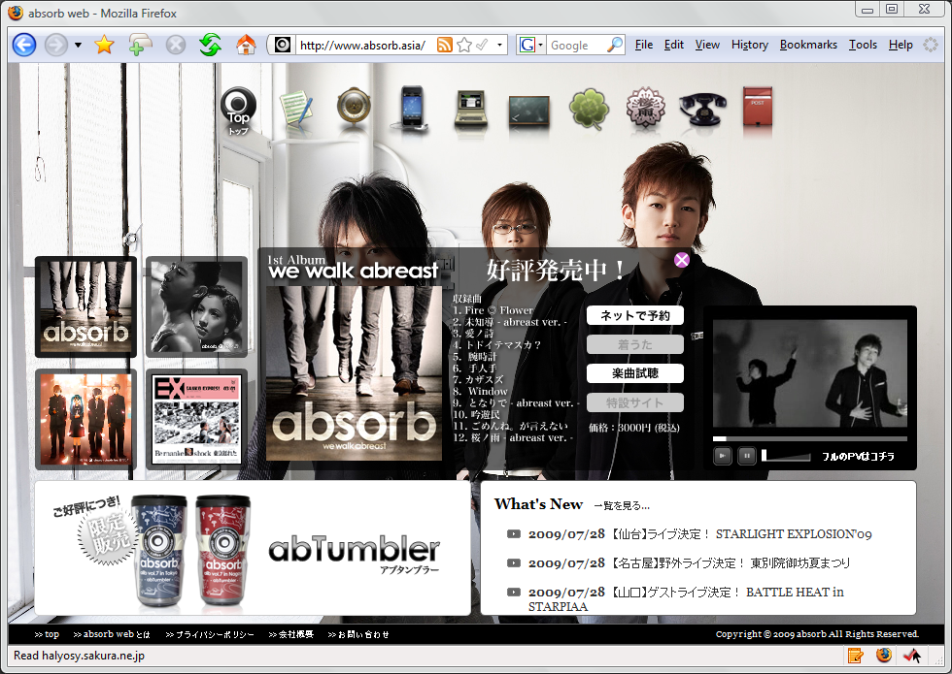
.Asia for Artists & Celebrities…
homan.asia
bluestars.asia
angelababy.asia
www800.asia
morimori.asia
absorb.asia

Slide 32

Filmbiz.Asia

Slide 33
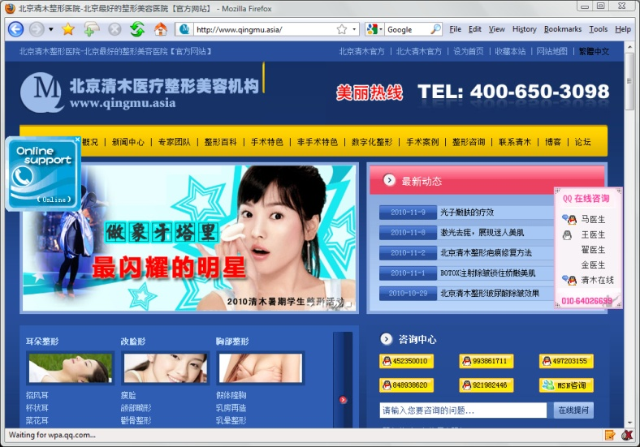
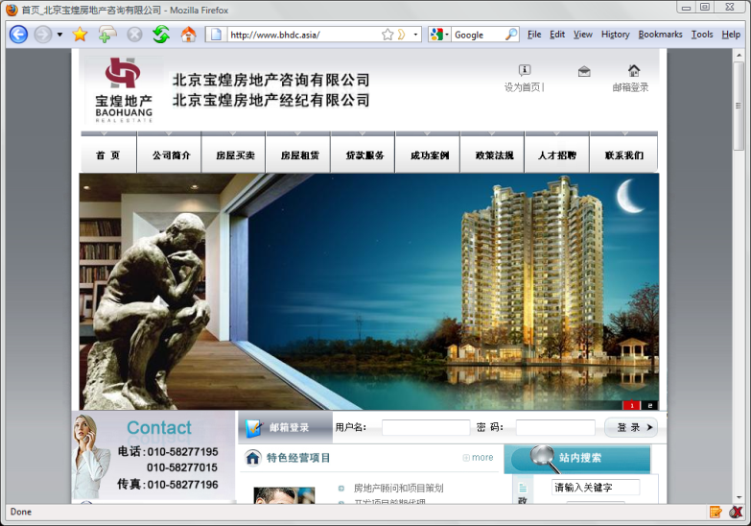
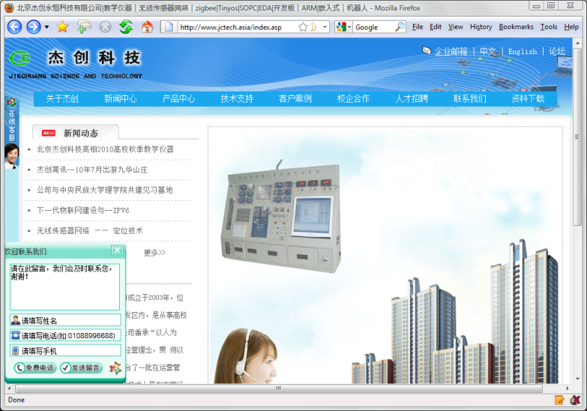
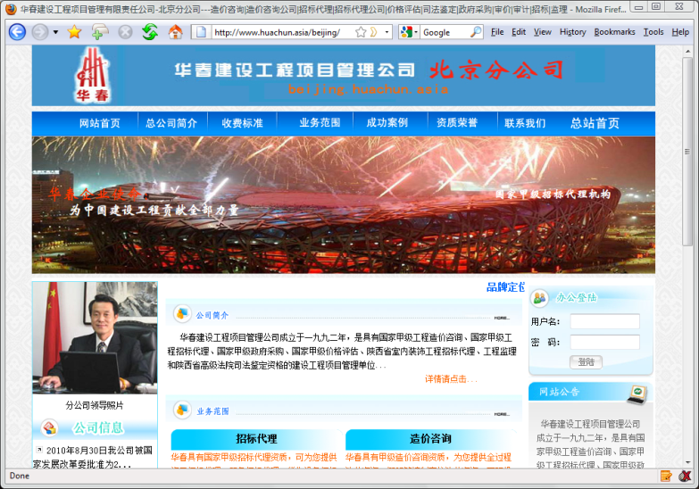
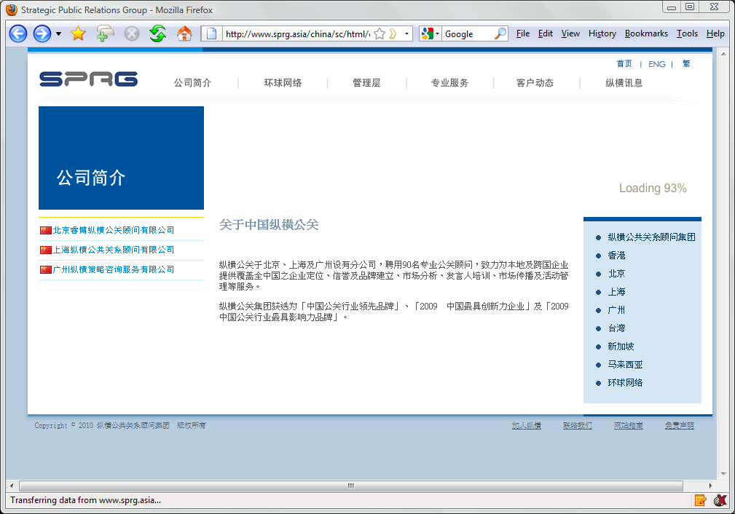
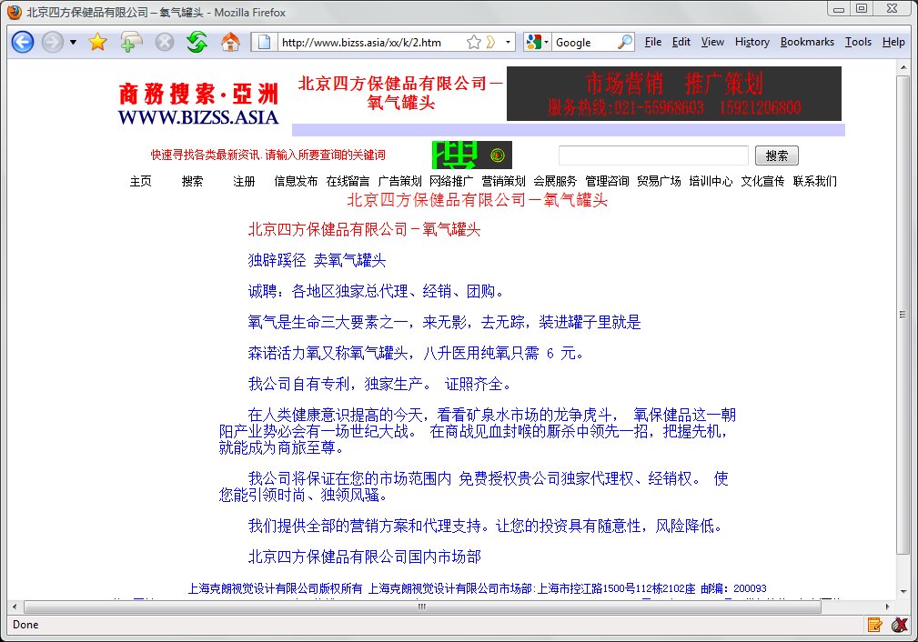
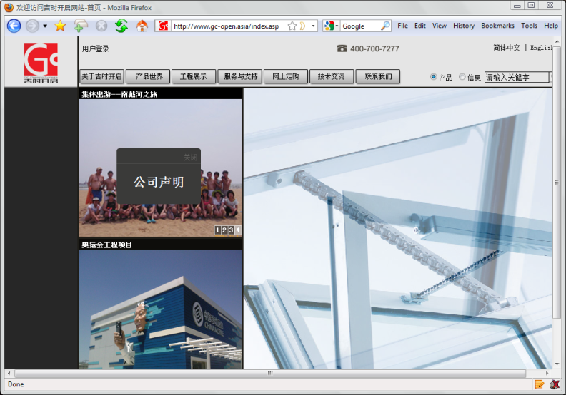
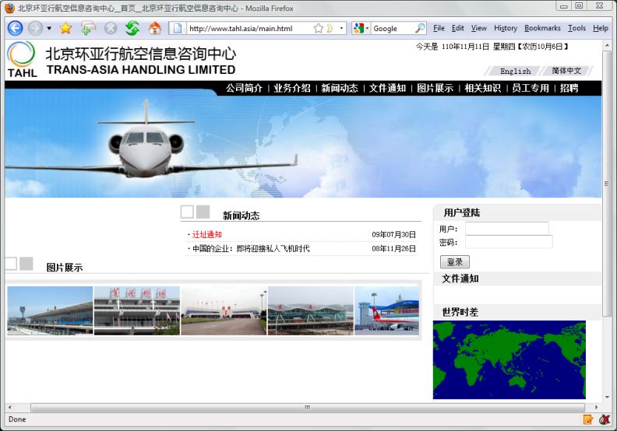

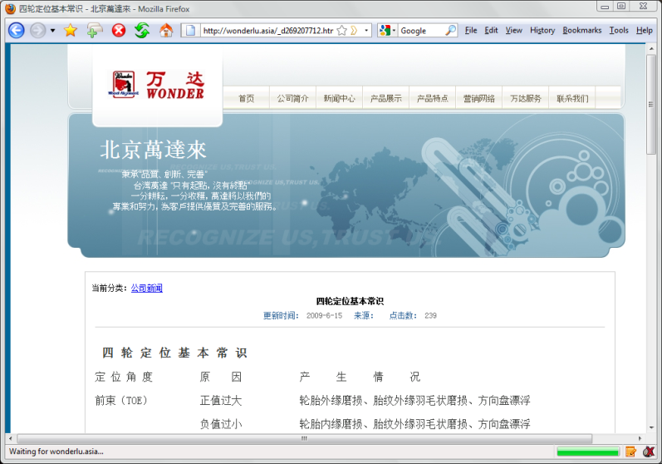
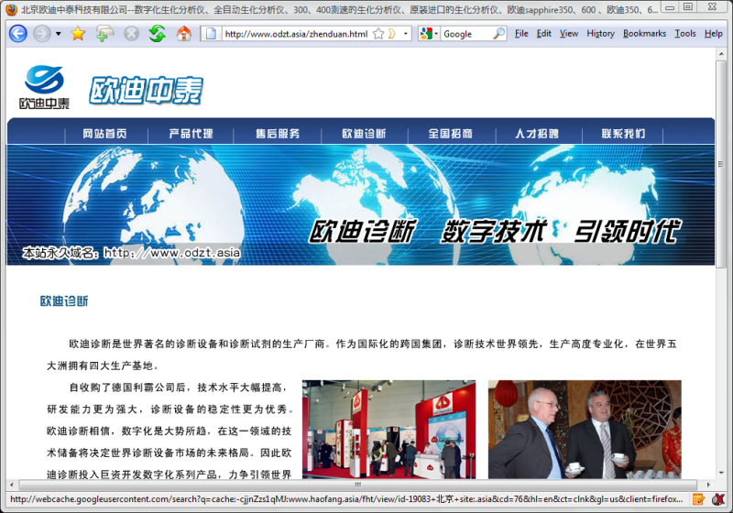
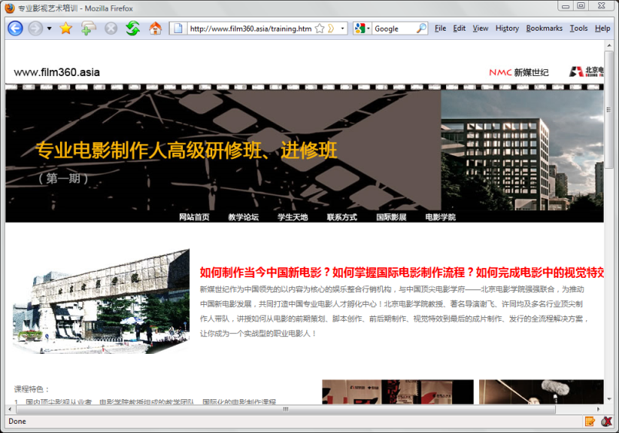
.Asia used by Companies in Beijing
www.qingmu.asia
www.bhdc.asia
www.jctech.asia
www.huachun.asia
www.sprg.asia
www.bizss.asia
www.gc-open.asia
www.tahl.asia
www.jingjia.asia
www.wonderlu.asia
www.odzt.asia
www.film360.asia

Slide 34
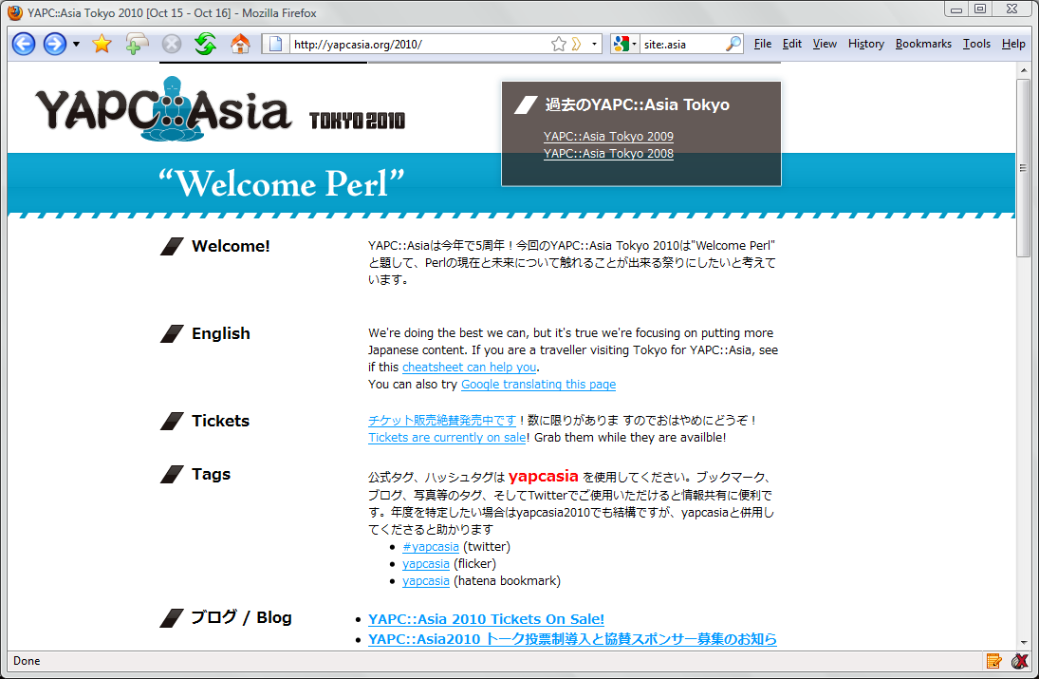
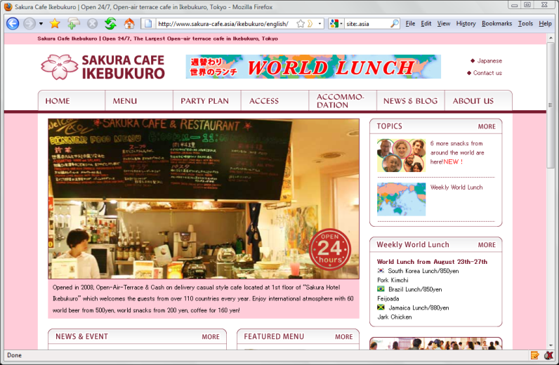
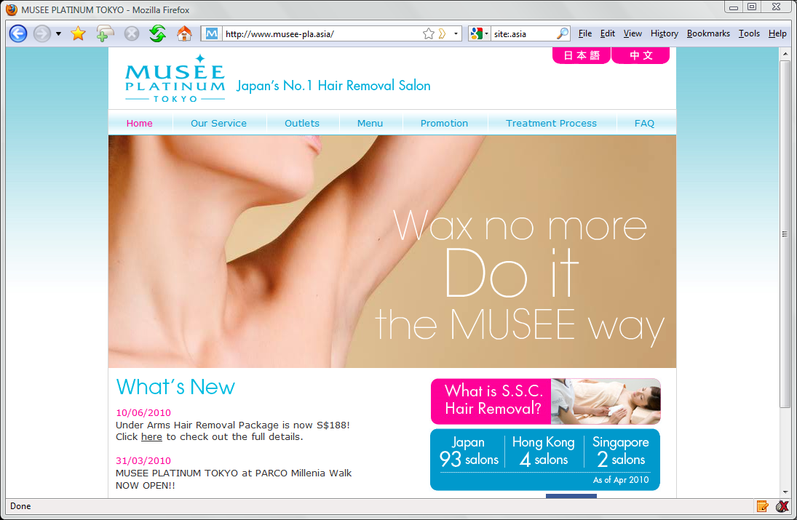
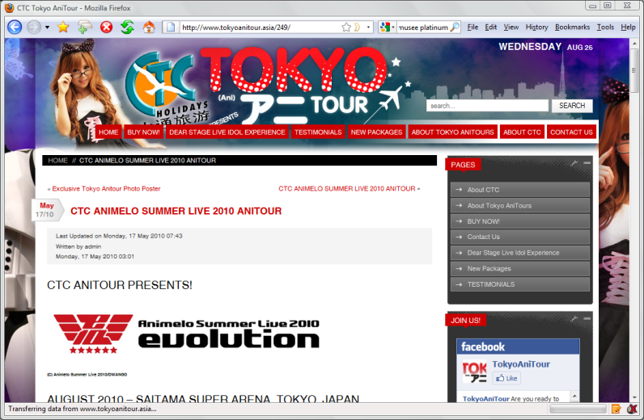

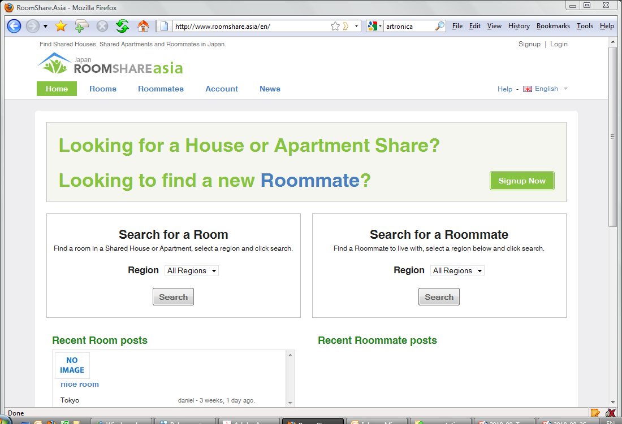
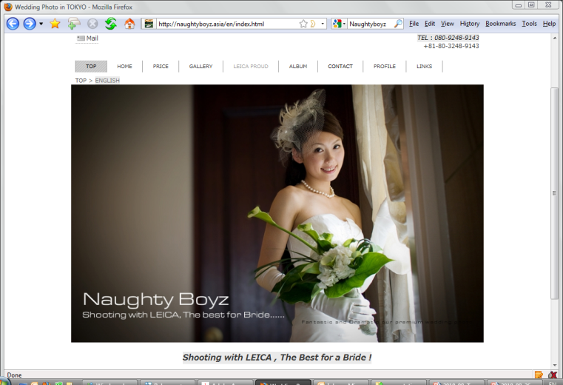
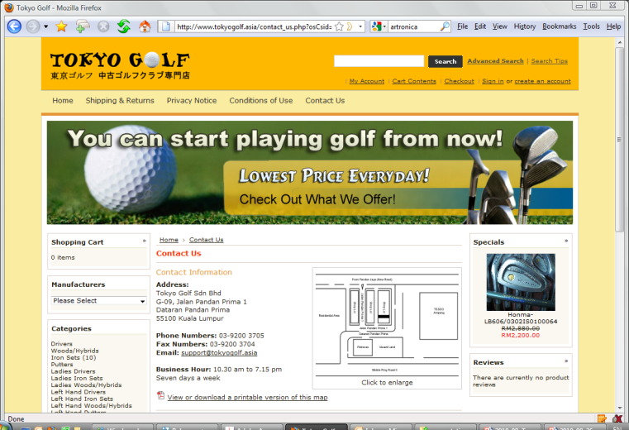
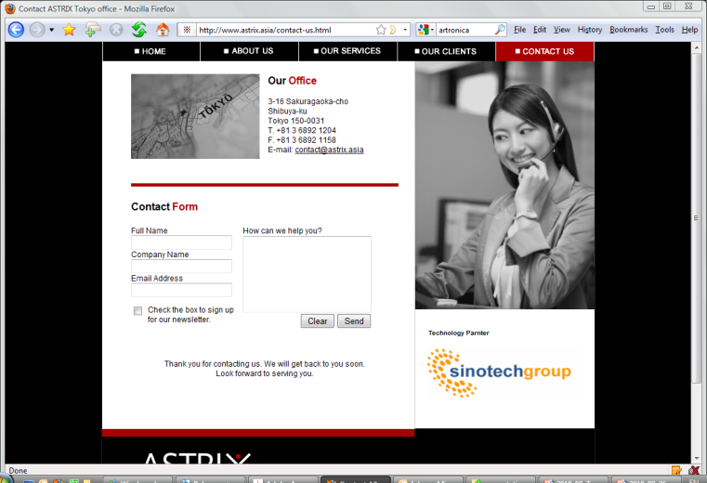
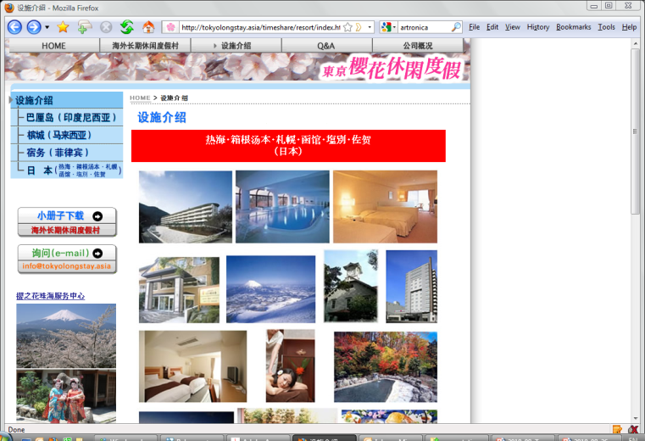
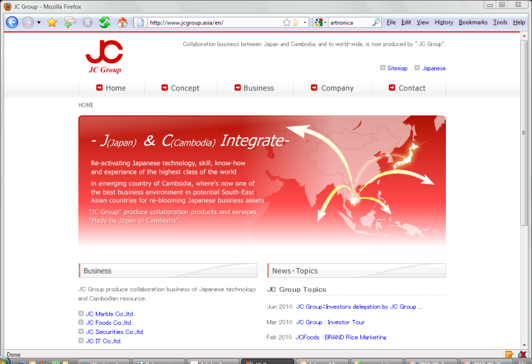
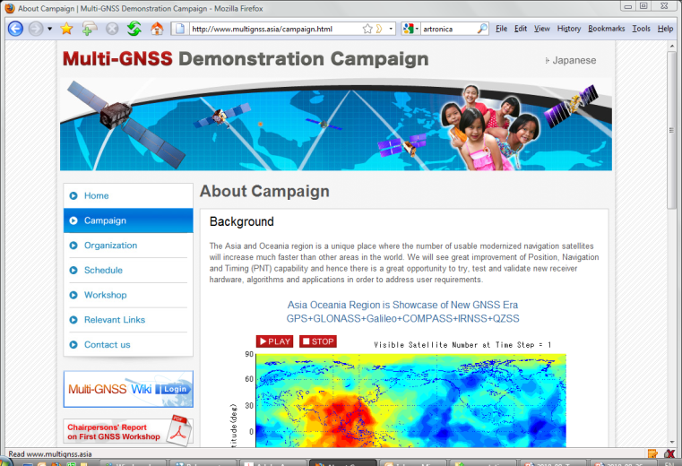
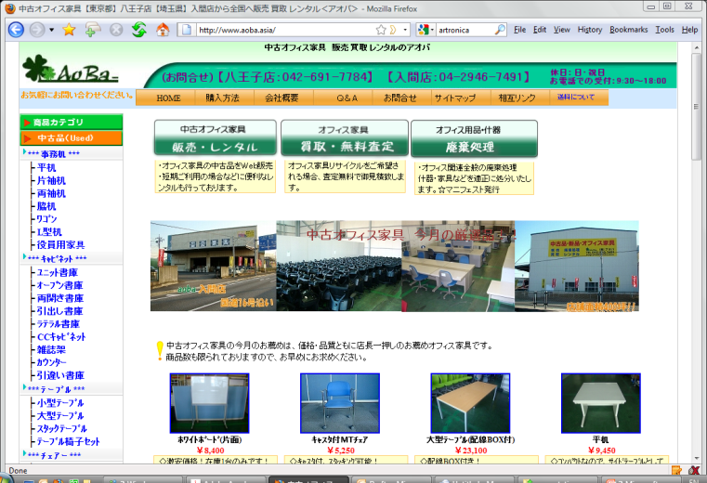
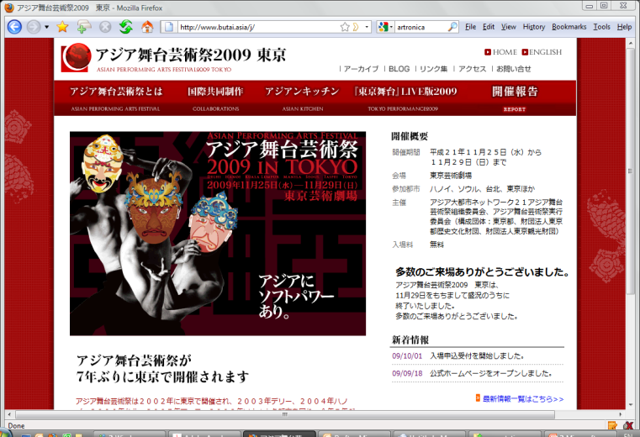
.Asia in Tokyo
yapc.asia
musee-pla.asia
gbes.asia
sakura-cafe.asia
tokyoanitour.asia
roomshare.asia
tokyogolf.asia
naughtyboyz.asia
astrix.asia
tokyolongstay.asia
aobo.asia
multignss.asia
butai.asia
jcgroup.asia

Slide 35

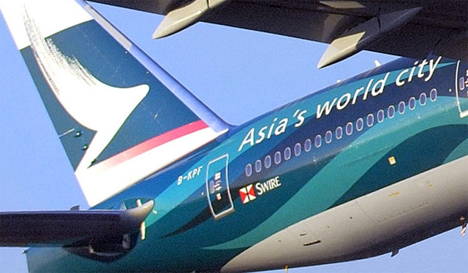


Slide 36
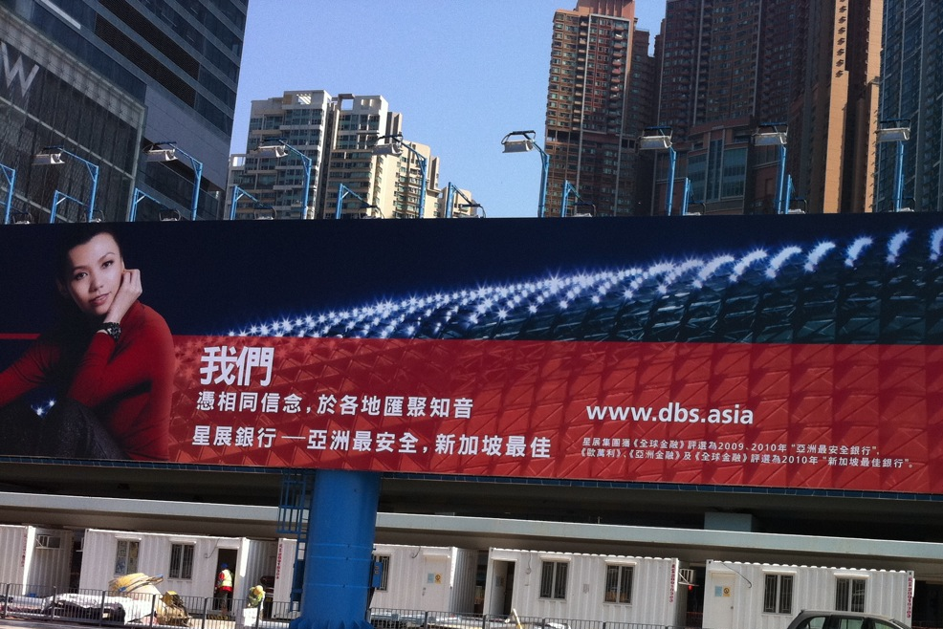

Slide 37

Regus.asia
@ APTLD Meetings Hong Kong 2011

Slide 38
Understanding the Evolving Asia Internet Marketplace

Slide 39
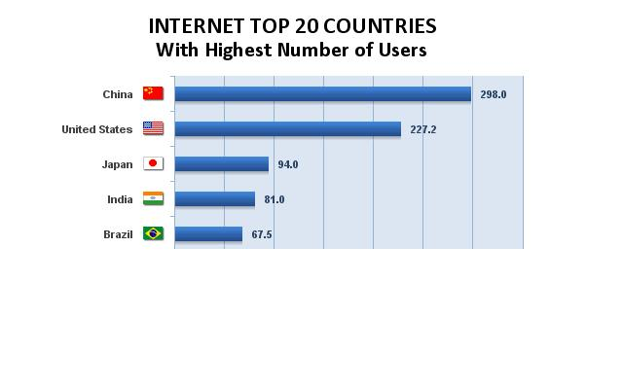
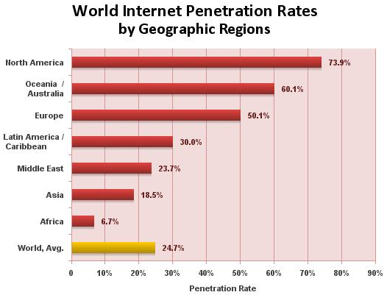
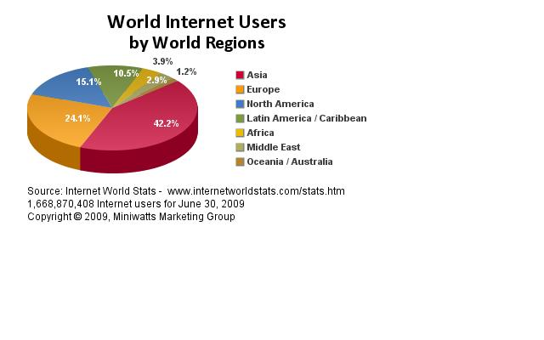
Growing Internet Population in Asia
Source: Internet World Stats

Slide 40

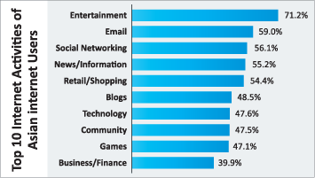

Bulk of Asia’s Population Under 30: 38 Hour Day 4 Things at Once
Friends Matter: Social Networking
Content Matters: People are Media
Cutting Through Matters: Relevance

Slide 41
Trends in Asia User Behaviors
Bargain seekers:
58% of Asian internet users say they made online purchases as a result of a coupon or offer they received in an email
78% to compare products, 75% for bargains
Music is expected to drive Asia’s mobile market with US$6.72 Billion by 2013
Asia leads the world in mobile shopping, with 8 out of 10 reported mobile shopping activity and 23% making a purchase in a month

Slide 42
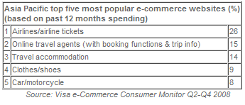
Strong Growth in Online Spending
Asian eCommerce consumers spending increased (to avg. US$3,109) despite challenging economic conditions (Visa e-Commerce Consumer Monitor)
Market research firm Euromonitor International forecasts online sales in Asia Pacific expected to reach in excess of US$71 billion by 2012
Next 5 years, shifting online population and growing spending power among Asian consumers means that Asian markets will represent a far greater % of the online consumers than they do today. (Forrester Research)

Slide 43


Sustained Growth in Online Ad Spend in Asia
Online Ad Spending to Grow by about 30% to over US$20 Billion by 2012
Online advertising saw sustained growth throughout Asia, compared to a 9.8% contraction in total advertising spending worldwide
Nielsen Company reported double digit growth for Q1 2010 advertising spending in Indonesia (26% -- US$1.27 billion), Taiwan (22.8% -- US$299.5 million) and Thailand (10.8% -- US$664.4 million)
Nielsen’s Hong Kong office reported that online ad revenues reached US$32.7 million in Q4 2009 to boost full year spending to US$111.4. The total number of advertisers and campaigns more than doubled from Q4 2008 to Q4 2009, signaling an acceptance of online ads among advertisers in Hong Kong.
Fastest Growth in Online Ad Spending Expected to be in Asia

Slide 44
Asia Market Integration
Since Jan 1, 2010: China + 10 South East Asian Countries implemented the
China ASEAN Free Trade Area (CAFTA)

Slide 45

.Asia improves SEO
Searching: Media Asia
2 generic and highly searched keywords
media.asia ranks #1

Slide 46

Success of “.Asia” Domain Critical to Success of DotAsia Organisation
DotAsia as a not-for-profit organisation with a mandate to promote Internet development and adoption in Asia.

Slide 47


Slide 48

www.olpc.asia

Slide 49

CreativeCommons.asia

Slide 50

Paragon100.asia

Slide 51

APEA.Asia

Slide 52

NetMission.Asia
Class of 2009
Completed Training
ICANN / APNG APNIC / APNG
Community Projects:
Children’s Carnival
Youth & Family → Pilot for HK gov supported large scale Internet education program (hiring 500 youth)
Middle-Aged Women Program → Internet training for disadvantaged middle-aged women
Elderly Survey
Youth IGF Camp

Slide 53


Slide 54

Asia Open Source Software Centers

Slide 55

rIGF.Asia
Over 350 participants from over 20 countries across 3 consecutive events

Slide 56


Slide 57


Slide 58

Digital Inclusion Grants Fund

Slide 59


Slide 60
Strategic Community Contributions
Reduced Direct Cash Sponsorships
Cost Recovery Approach
Utilization of .ASIA Domain as a requirement
Self-Sustainable Projects
Efforts & Expertise based Contributions

Slide 61
Overcoming Challenges in 2010
Settlement of Legal Challenges
Delays in IDN.Asia Launch
ICANN Approval Process
Adding Hong Kong Characters to CDNC Tables
Consideration of Chinese IDNs and Japanese IDNs existing in same “.ASIA” zone

Slide 62


IDN.Asia Launch 2011
March 2011 – Pioneer Domains Program
2011 Q2 – Sunrise
2011 Q3 – Landrush

Slide 63

DNSSEC.Asia
.ASIA TLD Signed in November 2010
Workshop / Seminar / Advocacy Series

Slide 64
.Asia Financial Report
Fiscal Year Ending September 30, 2010

Slide 65
Financial Report
Fiscal Period
Oct 1, 2009 – Sep 30, 2010
Fourth Fiscal Year
Auditor
BDO Limited
Currency
Expressed in USD

Slide 66
Financial Report
Financial Statements
Operating Expenses
Investment Portfolio

Slide 67
Financial Statements

Slide 68
Income Statement (Oct 1, 09 to Sep 30, 10)
Income (Recognized) | $4,338,314
Cost of Sales (Recognized) | -$1,301,199
Gross Profit | $3,037,115
Other Income (Interest & Misc) | $246,124
Operating Expenses | -$1,309,950
Other Costs | -$13,442
Profit before taxation | $1,959,847
Taxation | -
Profit for the period | $1,959,847

Slide 69
Balance Sheet (as at Sep 30, 10)
Fixed Assets | $71,640
Current Assets
Cash & Bank Deposits | $1,917,873
Available-for-sale Investments | $3,116,522
Accounts Receivable | $40,915
Other Receivables, deposits & Prepay. | $811,766
Deferred Expenses | $581,528
Total Current Assets | $5,887,076

Slide 70
Balance Sheet (Cont'd)
Current Liabilities
Accounts payable | $54,633
Accruals | $561,994
Deposits Received | $1,670,141
Deferred Income | $1,691,991
Total Current Liabilities | $3,978,759
Non-Current Liabilities
Loan Payable | $574,519

Slide 71
Equity
Retained Earnings (Loss) | -$705,432
Current Earnings (Profit) | $1,959,847
Unrealized Gain on Investments | $151,023
Total Equity | $1,405,438

Slide 72
Summary
Total Assets | $5,958,716
Total Liabilities | $4,553,278
Total Equity | $1,405,438
Total Liabilities & Equity | $5,958,716

Slide 73
Operating Expenses
Salaries & Professional Fees | $703,759
Travel & Outreach | $213,696
Marketing & Promotion | $173,389
Community Contributions | $102,389
Other Expenses | $116,716
Total Operating Expenses | $1,309,950

Slide 74
Operating Expenses
Total Operating Expenses: $1,309,950

Slide 75
Investment Portfolio (Current)
Investment Portfolio at JP Morgan
Current Market Value: $4,099,352
Conservative portfolio aiming at long-term investment
Mainly investing in bonds which generate steady income from coupon interests issued regularly

Slide 76
Investment Portfolio (Breakdown)
 | Value | % | Annualized Yield
Cash & Cash Equiv. | $588,436 | 14% | 0 - 0.2%
Fixed Deposits | $701,358 | 17% | 0.6 – 0.78%
Fixed Income (Bonds) | $2,809,558 | 69% | 6.64%
Total | $4,482,282 | 100%

Slide 77
Overview
17:00 Welcome Remarks
17:20 DotAsia Operations in 2010
17:50 Audited Financials (Fiscal Year 2009-2010)
18:10 Member Resolution (Ratification of Board Elections)
18:15 Community Development Updates
18:30 Technology Provider Update (Afilias)
18:40 DotAsia Strategic Plans 2011
18:50 Open Discussion
19:00 AP* DotAsia Joint Dinner

Slide 78
Ratification of Board Elections 2011 Results

Slide 79
Board Elections 2010
Seats up for election
4 seats from Sponsor Member Category
1 seat from Co-Sponsor Member Category
Development of Election Procedures
First Draft Posted: Nov 10, 2010
Final Procedures Posted: Nov 29, 2010
Nominations Process
December 1, 2010 (Wed) – Nomination Period Begins
January 5, 2011 (Wed) – Nomination Period Ends
5 weeks

Slide 80
Highlights of Procedures
Nominations & Voting Process (via email)
Number of Eligible Members: 28
Eligible No. of Nominations & Seconds: No. of Vacancy in Category
Eligible No. of Votes: No. of Vacancy in Category
Sub-Regions (Sponsor Category):
At least 1 member from each of the 4 Sub-Regions
North and Northeast Asia
South and Southeast Asia
Middle East, Asia Minor and Eurasia
Australia and Pacific Asia
Remaining directors already fulfill diversity requirements

Slide 81
Nominations Recieved
Candidates Nominated: 5
Sponsor Category: 4
Co-Sponsor Category: 1
Candidate | Nominated by: | Seconded by:
Atsushi ENDO | JPRS (.JP) | SGNIC (.SG)
LIM Choon Sai | JPRS (.JP) | CNNIC (.CN)
Dr. THAM Yiu Kwok | SGNIC (.SG) | CNNIC (.CN)
Xiaodong LEE | SGNIC (.SG) | JPRS (.JP)
Candidate | Nominated by: | Seconded by:
Tommy MATSUMOTO | APNG | APNIC

Slide 82
Voting Process
Sponsor Members
Number of candidates (4) standing for election in the Sponsor Member category is equal to the number of vacancies in the category (4)
No voting required
Co-Sponsor Members
Number of candidates (1) standing for election in the Co-Sponsor Member category is equal to the number of vacancies in the category (1)
No voting required

Slide 83
Board Elections 2010 Results
Elected Board Members (serving until AGM 2013):
Atsushi ENDO (re-elected)
LIM Choon Sai (re-elected)
Tommy MATSUMOTO (re-elected)
Dr. THAM Yiu Kwok (re-elected)
Xiaodong LEE (newly elected)
Other Elected Board Members (serving until AGM 2012):
Che-Hoo CHENG
Joel DISINI
Stafford GUEST
Alireza SALEH
Dr. SIR Jae-Chul

Slide 84
Member Resolution:
Thank You LI Guanghao (Howard) for serving on the DotAsia board since the incorporation of the organization on September 12, 2006
Ratification of the Board Election 2011 Results. Congratulate all Elected Candidates
Welcome Xiaodong LEE to the DotAsia Board.

Slide 85
Community Development Updates

Slide 86
Community Relations & Projects
Ching Chiao VP, DotAsia chiao@registry.asia

Slide 87
Agenda
Membership
Advisory Council
Community Engagement
Policy Participation

Slide 88
Membership
New Sponsor Member
Hong Kong Internet Registration Corporation
Applied on Jul 2010
Approved on Sep 2010
New Co-Sponsor Member
Asia Pacific Internet Association
Applied & Approved on Feb 2011
In discussion with
.JO and .YE

Slide 89
Membership
Sponsor Member: 22
.AF, .BT, .CN, .HK, .ID, .IN, .IR, .JP, .KH, .KR, .KZ, .MN, .MO, .NU, .NZ, .PH, .SG, .TJ, .TH, .TW, .UZ, .VN
Co-Sponsor Member: 7
APNIC, APNG, APCERT, APTLD, APRALO, & PAN, APIA
Membership Briefing & Application is available on http://www.registry.asia/about/members.html

Slide 90
Advisory Council
- Policy consultation
- Governance on SCP fund and projects
Maria NG Lee Hoon (PAN)
Paul Wilson (APNIC)
Xue Hong (APRALO)
Hiro Hotta
Roy Ko (APCERT)
Jian Zhang (APTLD)
Izumi Aizu
Kanchana Kanchanasut (APNG)
Kilnam Chon
Khaled Fattal
Kenny Huang

Slide 91
Community Engagement
ICANN
Brussels Registrar reception
Regional event in Tokyo
Community.Asia booth in Cartegena
Collaboration with registrars & domainer groups
APrIGF
APRICOT / APNIC / APTLD / APNG / AP*
ISOC / INET / IETF
Cross-sector
Communic.Asia (with APNIC and APIA)
CIRC.Asia
Blogfest.Asia

Slide 92



Asia Pacific Regional Internet Governance Forum (APrIGF)
Held for the first time in Cyberport, Hong Kong, on June 2010
Over 60 international experts, 300 participants from over 20 countries to discuss the future and possibilities of regional and global collaborations on Internet governance issues.
Mr. Jeremy Godfrey, Government Chief Information Officer of the Hong Kong SAR opened the meeting, followed by welcome remarks by Mr. Markus Kummer, Executive Coordinator to the United Nations (UN) IGF Secretariat
Meeting consist of three parts:
Youth IGF Camp (June 12‐14)
Asia Pacific Regional IGF Roundtable (June 14‐16)
Hong Kong IGF Conference (June 17‐18)

Slide 93



12th APNG Camp in Hiroshima, Japan

Slide 94



13th APNG Camp in HK
21~24 Feb, 2011, rm S426~S427, HKCEC
29 fellows selected from 15 countries (2 from Africa)
Runs in parallel with NetMission program
Formalizing APNG local camp
Initiating Internet Museum Asia (IMAsia) and AP Online School projects

Slide 95

CIRC.asia
2008 – HKU
2009 – U. of Penn
2010 – PKU
2011 – Georgetown U

Slide 96



2010.Blogfest.asia
-- Connection with Social / Grassroot media
-- Collaborate with Tourism industry / gov’t
-- 2011 location candidates:
Singapore
Taiwan
Thailand

Slide 97







Slide 98



Community Engagement -- Social Media

Slide 99
Policy Participation
GNSO
Ching (council)
New gTLD program: Joint Applicant Support WG; Rec6 (Limited Public Interest); Board / GAC meeting in Brussels
Registration Abuse
Edmon
JIG (1-character / Variant / TLD acceptance) WG Co-Chair
International Registration Data WG Co-Chair
ALAC
Edmon Chung (council) and Pavan Budhrani (APRALO)
Regular update in GAC

Slide 100



DNSSEC.asia / Summit / Workshop

Slide 101
Thank you

Slide 102



We have a mission
“Your Job as the NetMission Ambassadors is to spread the knowledge of IT and the access to the Internet. You also need to raise people’s awareness of facilitating access to the Internet and contributing to the development of the Internet” – Vint Cert, Father of Internet
We have a mission!!
NetMission Ambassadors 2009-2010

Slide 103
Ambassadors Uniqueness
Young and passionate - their own Vision to create a cyber utopia
Knowledge based volunteers
An Autonomous working environment
An emphasis on international collaboration, and participation from all sectors
Participation in Regional and International conferences

Slide 104





Knowledge based volunteers

Slide 105




An Autonomous working environment

Slide 106



An emphasis on international collaboration, participation from all sectors
7
7

Slide 107
Participation in Regional and International conferences
12th APNG Asia Pacific Next Generation Camp, Hiroshima, Japan
United Nations Internet Governance Forum (UNIGF), Vilinus & Sharm El Shiekh, Egypt
Youth IGF, London UK
ICANN Meeting in Seoul, Korea
APNIC Meeting in Beijing, China

Slide 108
Overview
17:00 Welcome Remarks
17:20 DotAsia Operations in 2010
17:50 Audited Financials (Fiscal Year 2009-2010)
18:10 Member Resolution (Ratification of Board Elections)
18:15 Community Development Updates
18:30 Technology Provider Update (Afilias)
18:40 DotAsia Strategic Plans 2011
18:50 Open Discussion
19:00 AP* DotAsia Joint Dinner

Slide 122
DotAsia Strategic Plan 2011

Slide 123
Multi-Dimensional Growth
Expansion
Continue to develop channel
Launching of IDN.Asia
Horizontal Development
Support other TLDs
Explore New gTLD Opportunities
Vertical Development
Vertical Integration Deregulation
Secondary Market
Diversification
.Asia Domains & Other Investments
Leveraging Funding Sources

Slide 124
More Progressive in Development
Maturing organizational capacities
Revitalizing economy & industry
Diversification of revenue base
Developing new ideas that support “.Asia”

Slide 125
Key Considerations on Approach
Direction
Horizontal / Vertical / Multi-Dimensional
Principles
Social value / responsibility
Commercial value / sustainability
Synergistic value / leverage
Model
Technology / Knowledge Partners
Financial Partners
Conceptual Incubation

Slide 126





Slide 127

Open Source Registry-Registrar System

Slide 128







Every .Asia Domain Contributes to Internet Development in Asia

Slide 129
Highlights @ APRICOT-APAN
DNSSEC Asia Summit
Monday, Feb 21
9:30 AM – 12:30 Noon
HKCEC Room S221
OpenR.Asia BoF?
APrIGF 2011?
BOF: Wednesday, Feb 23 (S222)
Time: TBC

Slide 130
Joint AP* DotAsia Dinner
Ramas (www.ramas.asia)
2A -1 ,2/F, Sun Hung Kei Centre, 30 Harbour Rd, Wanchai (walking distance)

