Slide 1
DotAsia AGM 2010
Feb 28, 2010
APRICOT Kuala Lumpur

Slide 2
Overview
Review of DotAsia in 2009
Update from Afilias (Technology Partner)
Audited Financial Report
  Fiscal Year: Oct 2008 – Sep 2009
Community Development & Contributions
Strategic & Operational Plans
Member Resolutions
Open Discussion
Joint AP* Dinner

Slide 3
DotAsia in 2009

Slide 4
Strategic Directives in 2009
Mass market awareness and developing strong foundation of active Usage of .Asia domains
Deliver on mandate as a not-for-profit organization through strategic Community Projects through sustainable support & efforts & expertise based contributions
Remain Conservative on budget and begin to invest into mass market and awareness promotion

Slide 5
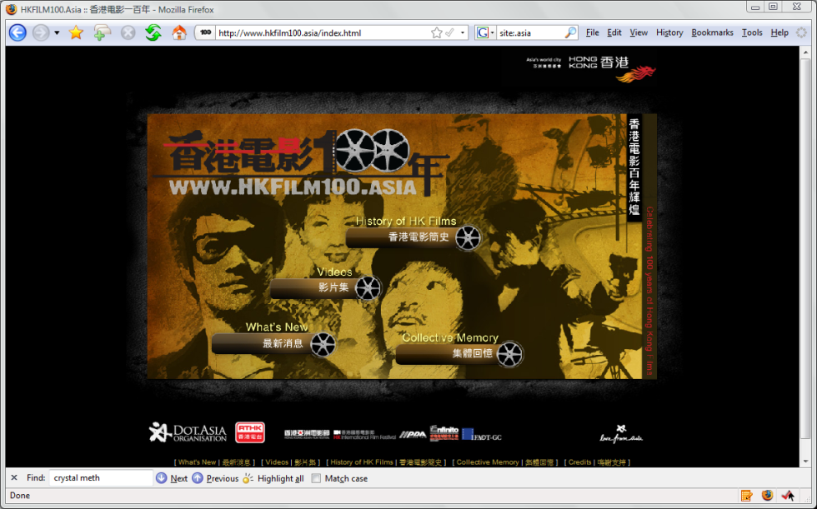
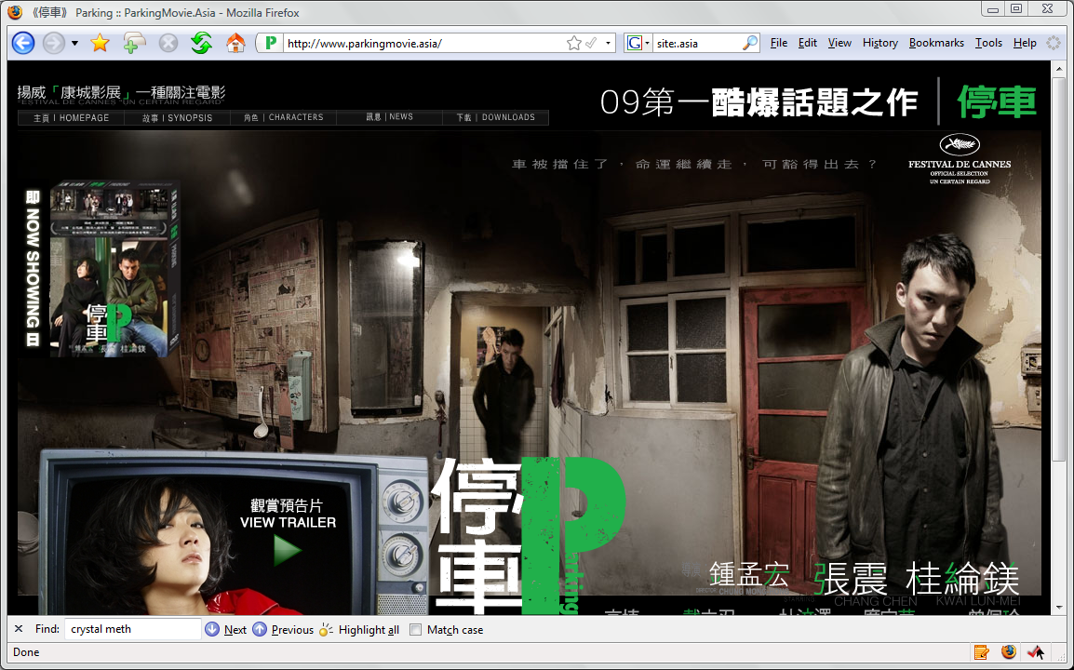

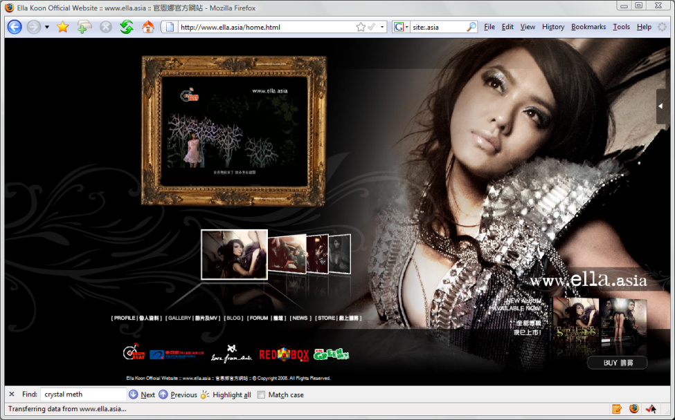
Building Mass Market Awareness
www.HKFilm100.asia
www.ParkingMovie.asia
www.HKIFFshop.asia
www.ella.asia

Slide 6
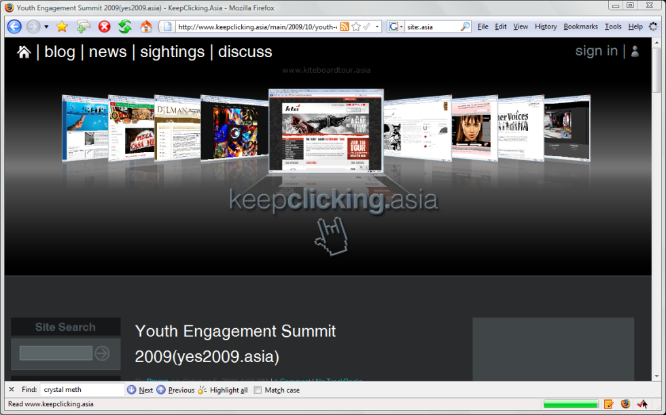
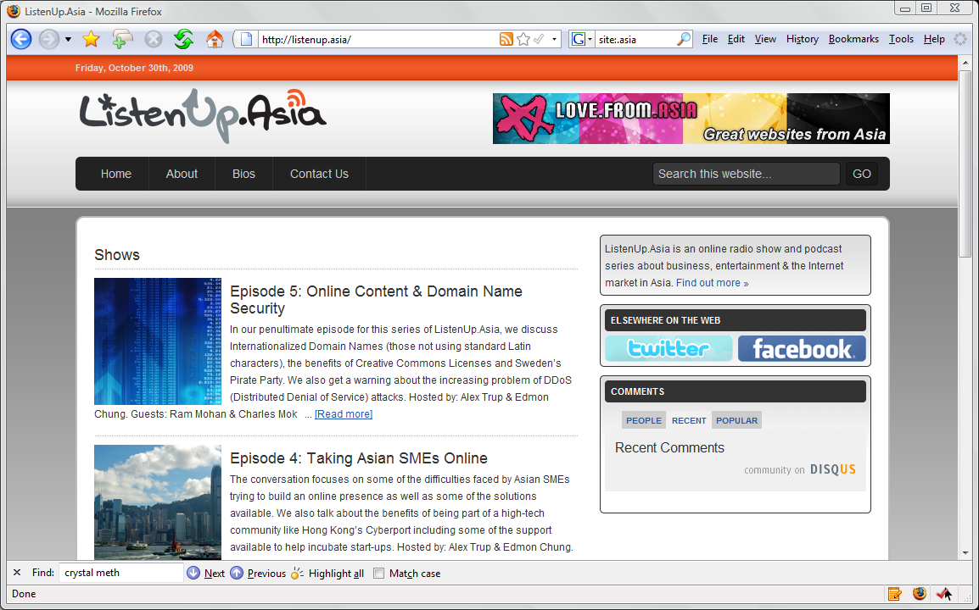

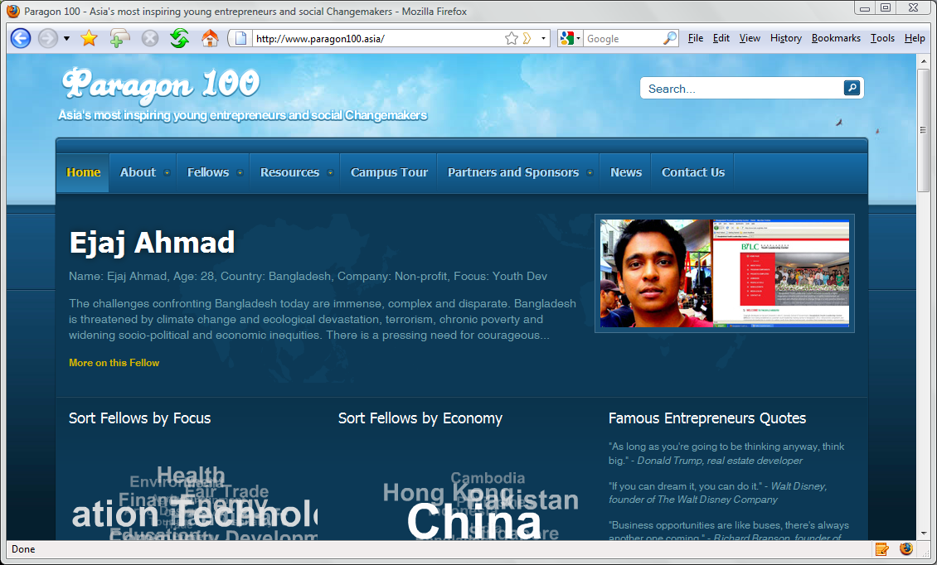
Developing Content & Community
www.KeepClicking.asia
www.ListenUp.asia
www.APEA.asia
www.Future100.asia

Slide 7
Other Projects & Activities in 2009
Marketing / Awareness: Goomusic.Asia | Whatsup.Asia | China Domain Industry Convention | ADNDRC Meeting | DomainFest | TrafficDownUnder | SYSTEM Munich | Double-Double | Home Market Growth | FreeB.Asia | Communic.Asia | DJMagFest.Asia | ……
Community Contributions: DSF.Asia | AP* Retreat (Manila & Beijing) | APXLDS.Asia | APNG Camp | CIRC.Asia | IPv6world.Asia | Chido.Asia | Interchallenge.Asia | ICANN.Asia | 3C Creativity Dialogue | GoGreenIT.Asia | IGF Workshop, HK | CVCF.cyberport.Asia | …

Slide 8

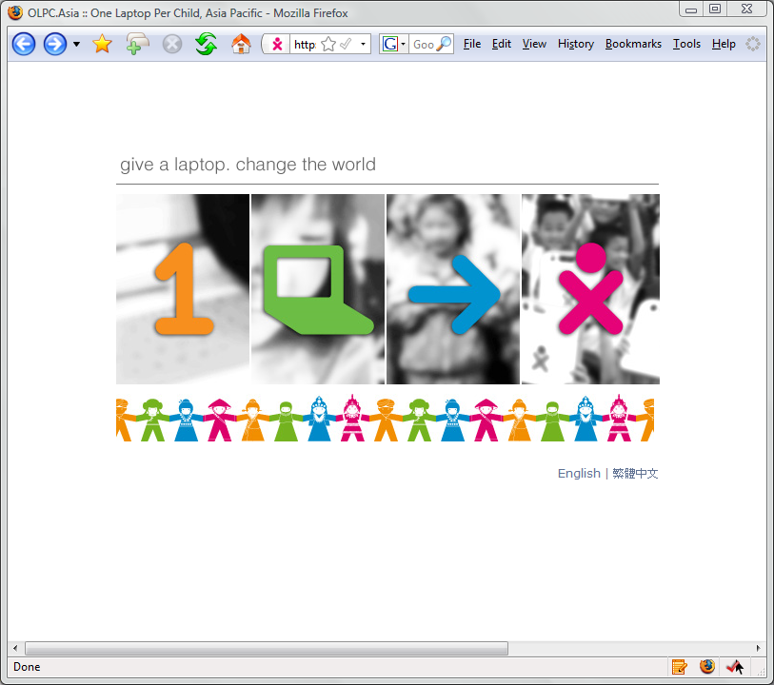
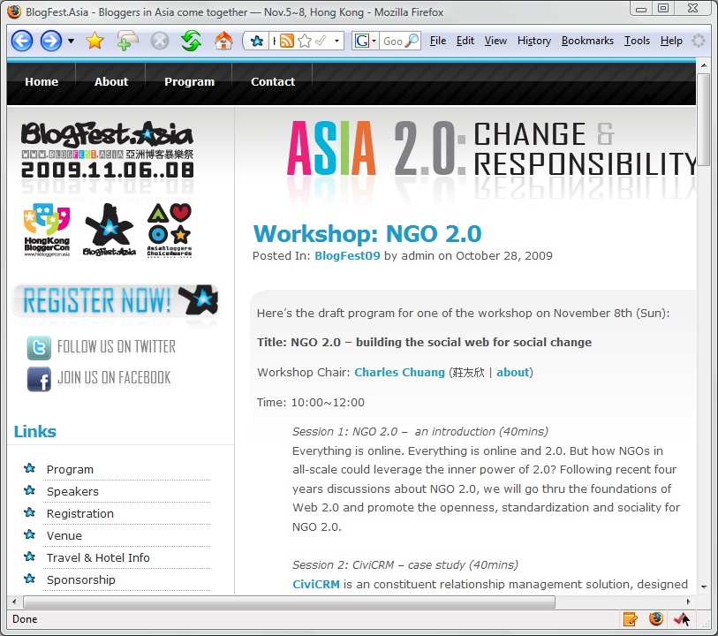
Major DotAsia Community
Projects in 2009
NetMission.Asia
OLPC.Asia
Blogfest.Asia

Slide 9
Inspiring Usage of .Asia…

Slide 10
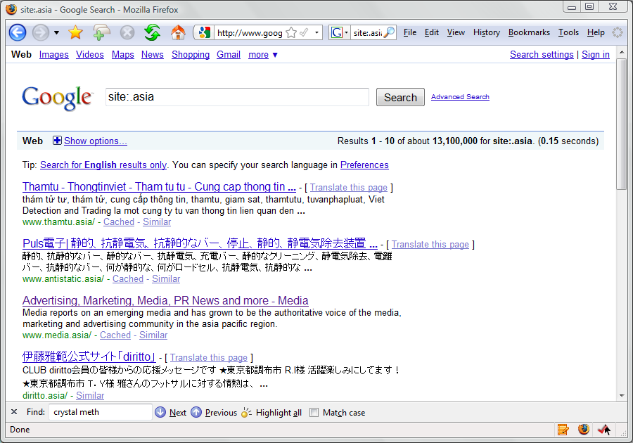

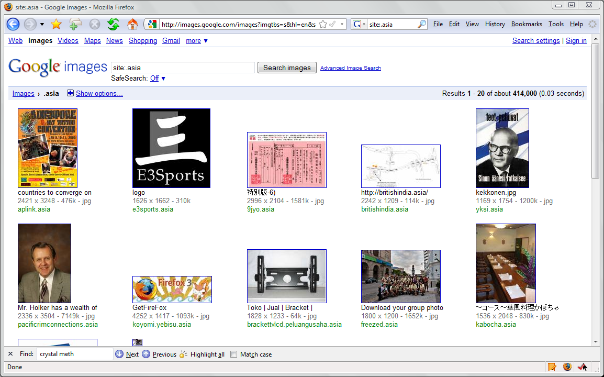
Growing Presence of .Asia on the Web
Grown from about 1.5M last year to ~13M
Growing on Alexa Top 1M: ~150 (0.015%)
Growing to >400K

Slide 11
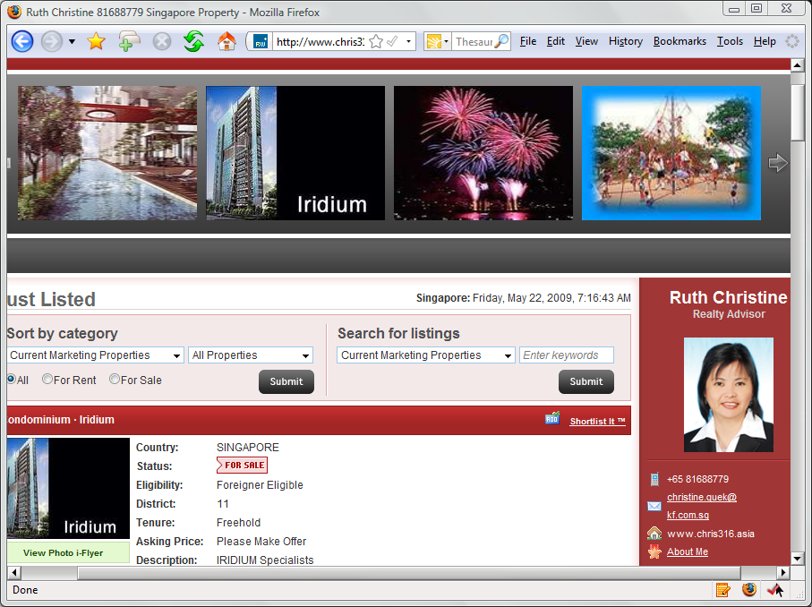
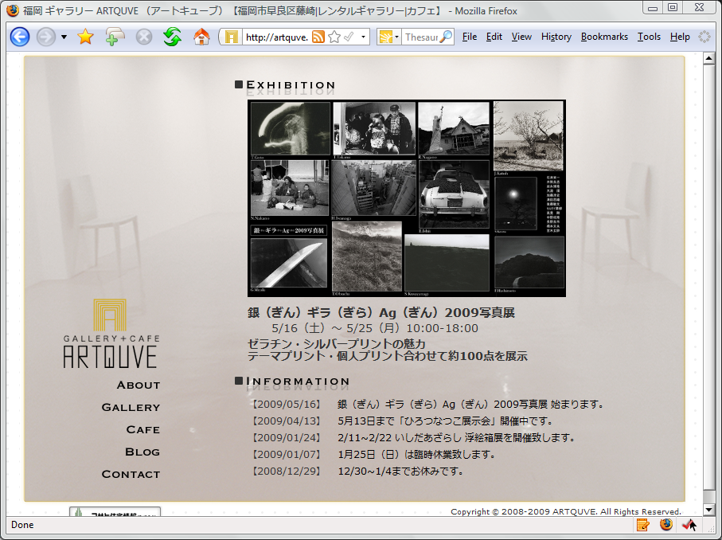
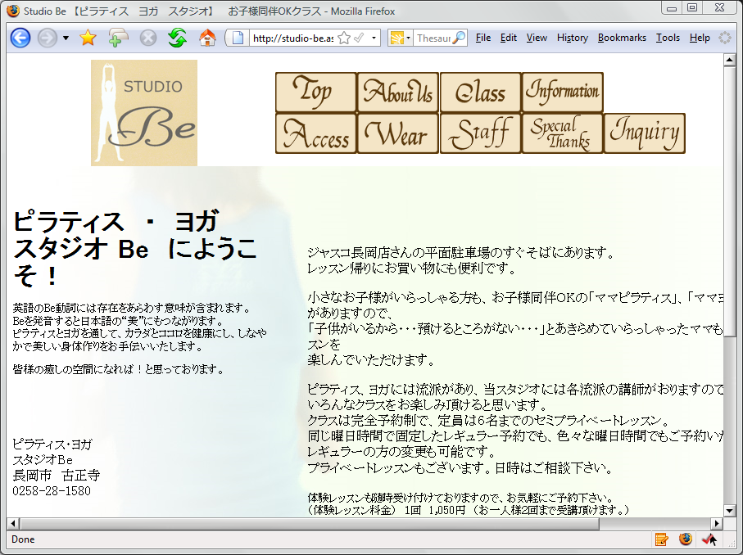

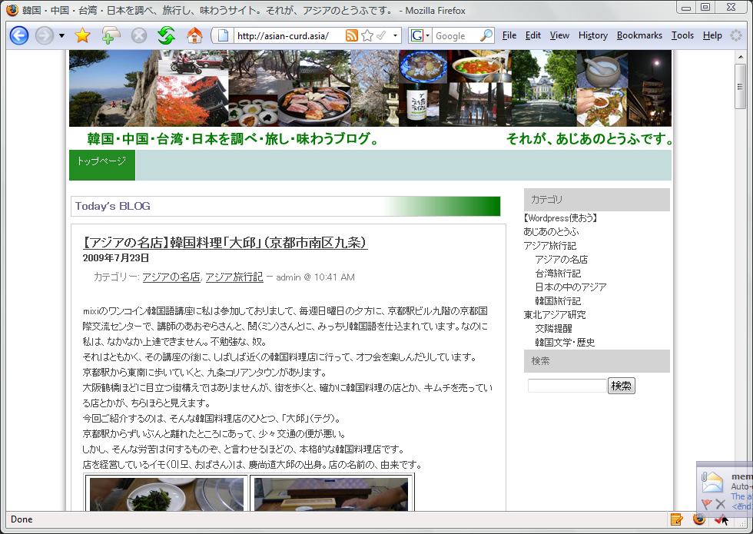
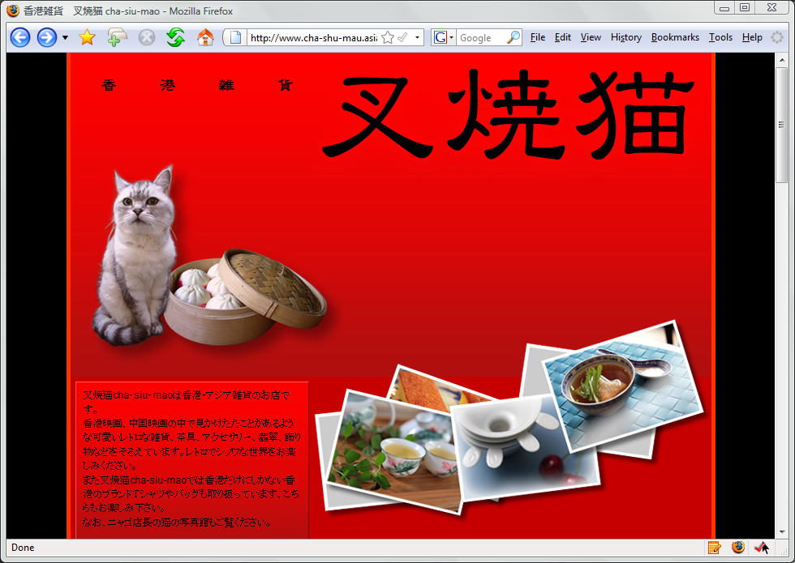
Choosing not to use .com…
chris316.asia
artquve.asia
studio-be.asia
rotarychild
mortality.asia
asian-curd.asia
cha-shu-mau.asia

Slide 12


Slide 13
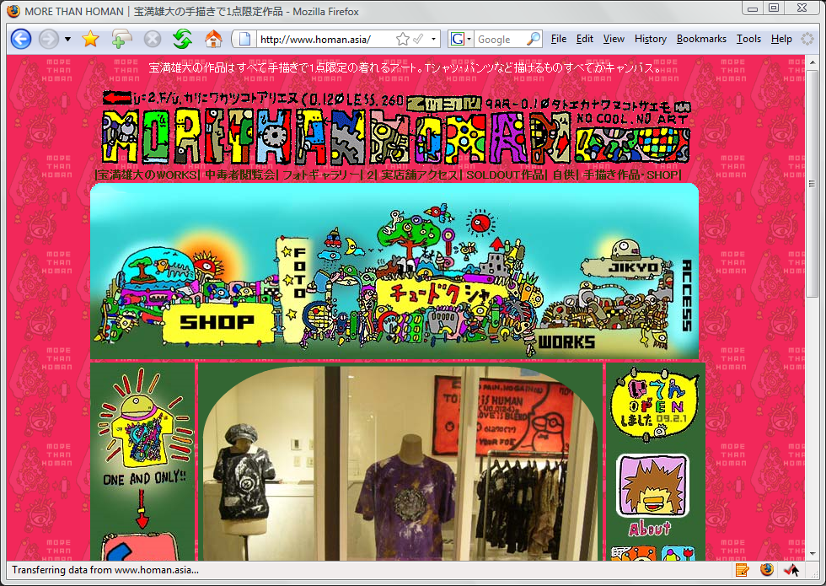
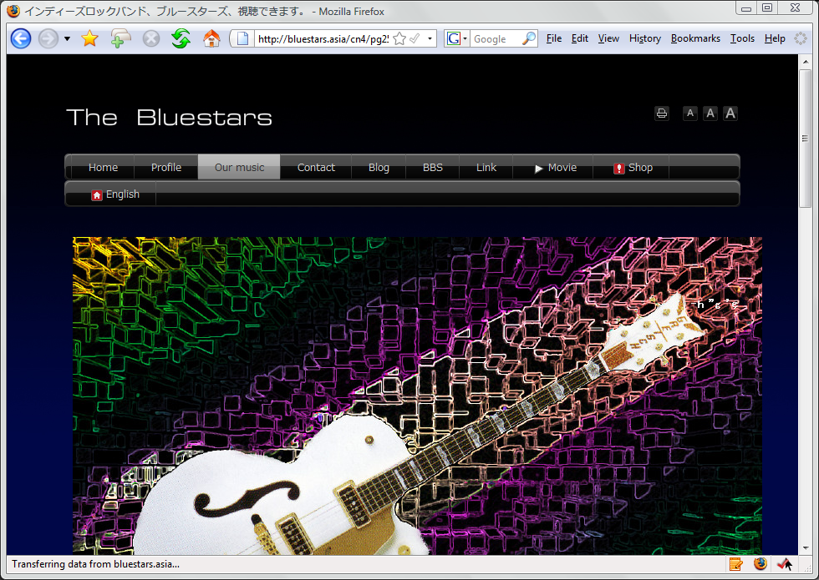

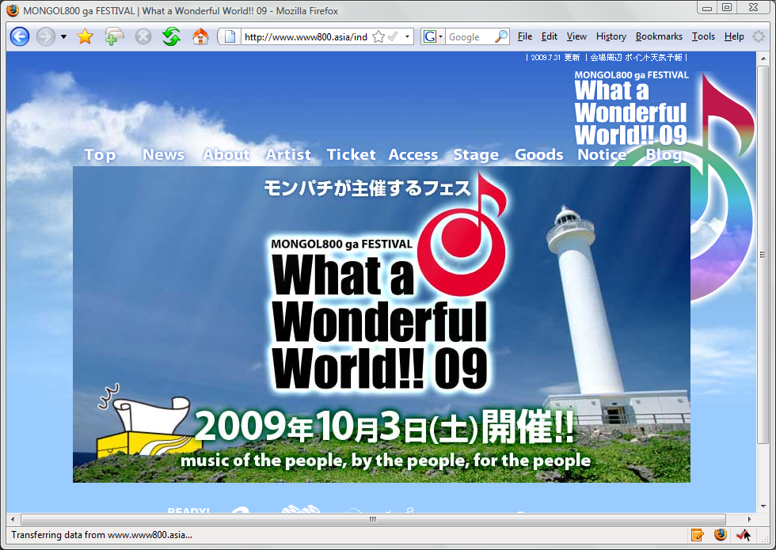
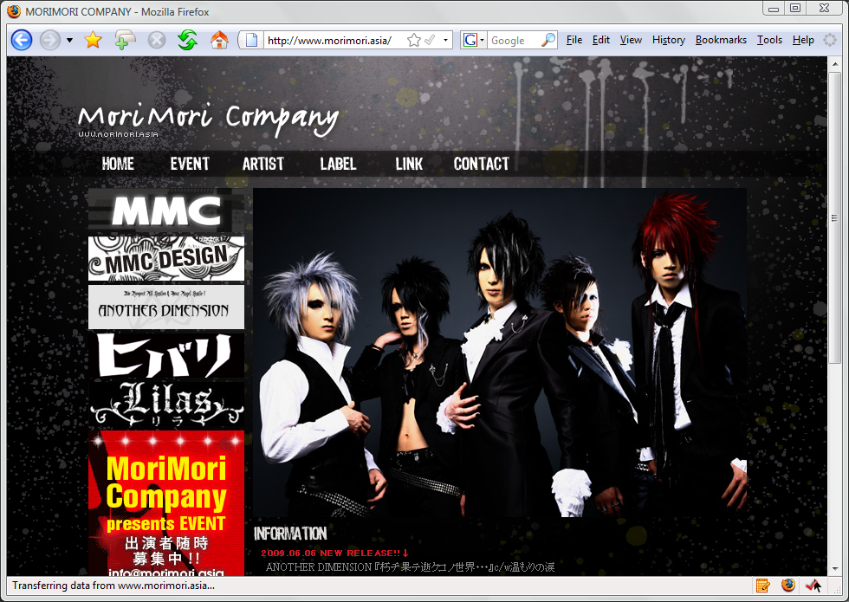
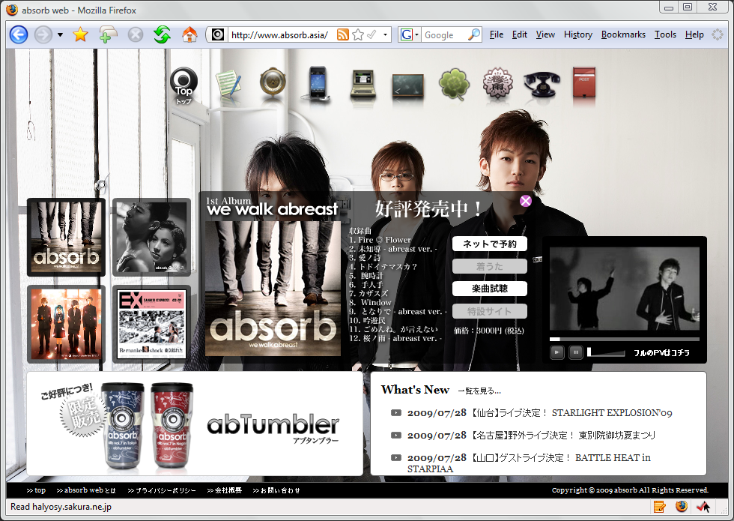
.Asia for Artists & Celebrities…
homan.asia
bluestars.asia
angelababy.asia
www800.asia
morimori.asia
absorb.asia

Slide 14
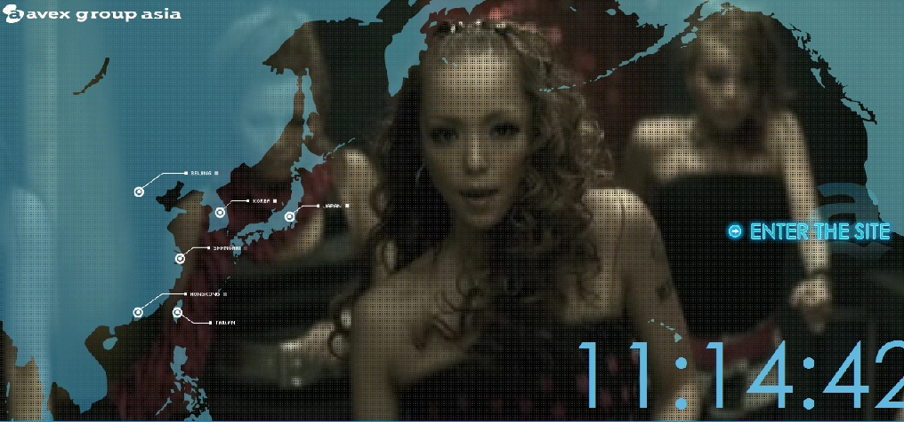
www.avex.asia

Slide 15

BiggestLoserClub.Asia

Slide 16

www.fanz.asia

Slide 17
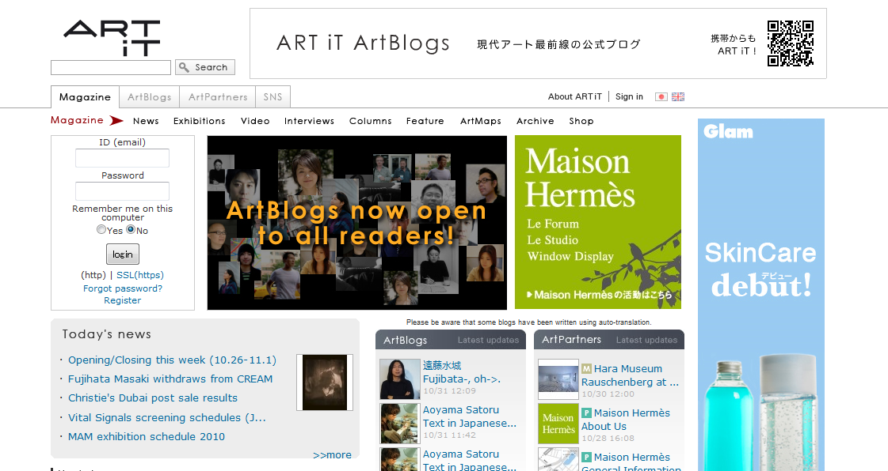


www.art-it.asia

Slide 18

www.kiteboardtour.asia

Slide 19

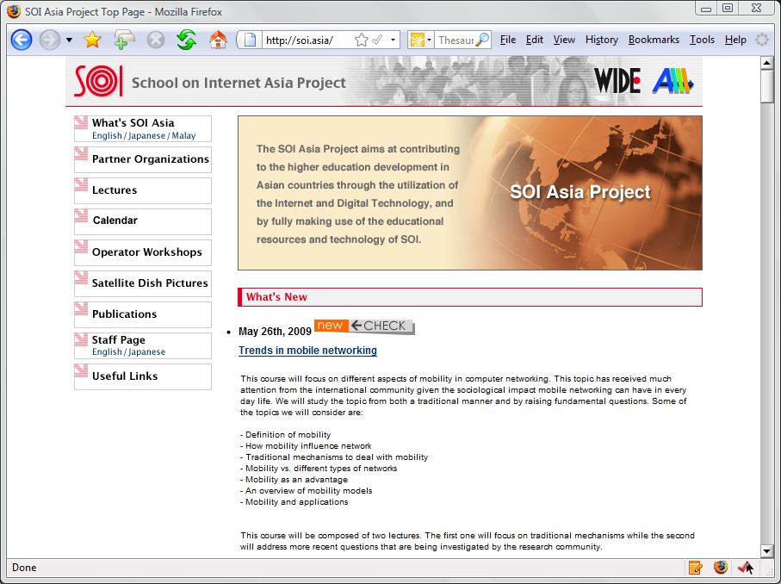
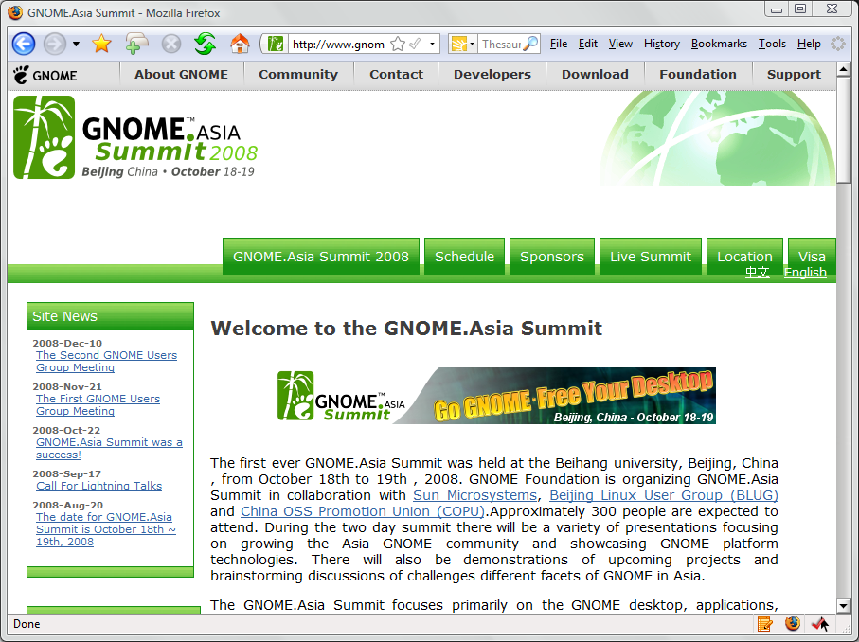
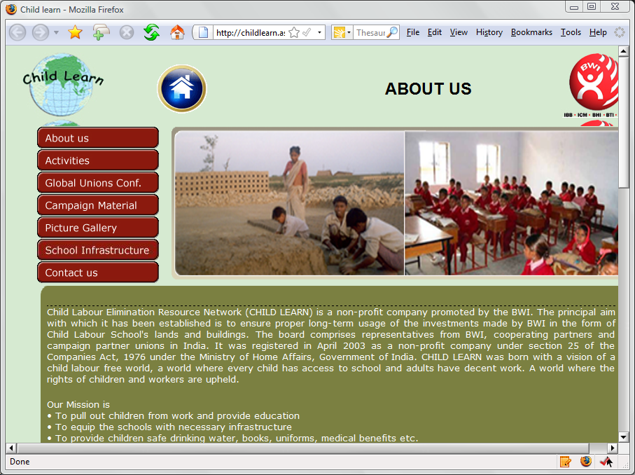

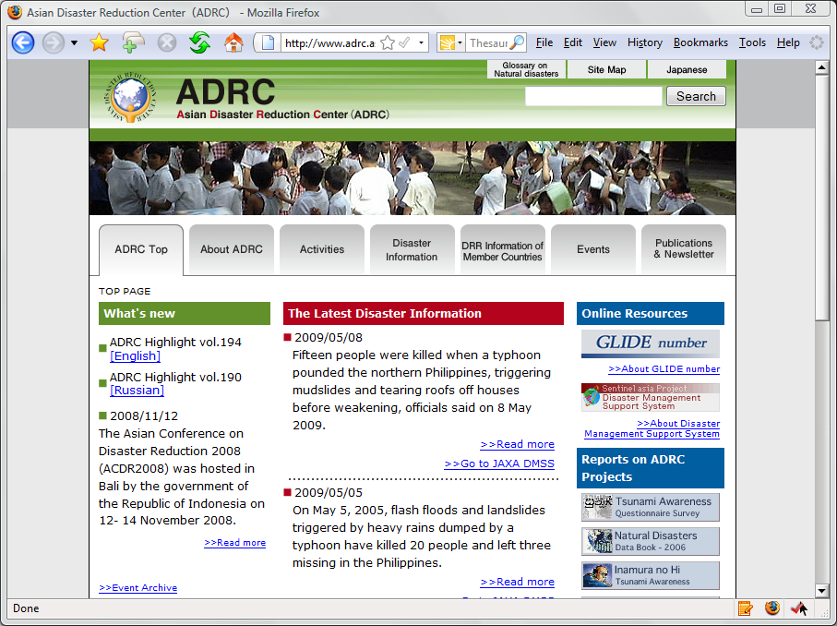
.Asia for Regional Conferences & Events…
nevertap.asia
soi.asia
gnome.asia
childlearn.asia
digitalmedia.asia
adrc.asia

Slide 20
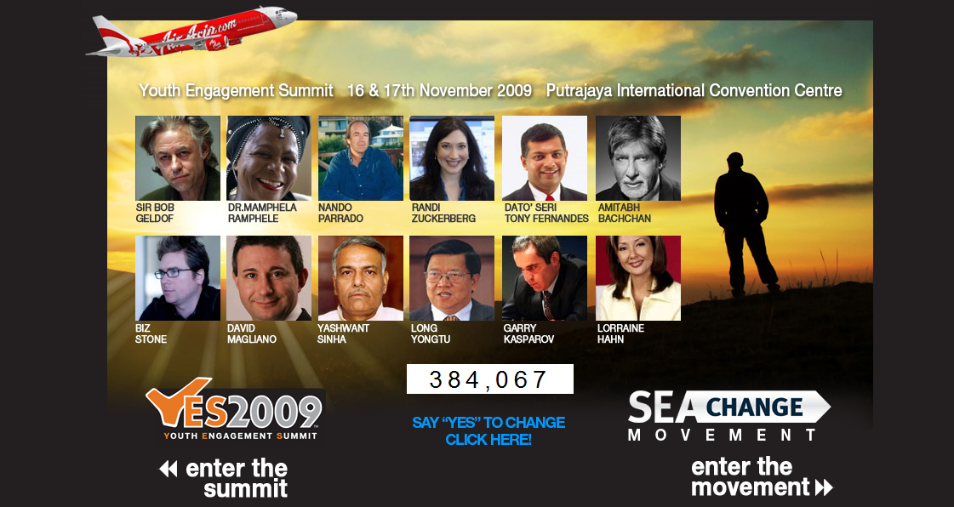
www.Yes2009.asia

Slide 21

www.haja.asia

Slide 22

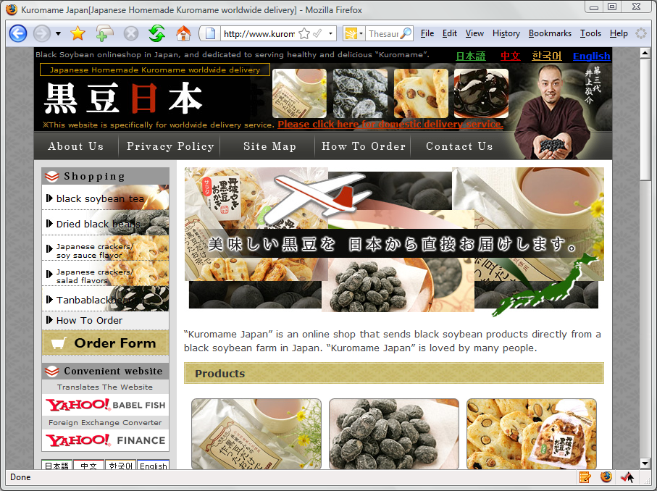
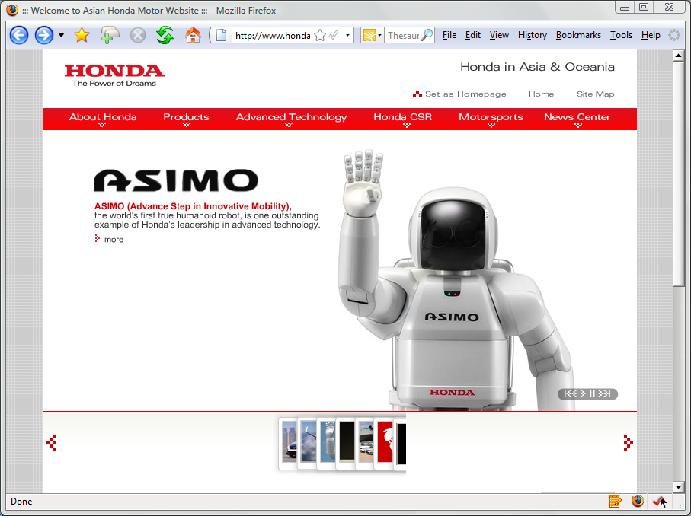
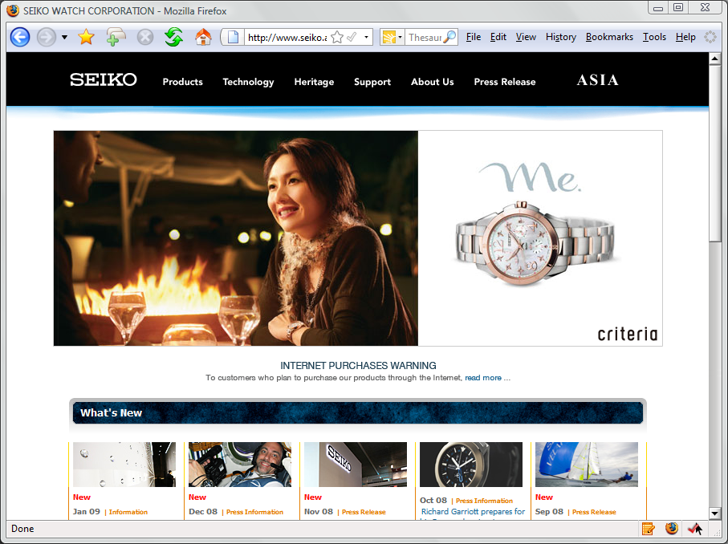
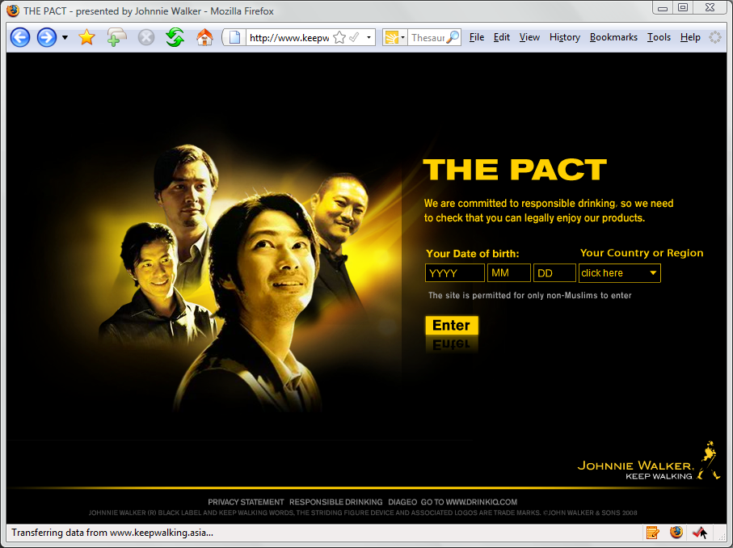

.Asia represents where you do business…
hi-en.asia
kuromame.asia
honda.asia
seiko.asia
keepwalking.asia
koikeya.asia

Slide 23
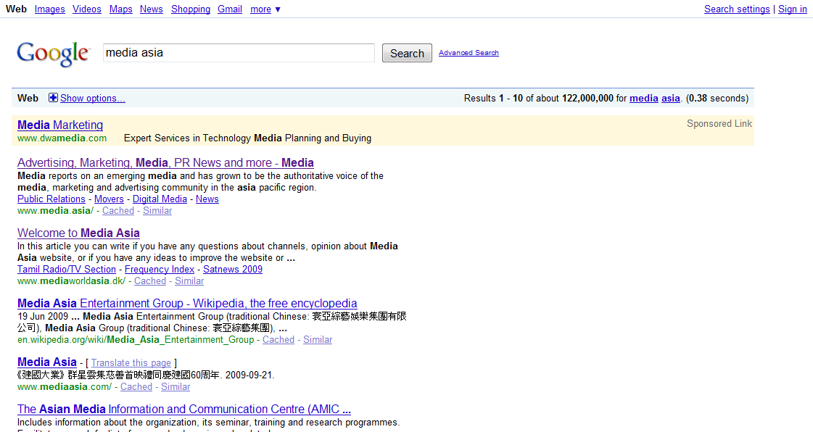
.Asia domain improves SEO/ranking
Searching:
Media Asia
media.asia ranks #1

Slide 24

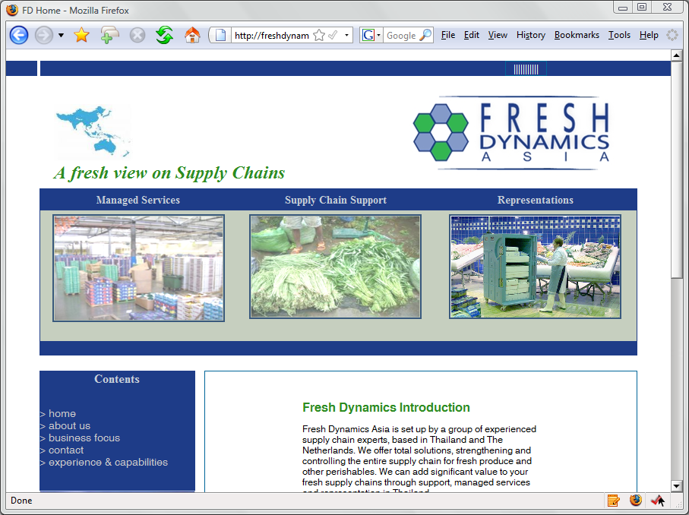
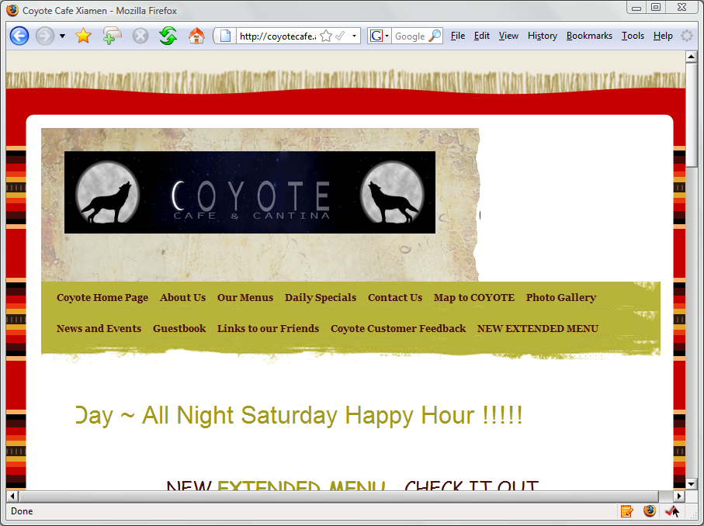
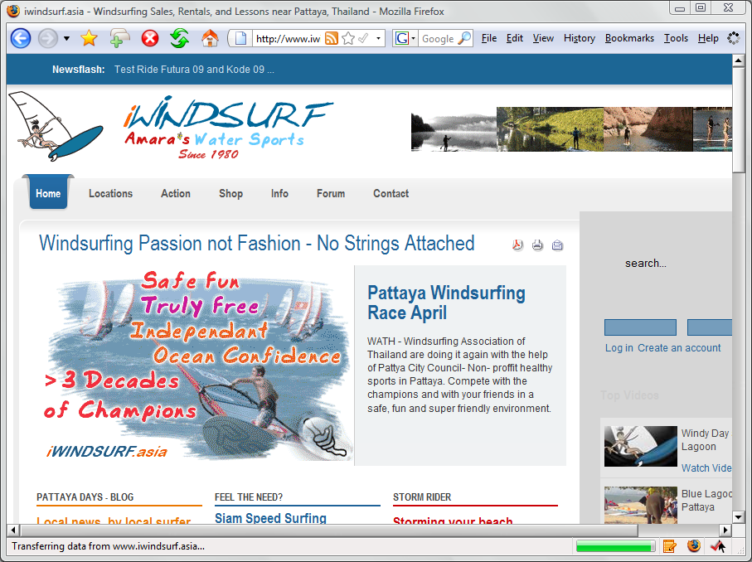
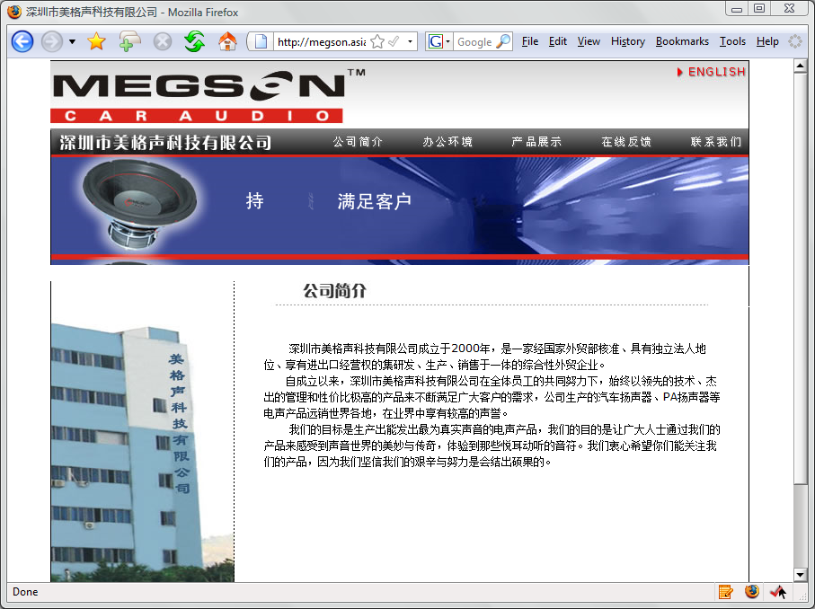

Local SMEs coming online
tianjiu.asia
freshdynamics.asia
coyotecafe.asia
iwindsurf.asia
megson.asia
e3sports.asia

Slide 25
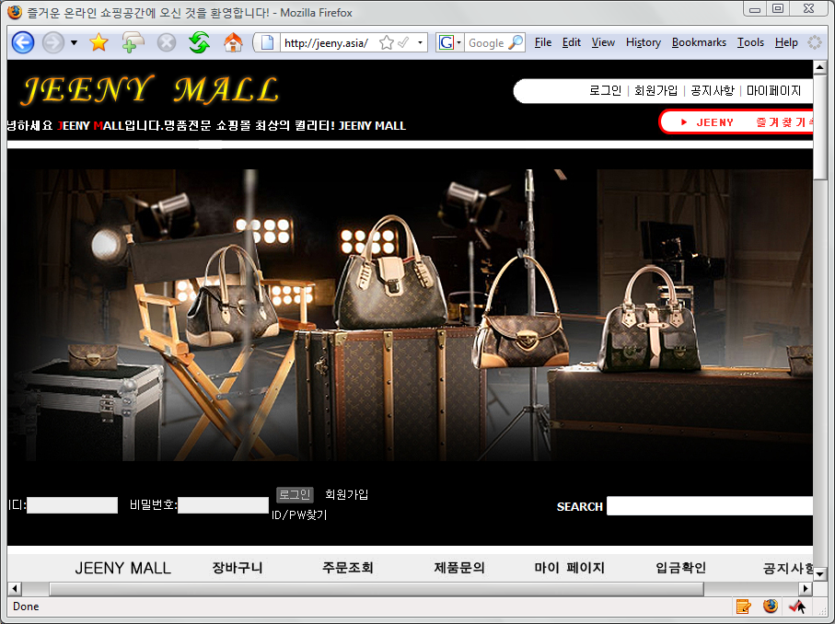
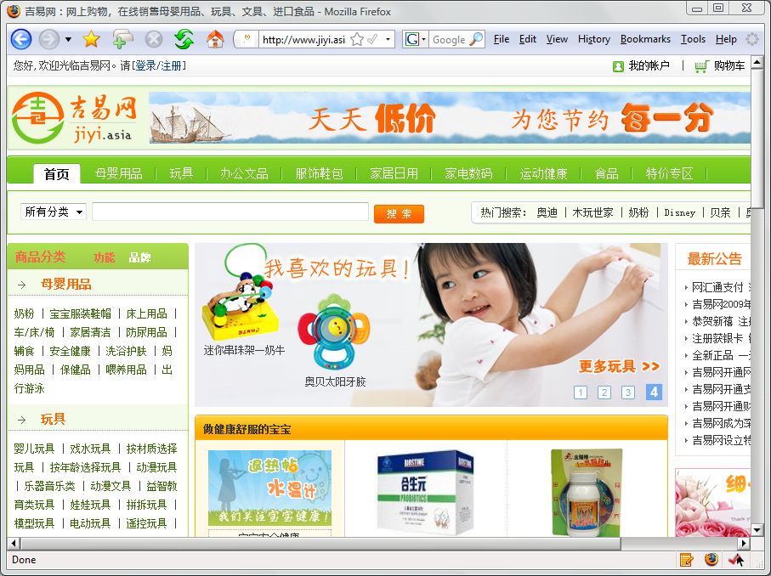
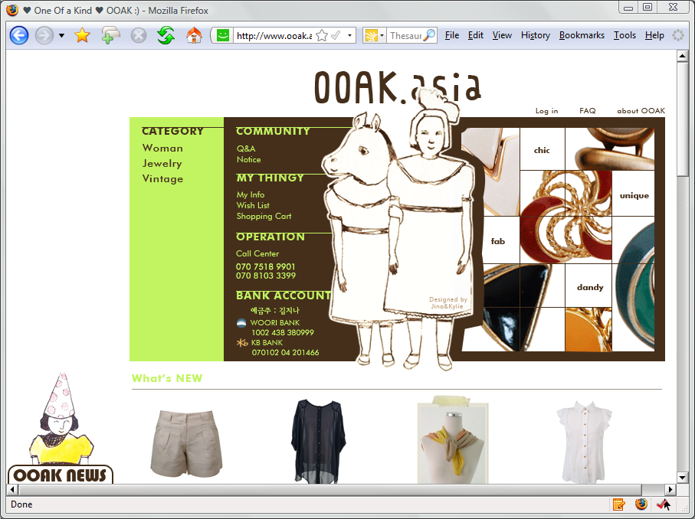
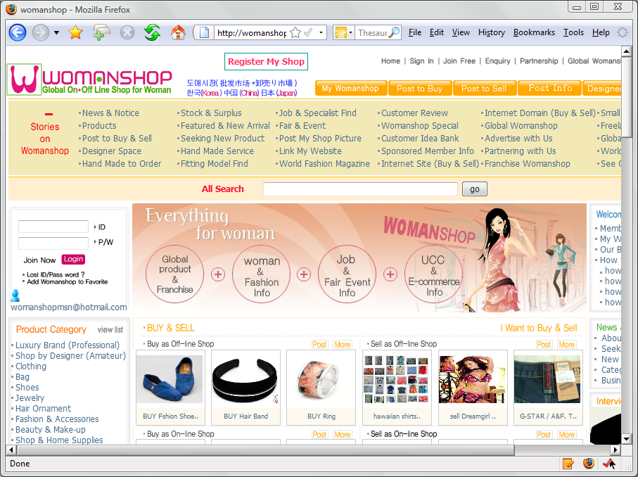
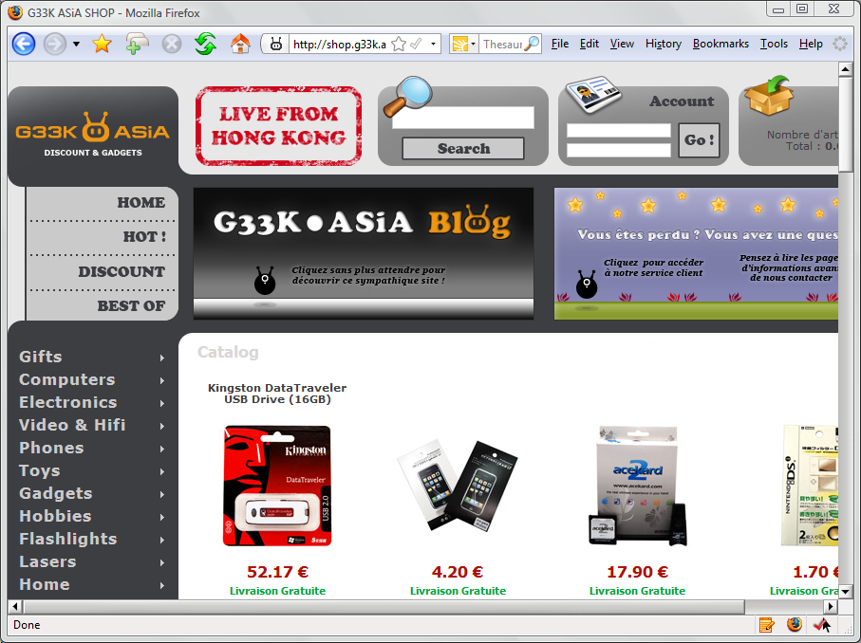
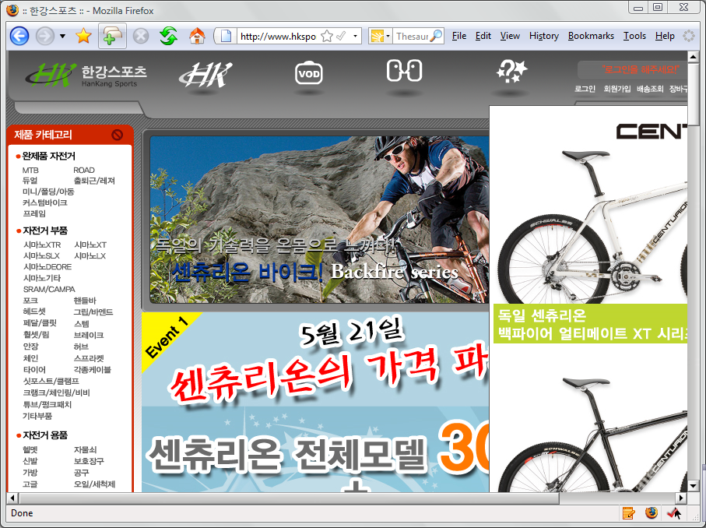
eCommerce Enterpreneurs
jeeny.asia
jiyi.asia
ooak.asia
womanshop.asia
g33k.asia
hksports.asia

Slide 26


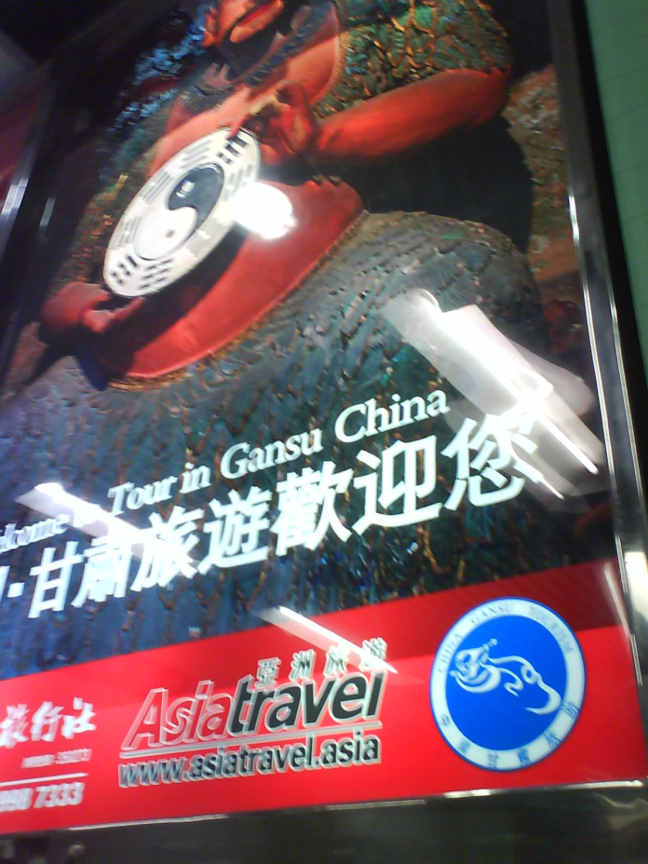
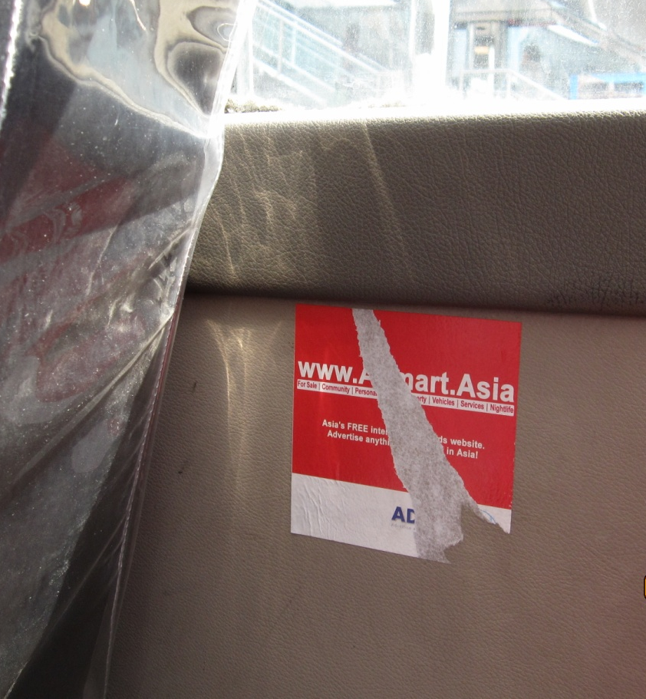
Growing SME Offline Ads utilizing .Asia

Slide 27
Delivering on Strategic Directives
Gradually developing mass market awareness
Small Businesses making use of .Asia
Developing foundation of usage of .Asia domains
Creating synergy and awareness through community contributions & projects

Slide 28
Challenges Ahead
First Renewals (Landrush)
  February – April 2010
Slow Growth of Domain Registrations
  General industry slow down
  Channel development (148 Registrars >100 active, but, lack of resellers and storefronts offering .Asia)
  CED Requirement (technical barrier)
  Relatively high street price
Mass Market Awareness
  General awareness among Internet users
Launching IDN

Slide 29
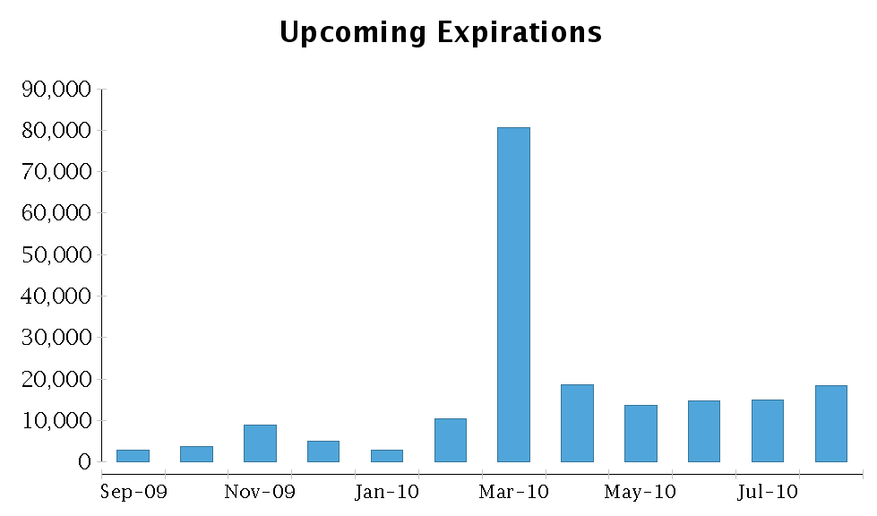

Slide 30
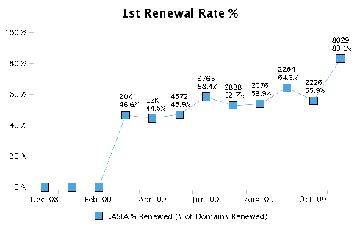
1st Time Renewal Rates

Slide 31
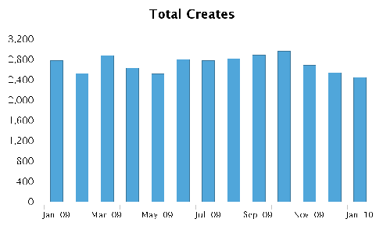
Monthly New Registrations
Total Domain-Years Registered: ~550,000
Domains Under Management: ~250,000

Slide 32
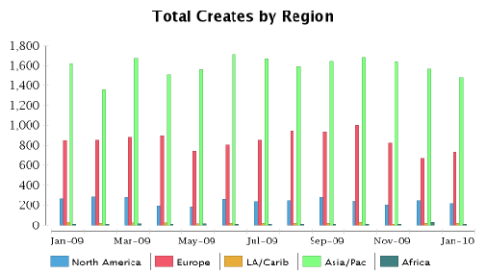
New Registrations (By Region)

Slide 33


Experimenting with Promotional Programs
Double-Double Price Discount Program
FreeB.asia program
  Free USB memory stick with every
  2 years or more registration
Home Market Growth Program
  Greater China Region (Mar – May 2009)
  Japan & Korea (Nov 2009 – Jan 2010)

Slide 34
Top 12 Economies – Ending Dec 2008

Slide 35
Top 12 Economies – Ending Oct 2009

Slide 36
Strong Base for Development
Strong Technology Partner: Afilias
Stable Financial Base with
Ample Cash Reserves

Slide 37
Overview
Review of DotAsia in 2009
Update from Afilias (Technology Partner)
Audited Financial Report
  Fiscal Year: Oct 2008 – Sep 2009
Community Development & Contributions
Strategic & Operational Plans
Member Resolutions
Open Discussion
18:00PM Joint AP* Dinner

Slide 38
Overview
Review of DotAsia in 2009
Update from Afilias (Technology Partner)
Audited Financial Report
  Fiscal Year: Oct 2008 – Sep 2009
Community Development & Contributions
Strategic & Operational Plans
Member Resolutions
Open Discussion
Joint AP* Dinner

Slide 39
.Asia Financial Report
Fiscal Year Ending September 30, 2009

Slide 40
Financial Report
Fiscal Period
  Oct 1, 2008 – Sep 30, 2009
  Third Fiscal Year
Auditor
  BDO Limited (previously Shu Lun Pan Horwath Hong Kong CPA Limited which has merged with BDO, BDO were appointed to fill the casual vacancy caused by the merger)
Currency
  Expressed in USD

Slide 41
Financial Report
Financial Statements
Operating Expenses
Investment Portfolio

Slide 42
Financial Statements

Slide 43
Income Statement (Oct 1, 08 to Sep 30, 09)
Income (Recognized) | $5,213,509
Cost of Sales (Recognized) | -$1,404,847
Gross Profit | $3,808,662
Other Income (Interest & Misc) | $103,908
Operating Expenses | -$1,439,004
Other Costs | -$19,380
Profit before taxation | $2,454,186
Taxation | -
Profit for the period | $2,454,186

Slide 44
Balance Sheet (as at Sep 30, 09)
Fixed Assets | $45,777
Current Assets
Cash & Bank Deposits | $1,118,790
Available-for-sale Investments | $4,113,147
Accounts Receivable | $173,166
Other Receivables, deposits & Prepay. | $402,333
Deferred Expenses | $581,528
Total Current Assets | $6,388,964

Slide 45
Balance Sheet (Cont'd)
Current Liabilities
Accounts payable | $128,097
Accruals | $540,823
Deposits Received | $1,716,092
Deferred Income | $4,008,946
Total Current Liabilities | $6,393,958
Non-Current Liabilities
Loan Payable | $677,209

Slide 46
Equity
Retained Earnings (Loss) | -$3,159,618
Current Earnings (Profit) | $2,454,186
Unrealized Gain on Investments | $69,006
Total Equity | -$636,426

Slide 47
Summary
Total Assets | $6,434,740
Total Liabilities | $7,071,166
Total Equity | -$636,426
Total Liabilities & Equity | $6,434,740

Slide 48
Operating Expenses
Salaries & Professional Fees | $669,103
Travel & Outreach | $241,425
Marketing & Promotion | $175,901
Community Contributions | $145,061
Other Expenses | $98,601
Total Operating Expenses | $1,330,091

Slide 49
Operating Expenses
Total Operating Expenses: $1,330,091

Slide 50
Investment Portfolio (Current)
DotAsia has accumulated a certain amount of cash and looking for yield enhancement
Investment Portfolio at JP Morgan
Current Market Value: $4,482,282
Conservative portfolio aiming at long-term investment
Mainly investing in bonds which generate steady income from coupon interests issued regularly

Slide 51
Investment Portfolio (Breakdown)
 | Value | % | Annualized Yield
Cash & Cash Equiv. | $1,375,866 | 31% | ~0%
Fixed Deposits | $500,000 | 11% | 1.26%
Fixed Income (Bonds) | $2,606,416 | 58% | 5.13%
Total | $4,482,282 | 100%

Slide 52
Overview
Review of DotAsia in 2009
Update from Afilias (Technology Partner)
Audited Financial Report
  Fiscal Year: Oct 2008 – Sep 2009
Community Development & Contributions
Strategic & Operational Plans
Member Resolutions
Open Discussion
Joint AP* Dinner

Slide 53
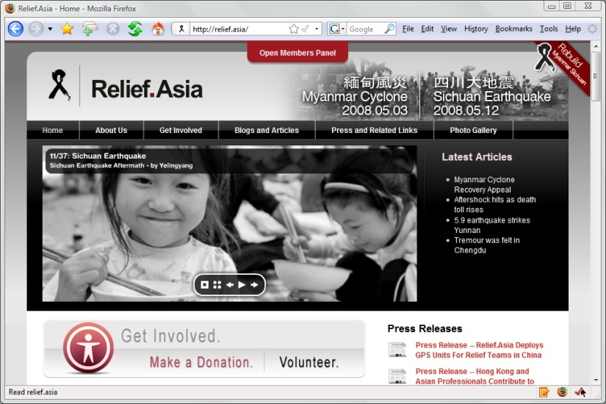
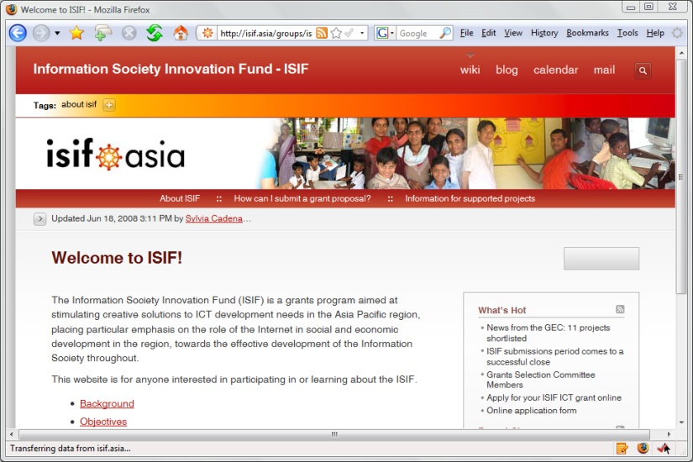





Ongoing Community Projects
Relief.Asia: Disaster Relief and Rebuild knowledge platform
ISIF.Asia: R&D Innovations grants fund for ICT
CreativeCommons.Asia: Sharing & Creative community
DSF.Asia: Digital Inclusion project grants fund
OSS.Asia: Regional Open Source Software platform
OLPC.Asia: One-Laptop-Per-Child Initiative in Asia
NetMission.Asia: Student Ambassadors on Digital Divide & Internet Governance

Slide 54
Emerging Models (beyond direct cash funding and/or sponsorship)
Administrative Support & Project Mgt
  Webmaster / Secretariat / etc.
  Joint Presentation of Special Events
Self Sustainability
  New projects emerging out of core event/project
  Attracting additional sponsors
Cost Recovery Model
  Cash Flow Support to Facilitate Projects
  Convertible Loans (unrecovered loans → sponsorship)

Slide 55
Overview
Review of DotAsia in 2009
Update from Afilias (Technology Partner)
Audited Financial Report
  Fiscal Year: Oct 2008 – Sep 2009
Community Development & Contributions
Strategic & Operational Plans
Member Resolutions
Open Discussion
Joint AP* Dinner

Slide 56

Not-for-profit Organization
Core Mandate of DotAsia: Promote Internet Development & Adoption in Asia
  Digital Divide (Digital Inclusion)
  Education
  Research & Development
Success of “.Asia” domain critical to success of DotAsia Organisation
  Core source of income
  Awareness and brand

Slide 57
Every .Asia Domain Contributes to Internet Development in the Region

Slide 58
Launching IDN.Asia
Sunrise Policies Posted Dec 2009
  Multi-phased launch process
Estimated Timeline:
  Q12010: Finalization of Sunrise/Launch Policies
  Q2/Q32010: Finalization of Language Policies
  Q32010: Pioneer Phase
  Q42010 : Sunrise
  Q12011: Landrush
  Q22011: Go Live

Slide 59
Highlights of Proposed Policies
Similar to launch of ASCII .Asia
  Simplified Sunrise process
  Auction process for Sunrise & Landrush
Consideration for existing .Asia domain holders
  Existing Romanized .Asia domains can participate in Sunrise process for Priority registration
Commitment to Grandfather registrations for future IDN TLDs
  中文.Asia →中文. 亞洲

Slide 60
Languages to be included in Launch
CJK: Chinese, Japanese, Korean
Arabic: including Arabic/Persian/Urdu, etc.
Indic Languages
Language Policy Considerations
  ccTLD Language Policies may be different than gTLD
  E.g. Arabic script languages, Chinese & Japanese
Variant Management Considerations
  Reserved / Blocked / Automatically Delegated
http://www.idn.asia

Slide 61
Promoting Market Awareness
Channel Development &
Strategic Community Contributions

Slide 62
Channel Development
Key Goals:
  Encourage more resellers to offer .Asia domains
  Bring down street prices
  Further develop market awareness
Working more directly with Registrars
Developing Resellers and end customer markets
Explore possibilities for updating Charter Eligibility Requirements for registration of .Asia domains

Slide 63
Community Contributions [AGM 2009]
Moderation on Sponsorships
Explore sustainable support
  Preference on self-sustainable projects
  Provide support in cash flow
  Aim for cost-recovery on supported projects
  Loan or investment structure
Efforts & Expertise based Contributions
  .Asia domain names (and domain names in general)
  Website development and maintenance
  Leveraging network

Slide 64
Sponsor Community Projects (SCP)
For each .Asia domain registered, an amount is allocated (currently US$1) into a Sponsor Community Projects (SCP) Fund
The fund currently has: ~US$300k
Joint community projects with Sponsor Members (ccTLDs)
Leveraging this fund to further develop market awareness around Asia

Slide 65
Criteria For SCP
Utilization of “.Asia” domain
Creating online content
  Blog / Wiki / etc.
  Supporting the promotion of awareness of .Asia domain
Tax Exemption Requirements to meet Charitable charter
  Relief of Poverty
  Advancement of Education
  Advancement of Religion
  Other Charitable Community Benefits (Substantially expended within Hong Kong)

Slide 66
Budget Development & Management

Slide 67
Conceptual Framework of Budget
Remain Conservative
  Cash Enough to run budget for 2 Years
  Similar concept as 2008/2009
Leveraging Community Projects
  Marketing allocations start to be focused more on domain pricing incentives
General Resource Allocations
  Human Resources: ~50%
  Marketing & Community Contribution: ~40%
    Marketing: ~25%
    Community Contributions: ~15%
  Other Administrative Costs: ~10%

Slide 68
Tax Exemption Application

Slide 69
Organizational Structure Adjustment
Tax Exemption Application as a Not-For-Profit Organization incorporated in Hong Kong
  Based on Consultation with Inland Revenue Department (IRD) and BDO (our auditors)
DotAsia to constitute of 2 Legal Entities:
  Charitable Foundation (new subsidiary to be formed)
  Application for Revenues Generated Overseas (from Hong Kong)
Governance Structure to remain the same

Slide 70
Overview
Review of DotAsia in 2009
Update from Afilias (Technology Partner)
Audited Financial Report
  Fiscal Year: Oct 2008 – Sep 2009
Community Development & Contributions
Strategic & Operational Plans
Member Resolutions
Open Discussion
Joint AP* Dinner

Slide 71
Ratification of Board Elections
2010 Results

Slide 72
Board Elections 2010
Seats up for election
  4 seats from Sponsor Member Category
  1 seat from Co-Sponsor Member Category
Development of Election Procedures
  First Draft Posted: Nov 18, 2009
  Second Draft Posted: Dec 1, 2009
  Final Procedures Posted: Dec 7, 2009

Slide 73
Highlights of Procedures
Nominations & Voting Process (via email)
  Number of Eligible Members: 27
  Eligible No. of Nominations & Seconds: No. of Vacancy in Category
  Eligible No. of Votes: No. of Vacancy in Category
Sub-Regions (Sponsor Category):
  At least 1 member from each of the 4 Sub-Regions
    North and Northeast Asia
    South and Southeast Asia
    Middle East, Asia Minor and Eurasia
    Australia and Pacific Asia

Slide 74
Nominations Process
Nomination Period:
  Dec 9, 2009 – Jan 13, 2010
Candidates Nominated: 6
  Sponsor Category: 5
  Co-Sponsor Category: 1
Candidate | Nominated by: | Seconded by:
Alireza SALEH | JPRS (.JP) | CNNIC (.CN)
Joel DISINI | IRNIC (.IR) | IUSN (.NU)
Stafford GUEST | IUSN (.NU) | JPRS (.JP)
Chen-Wen TARN | TWNIC (.TW) | CNNIC (.CN)
Dr. SIR Jae Chul | KISA (.KR) | JPRS (.JP)
Candidate | Nominated by: | Seconded by:
Che-Hoo CHENG | APNG | IDRC/PAN

Slide 75
Voting Process
Deemed Elected:
  Alireza SALEH (Only candidate from Middle East, Asia Minor and Eurasia sub-region)
  Stafford GUEST (Only candidate from Australia and Pacific sub-region)
  Che-Hoo CHENG (Only candidate in the Co-Sponsor Member Category)
Voting Period: Jan 27 – Feb 10, 2010
  13 votes casted (9 ballots received)
  Joel DISINI 4 votes
  Chen-Wen TARN 3 votes
  Dr. SIR Jae-Chul 6 votes

Slide 76
Board Elections 2010 Results
Elected Board Members (serving until AGM 2012):
  Che-Hoo CHENG (re-elected)
  Joel DISINI (re-elected)
  Stafford GUEST (newly elected)
  Alireza SALEH (re-elected)
  Dr. SIR Jae-Chul (re-elected)
Other Board Members (serving until AGM 2011):
  Atsushi ENDO
  LI Guang Hao
  LIM Choon Sai
  Tommy MATSUMOTO
  Dr. THAM Yiu Kwok

Slide 77
M&A (Constitutional) Amendment June 2009

Slide 78
Amendment of M&A [June 2009]
Term length definition of Board Members
  Clarify the term of the board member
  Tabled at AGM 2009 (Feb 22, Manila)
Final wording based on comments at AGM:
  all Directors serve on the Board for two (2) years and expire upon the conclusion of an annual general meeting. If such annual general meeting concludes within ninety (90) days of, before or after, the completion of two (2) years served by the Director, the term of the Director shall expire upon the conclusion of such annual general meeting. Otherwise, the Director shall serve until the next annual general meeting after the two (2) years served.

Slide 79
Amendment of M&A (June 2009)
Ballots Sent: May 7, 2009
Voting End: June 26, 2009
Resolution Passed:
  20 votes in favour
  1 vote abstain
  At time of resolution, there were a total of 26 members. 75% would be: 19.5

Slide 80
Proposed M&A (Constitutional) Amendment

Slide 81
Proposed Amendment of M&A: 2010
Member Resolutions
  Ordinary Resolution: Majority of votes (>50%) at Members meeting forming quorum (10 or 50% of the total number of Members, whichever is less)
  Special Resolution: 75% of all votes (by legal requirement)
Conceptual Change
  Introduction of “Active Members”
  Enabling better efficiency in handling Special Resolutions
  Without compromising rights of members who are less active

Slide 82
Proposed Amendment
Paragraph 29 of the Articles of Incorporation of the M&A:
Subject to the provision of this Article each Active Member shall be entitled to one vote at a general meeting of the Company…

Slide 83
Proposed Amendment
Active Members – An Active Member is any Member, irrespective of the category of membership that has participated at least once in any of the 3 immediate preceding Member Actions. An Active Member who thereupon do not participate in 3 consecutive Member Actions will no longer be considered as an Active Member.

Slide 84
Proposed Amendment
Members – Members who are not an Active Member shall be able to request to participate at any Member Action. Upon such request, a Member shall be deemed immediately as an Active Member.

Slide 85
Proposed Amendment
Member Action – A Member Action is: any General Meeting (including Annual General Meetings and Extraordinary General Meetings); any member resolution and/or ballot not carried out at a General Meeting; or, any Election of the Board of Directors. Participation at a Member Action means: being present at any General Meeting; casting of a ballot for any resolution not carried out at a General Meeting; nominating, seconding or voting at an Election of the Board of Directors.

Slide 86
Summary of Proposed Amendments
Growing membership of DotAsia
Updating of M&A may become prohibitive
Introduction of “Active Members”
Members who are not Active Members can become an Active Member immediately by simply participating
All members will continue to be notified and updated of Member Actions (other provisions of the M&A is not changed)

Slide 87
love.from.asia
Edmon Chung <edmon@registry.asia>

